Slide 1




Climate resilience and environmental sustainability of health facilities and services
Prof Bob Mash, Dr Christian Lokotola, Dr Rene English, Dr Stacey Blows, Prof Sa’ad Lahri (SU)
Dr Trish Schwerdtle, Dr Melissa McRae, Dr Kiran Jobanputra (Climate Action Accelerator)
Claire Adams (SD Manager, Department of Health and Wellness)

Slide 2
Hands up
If you work in a health facility or manage services
Notes:
Connect with the audience and the relevance of the topic to them

Slide 3
Outline
Concepts of climate resilience and environmental sustainability for facilities and services
How to evaluate and improve resilience & sustainability
How to evaluate and reduce carbon footprint
Notes:
Outline of the slide set

Slide 4
How would you define the concepts of climate resilience and environmental sustainability of health facilities (CRESH)?
Notes:
Questions to the audience to engage with the topic and assess level of prior knowledge

Slide 5
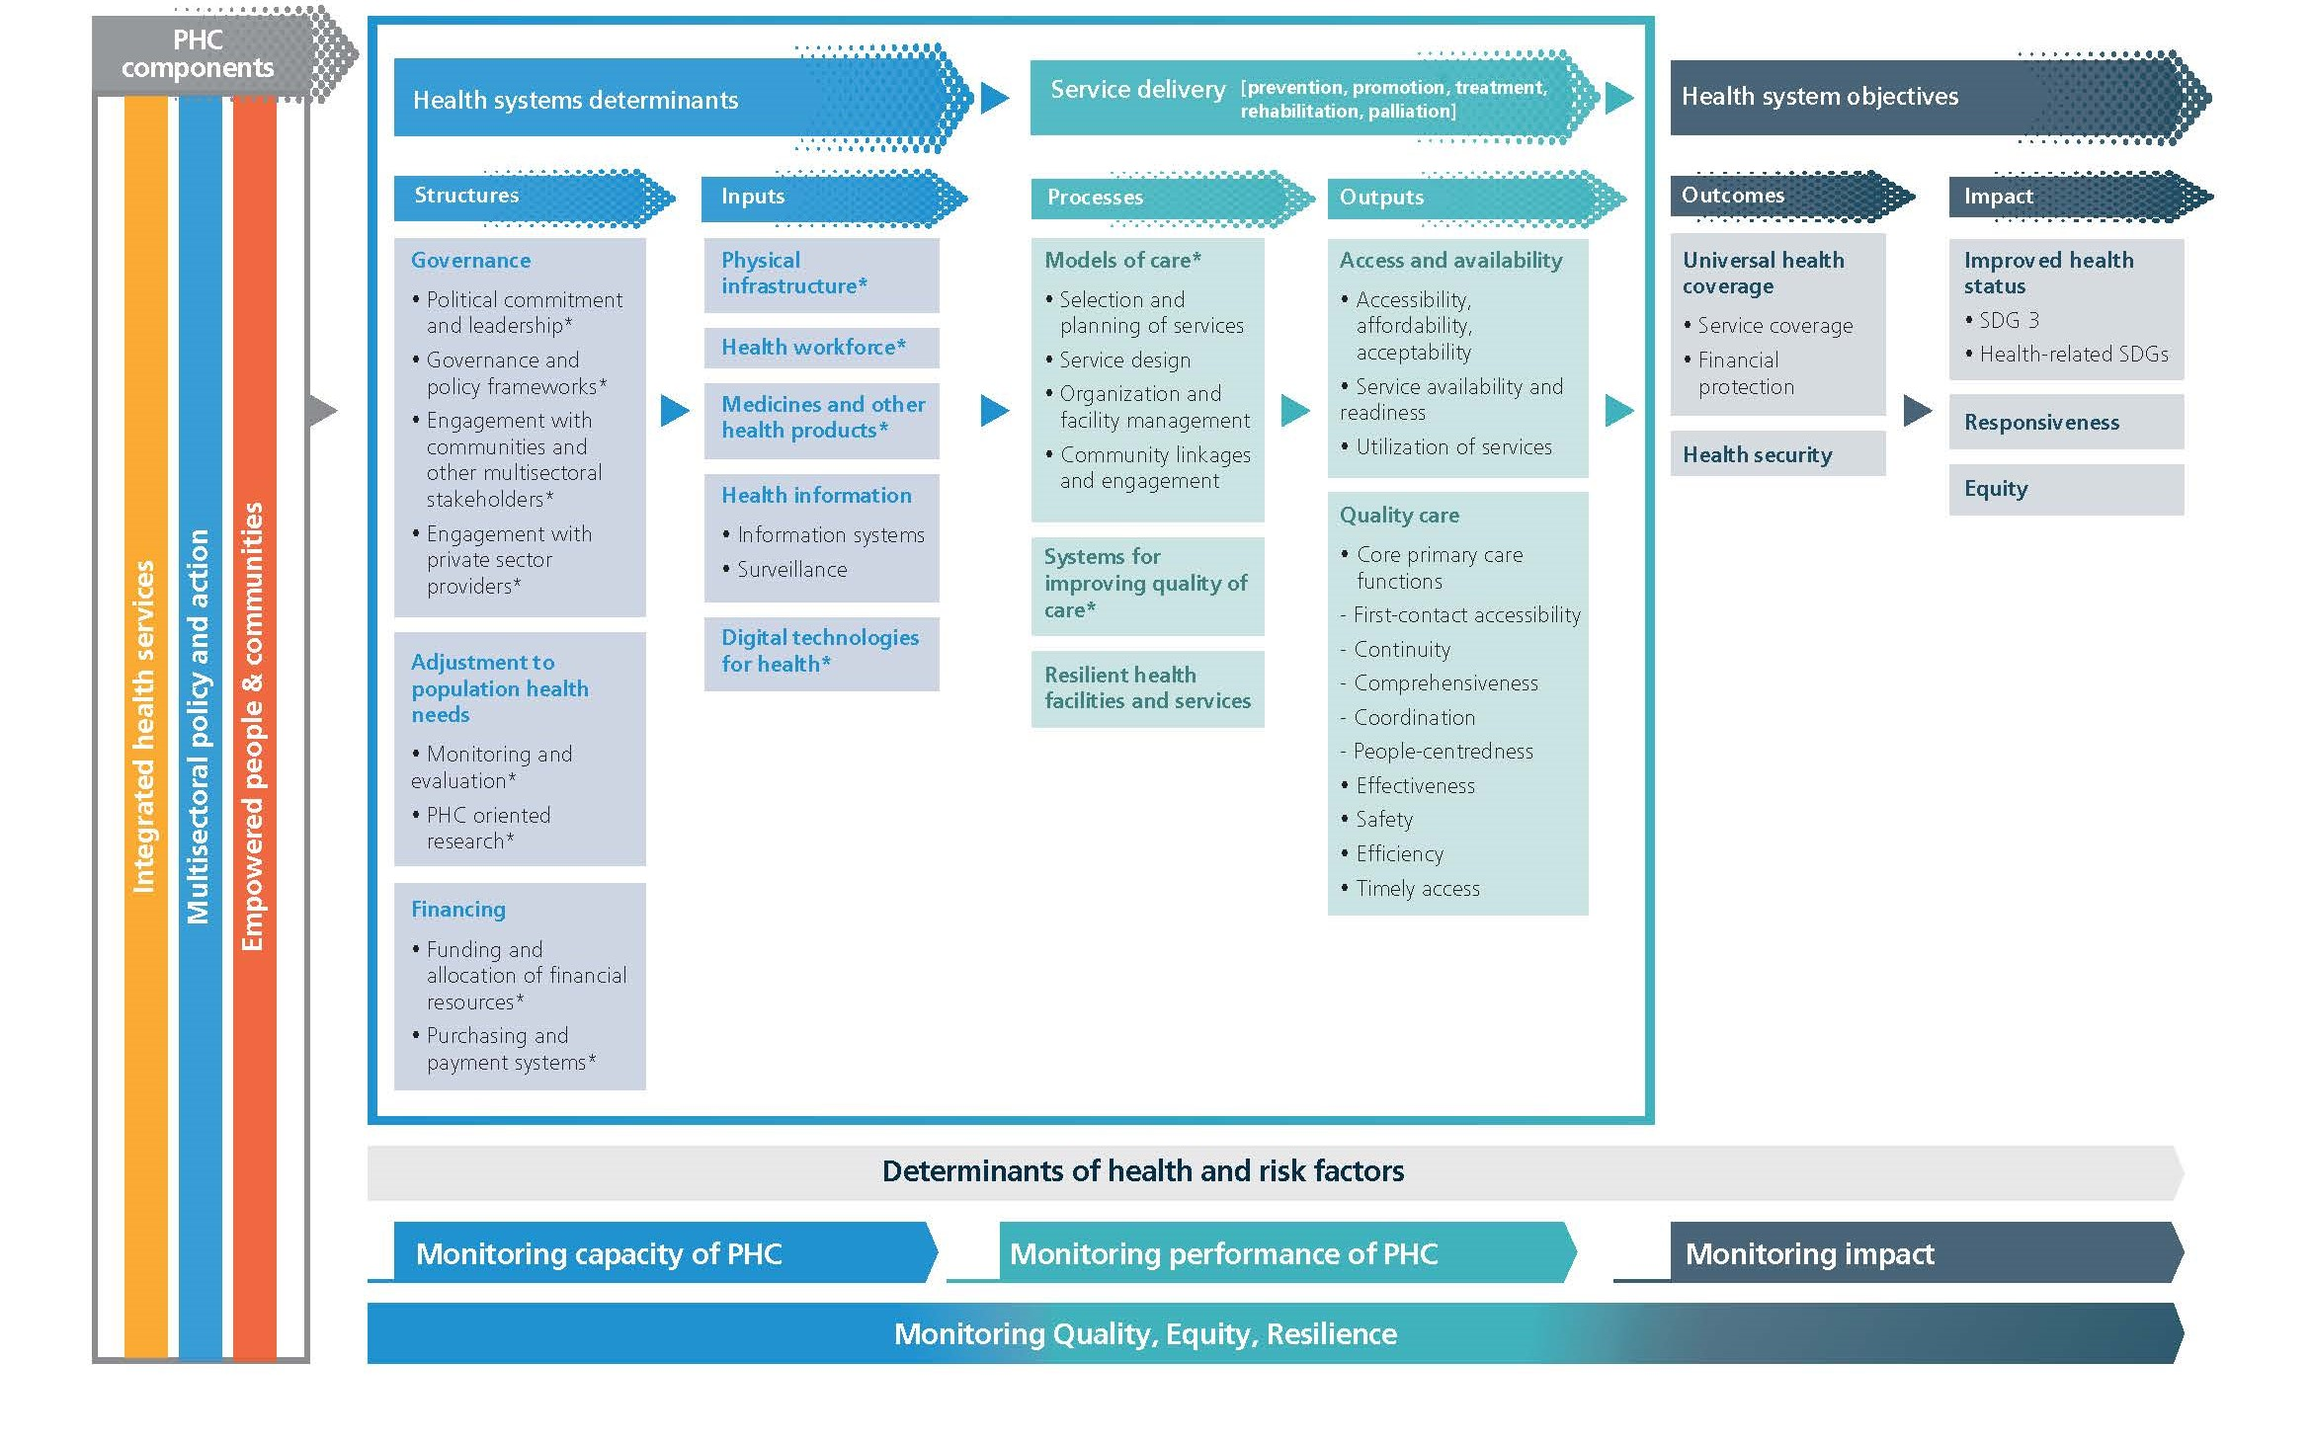
Notes:
The WHO measurement framework for health systems from a PHC lens includes “resilient health facilities and services” as one of the key processes in service delivery. At the bottom of the framework resilience is also seen as connected to the whole framework. Strengthening all aspects of the health system can improve resilience.

Slide 6
Definition
Climate resilient health care facilities are those that are capable to anticipate, respond to, cope with, recover from and adapt to climate-related shocks and stress, so as to bring ongoing and sustained health care to their target populations, despite an unstable climate.
WHO
Notes:
Definition of climate resilience for health facilities from WHO

Slide 7
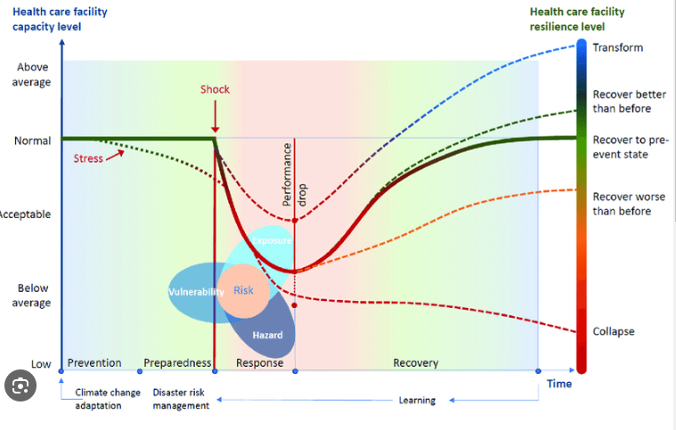
Concept of resilience
Notes:
The definition is portrayed graphically. A health facility may start at a low or high level of capacity prior to being challenged by a climate stress (e.g. drought) or shock (e.g. flood, heatwave). The facility then responds to the shock or stress and recovers. Recovery can be to the same level of capacity, lower or higher. The resilience of the facility is demonstrated by the ability to respond and recover fully. A learning organization may recover better than before and then also adapt and prepare better for the next challenge. The risk to the facility and services is dependent on the balance between vulnerability and capacity and the nature of the hazard to which it is exposed. If shocks and stressors come too often the facility may not have a chance to fully recover between them.

Slide 8
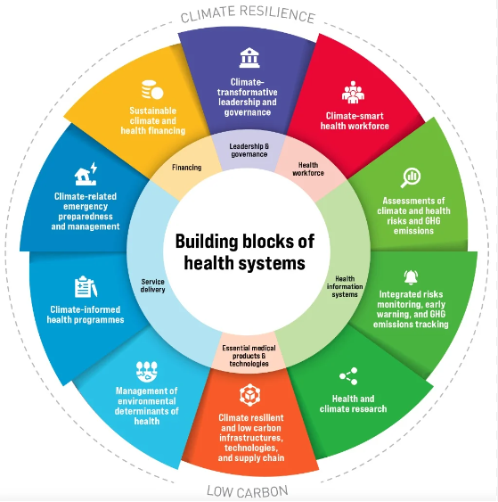
WHO guidance on resilient health systems
Notes:
The WHO have used the building blocks of the health system to describe how health systems should plan and prepare to be climate resilient and low carbon. There are 10 domains to think about. This is more at a national or sub-national level.

Slide 9

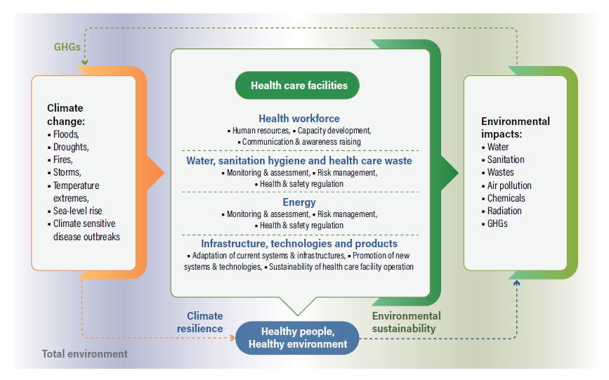
WHO guidance on resilient health facilities
Notes:
The WHO have also published guidance for the local facility or sub-district level. There are four key areas to consider when planning and preparing to be more climate resilient and environmentally sustainable. Note that it is the same four areas to think about to be more resilient on the one hand and less harmful to the environment on the other.

Slide 10
Top-down or bottom-up approaches
National adaptation plans and health systems
Local assessment and plans for health facilities
Notes:
We need both top-down (health-related national adaptation plans) and bottom-up more granular and contextual planning to fully support the development of climate resilient and environmentally sustainable facilities. They need to connect or align and support each other.

Slide 11
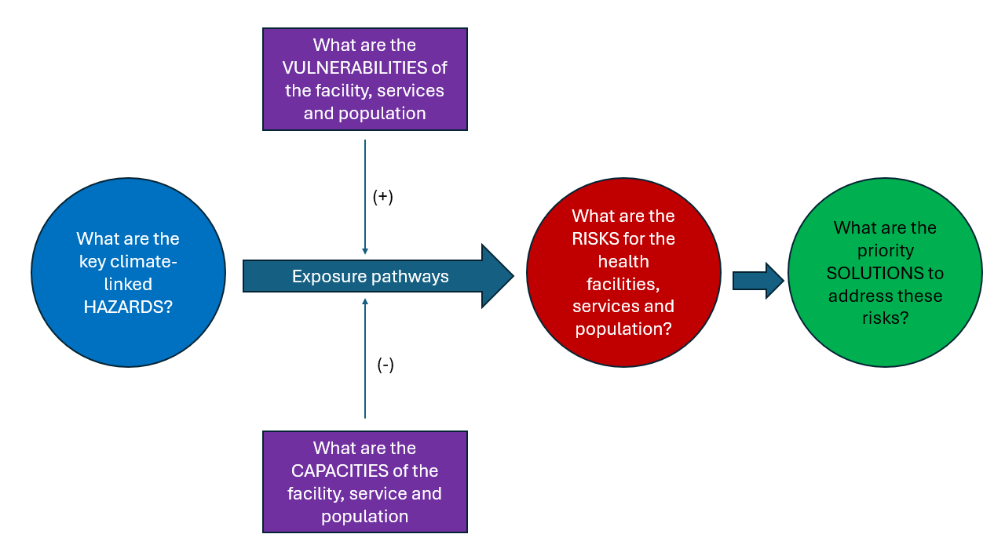
Conceptual framework
Notes:
When assessing risk this is the conceptual framework. Identify the climate hazards in the local area and the risks that they pose to health facilities and services. The risk may be more or less, depending on the degree of exposure, vulnerabilities and capacities. Once the level of risk is determined then solutions can be planned to address the risks.

Slide 12
Definition
Environmental sustainability in healthcare is fundamentally about reducing the ecological harm caused by medical practices and systems
Notes:
Definition of environmental sustainability

Slide 13
In Africa we don’t need to consider mitigation as our carbon footprint is so low – agree or disagree and why?
Buzz pairs
Notes:
Discuss this perspective with the audience – do they agree or disagree, and why.

Slide 14
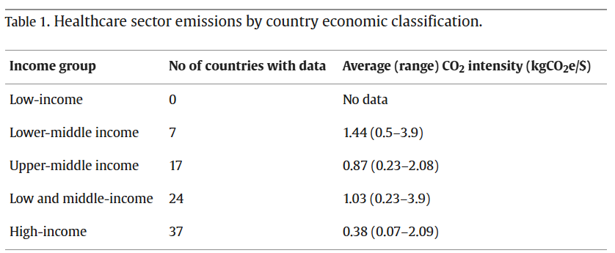
Are carbon emissions an issue in LMICs?
Health care emissions
Carbon intensity of emissions
4-5% of all GHG emissions due to the health sector
>90% historically from high-income countries
If LMIC health systems develop with this carbon intensity, then emissions will rapidly increase – future health system development and carbon need to be de-coupled
Baddley J, Rasheed FN. The Aga Khan development network’s (AKDN) approach to supply chain carbon foot printing for healthcare providers. Clean Logistics Supply Chain. 2023;7:100109.
Notes:
Globally the health system is a major contributor to GHG emissions. But in Africa our contribution is very small. However the amount of carbon emitted per $ spent in LMICs may actually be quite high and so there is a risk of becoming more important emitters as our health systems develop. Development of health systems in LMICs, therefore, should decouple from the emitting of carbon and follow a more environmentally sustainable pathway.

Slide 15
Think of one important aspect of health facilities and services that has a potential ecological harm
Buzz pairs
Notes:
Health facilities can do environmental harm in many ways – not just releasing GHGs. Ask people to discuss in pairs and come up with suggestions.

Slide 16
Environmental sustainability – Global Green and Health Hospitals and Health Care Without Harm
Leadership
Water
Buildings
Procurement
Travel
Medication
Waste
Food
Chemicals
Energy
Notes:
These are the 10 key areas to consider according to the Global Green and Health Hospitals network. NB health facilities and systems can also join the GGHH network which has resources to help tackle these issues.

Slide 17
Two tools that can be used for evaluating CRESH
Notes:
How then can we evaluate the CRESH (Climate Resilience and Environmental Sustainability of Health facilities).

Slide 18
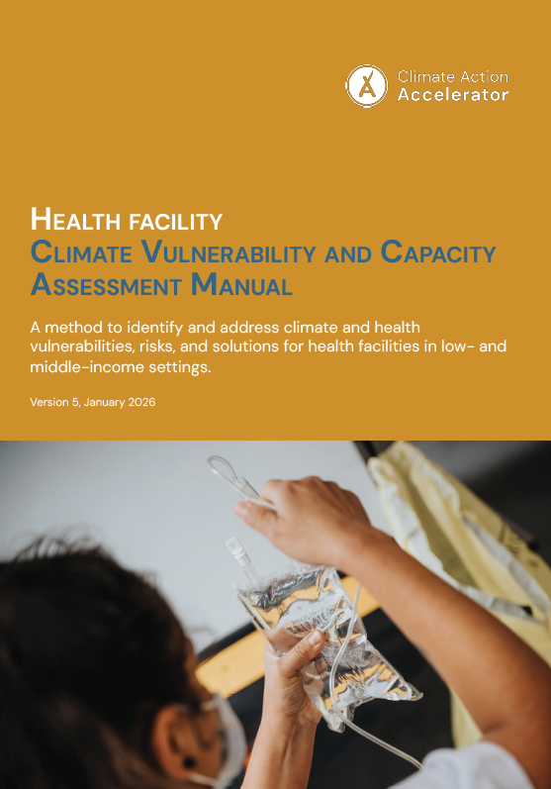
Climate Vulnerability and Capacity Assessment (VCA)
A comprehensive, mixed-methods diagnostic process that generates a hierarchical, achievable adaptation plan
https://climateactionaccelerator.org/climate-vca/
Notes:
This VCA tool/process has been developed by the climate action accelerator – the latest version can be found on their website.

Slide 19
6 stages
Stage 1: Desktop review
Stage 2: Contextualisation and planning
Stage 3: Audit of facilities
Stage 4: Scenario-based desktop focus group
Stage 5: Integration in matrix and solutions
Stage 6: Prioritisation and action plan
Notes:
This is a 6-step process to follow with your facility or a group of facilities.

Slide 20
Stage 1: Desk review of existing data
Select a district, subdistrict or facility
What are the climate hazards?
What do we already know about health facility vulnerabilities and capacities?
What are the knowledge gaps?
Notes:
Gather information on what is already known about hazards, exposures, vulnerabilities and capacities.

Slide 21
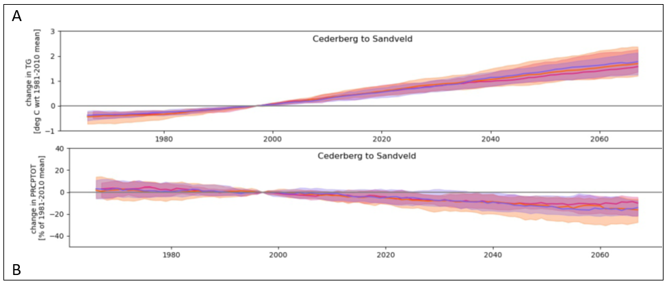
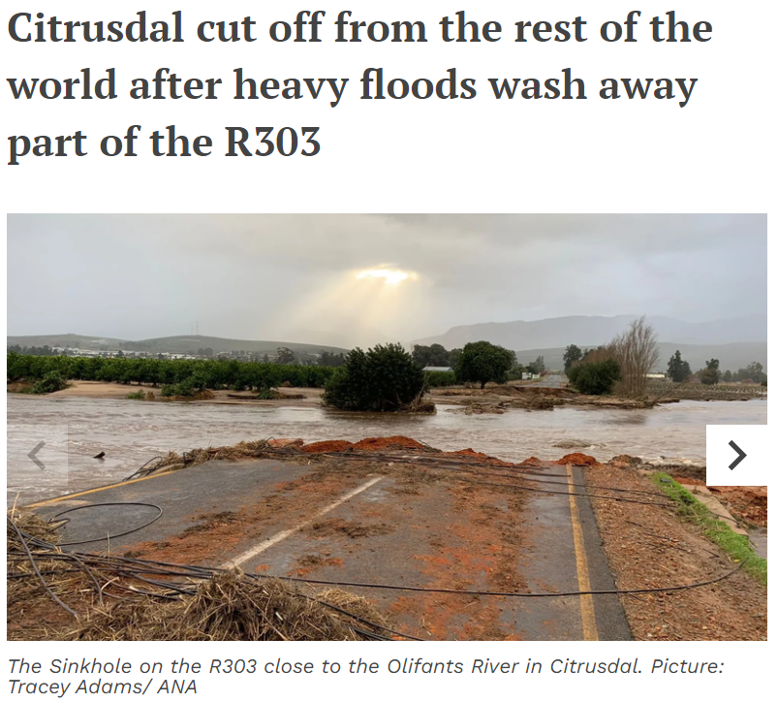
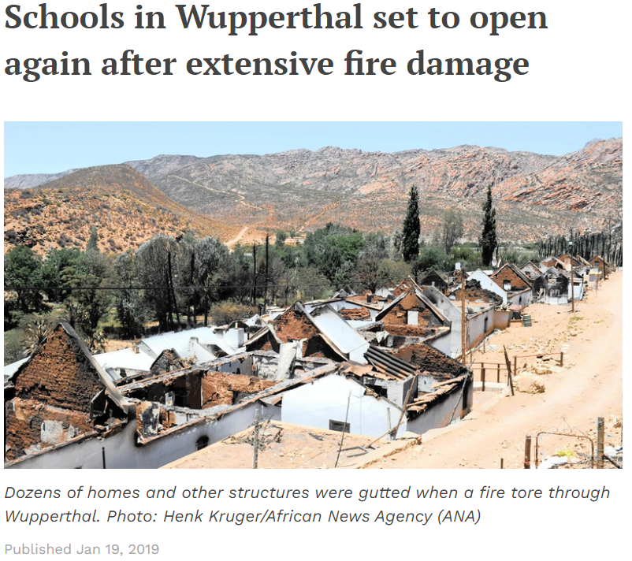
Cederberg subdistrict as an example
Notes:
For example in our VCA in Cederberg subdistrict in South Africa we had both quantitative data (modelling of climate chanage) and qualitative data (stories of climate shocks and stressors already experienced)

Slide 22
Stage 2: Planning and contextualisation
Who is in your CRESH team?
Which facilities will you include?
Who will you interview?
Content validation of audit tool and interview guide
Notes:
The contextualization of the tools, training of the team, and planning the VCA is very important.

Slide 23
Stage 3: Audit of the facility(s)
If you were to audit the CRESH of a health facility, what questions would you include?
Buzz pairs
Notes:
Stimulate ideas from the audience on what might be audited in the facility.

Slide 24
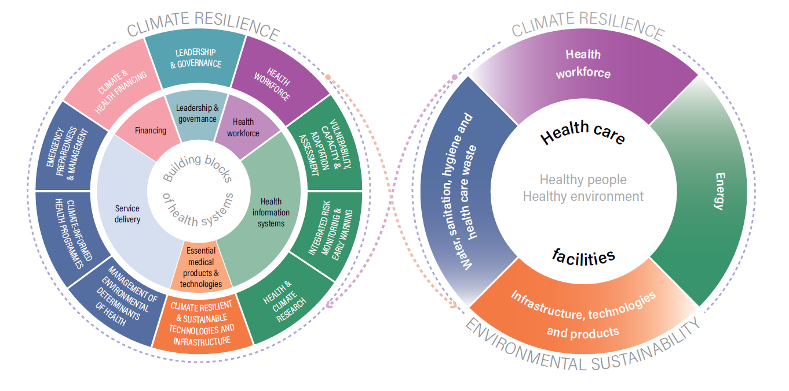
Integrate health system and health facility perspectives
Notes:
The CAA audit tool is based on the WHO guidance (4 domains as per right hand circle) and the service delivery aspects of the health system WHO guidance.

Slide 25
Six areas to audit in the VCA
Energy
Health workforce
Water, waste and sanitation
Emergency preparedness
Service delivery
Infrastructure and equipment
Notes:
The six areas to consider can be summarized like this

Slide 26
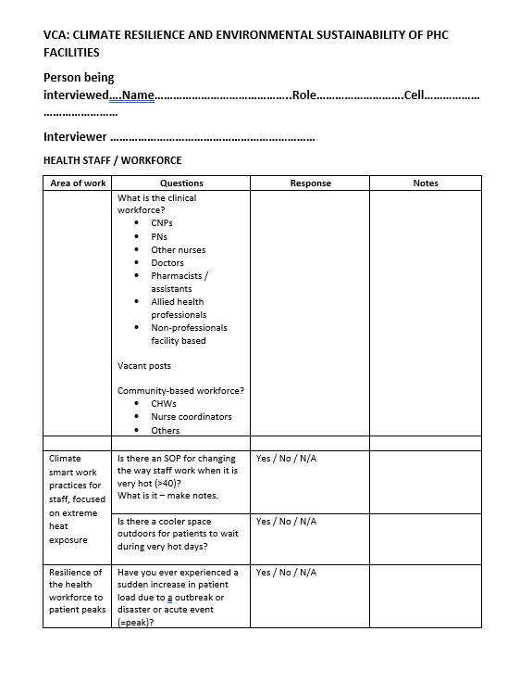
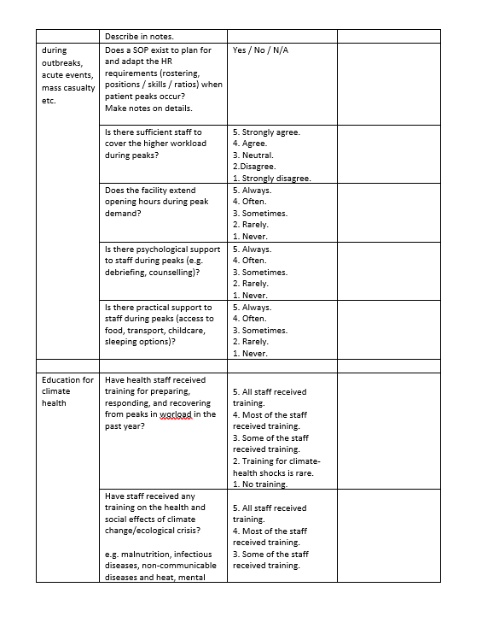
Notes:
This is an example of the audit tool with categorical answers as well as space for notes/comments. It is completed via an interview with the operational manager and walk-around the facility.

Slide 27
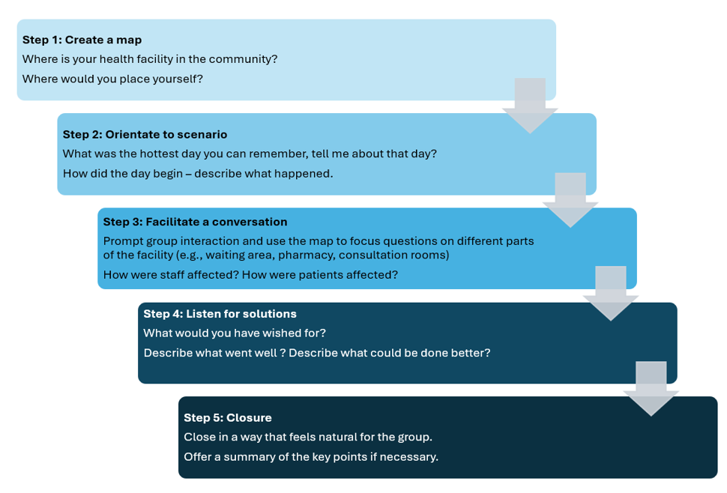
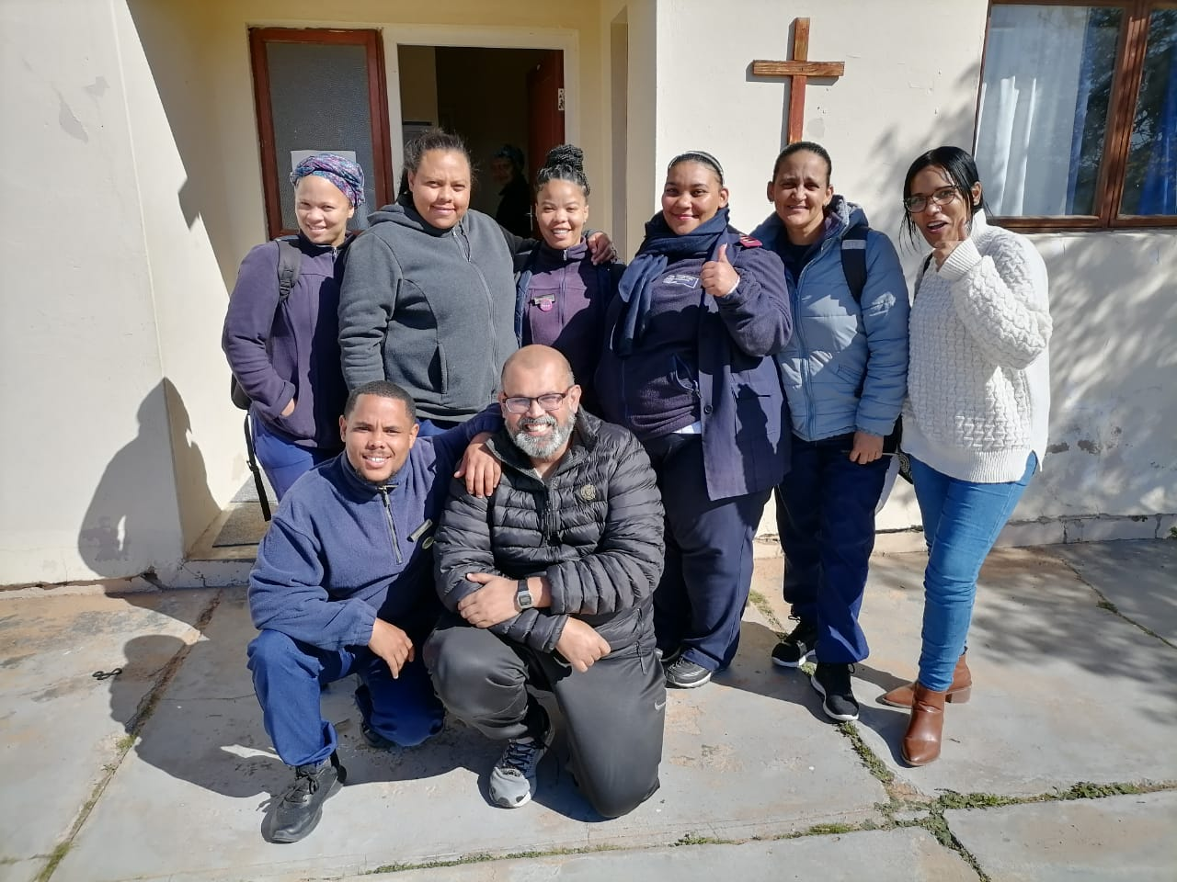
Stage 4: Focus group tabletop discussions
Notes:
Following the audit this focus group discussion is with a mixture of the community-based and facility-based staff. It is a facilitated discussion across the 5 steps in the slides.

Slide 28
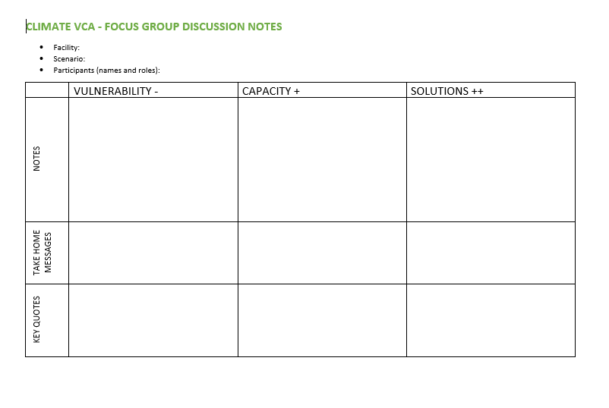
Rapid qualitative analysis using adapted framework method
Familiarisation with notes and tape
Deductive framework
Extract key issues according to the framework – per facility
Integrate issues from across facilities in 6 key areas – per subdistrict
Interpret and extract into matrix
Notes:
A second person observes and listens and makes notes using the template. The conversation is also recorded. Afterwards a rapid analysis using a deductive approach is made to identify the vulnerabilities, capacities and solutions that came out of the discussion.

Slide 29
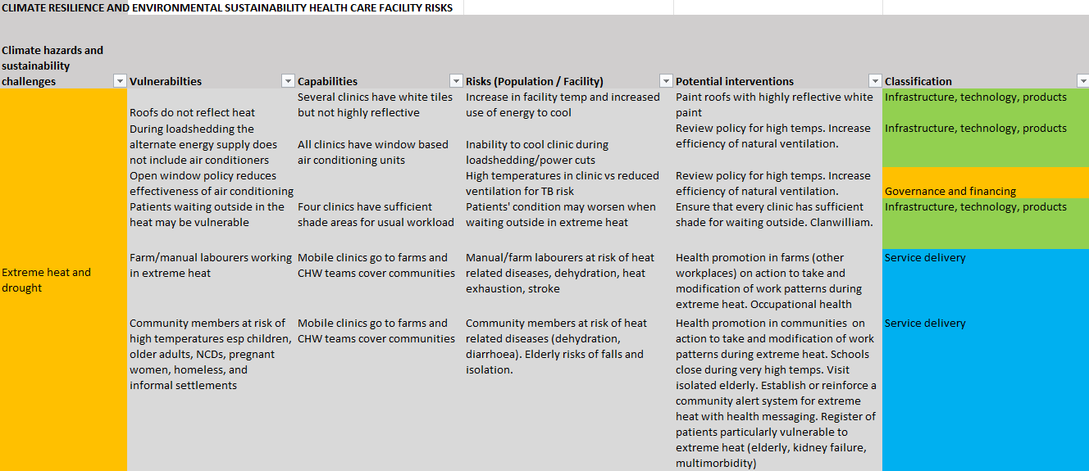
Stage 5: Information analysis
Notes:
All the information from steps 1, 3-4, are combined in this matrix. Potential solutions or interventions are identified and allocated to one of the six areas. Technical or expert advice may help define or suggest solutions.

Slide 30
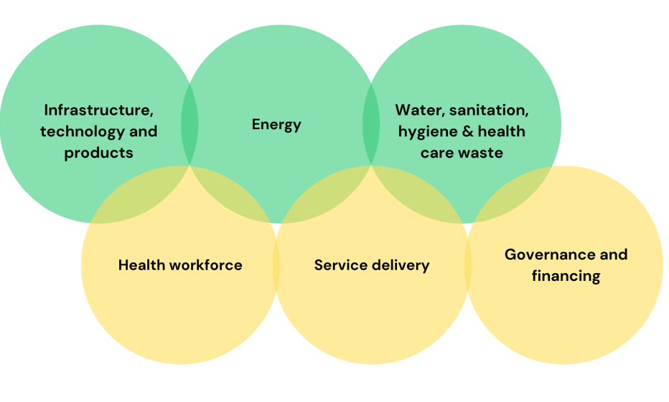
Step 6: Prioritisation and planning
Workshop with key stakeholders
Consider all proposed solutions in 6 areas
Prioritisation:
  Cost
  Impact on climate resilience
  Impact on carbon footprint
  Impact on other environmental parameters
  Other sectors
  Policy alignment
  Feasibility
Notes:
Solutions are discussed and ranked/prioritized using criteria with the relevant stakeholders / managers.

Slide 31
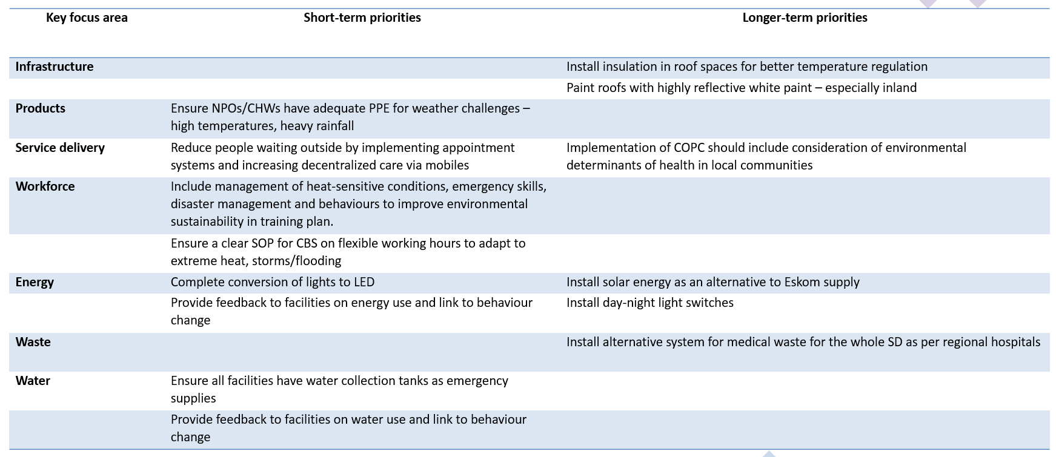
Action plan
Notes:
The solutions that are prioritized are put into an action plan. Some may be easy to do in the short term and others require resources and are more long term.

Slide 32

Notes:
See the underlying research study in Cederberg.

Slide 33

Climate Impact Checkup
Health Care without Harm
https://healthcareclimateaction.org/checkup
Notes:
The recommended tool from HCWH

Slide 34
If you were to measure the carbon footprint of a health facility what data would you think to collect?
Buzz pairs
Notes:
Moving on to the footprint, what data do people think should be collected.

Slide 35
Definition
“A carbon footprint (also called an inventory) is the sum of greenhouse gas emissions resulting from an activity, the operation of a facility, or the manufacture and use of a product. In this tool, a carbon footprint refers to a quantified list of a facility’s GHG emissions and sources.”
Notes:
Definiton of carbon footprint

Slide 36
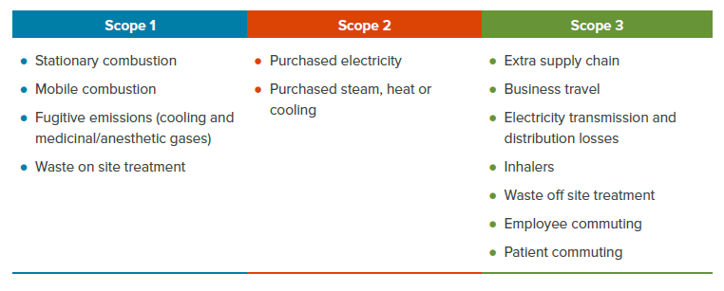
Detailed items in each scope
Notes:
Defining the scopes and what is included in each

Slide 37
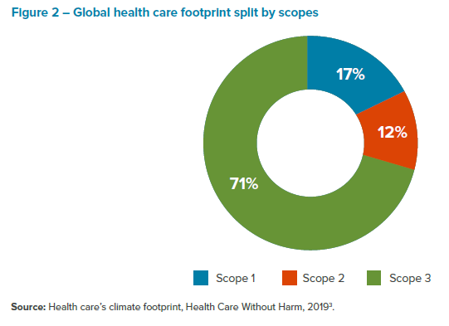
Notes:
What the results look like at a global aggregated level for the contribution of different scopes

Slide 38
GHG emissions = activity data x emission factor
GHG emissions from electricity = kilowatt hours of electricity x local emission factor
Notes:
Your data is combined with an emission factor to calculate the GHG emissions in equivalent Kg of CO2. Ideally emission factors should be at the country level.

Slide 39
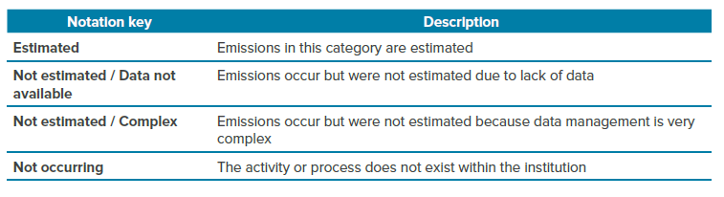
Availability of data
Notes:
It is not a problem is data is missing or too difficult to obtain

Slide 40
Data for scope 1
Item | Data needed
Stationary combustion | Total amount of fuel consumed
Mobile combustion | Total amount of petrol/diesel consumed
Fugitive emissions | Type of equipment, type of gas, quantity of gas reloaded
Medicinal/anesthetic gases | Total amount delivered – total amount discarded
Notes:
Data needed

Slide 41
Data for scope 2
Purchase of electricity | Total amount electricity consumed in kwh
Purchase of steam, heat and cooling | Quantity consumed of steam, how water, chilled water
Notes:
Data needed

Slide 42
Data for scope 3
Transport for business, staff commuting, patient commuting | Type transport, distance, frequency/number
Inhalers | Type of MDI and DPIs, number dispensed, number prescribed
Electricity transmission and distribution | Calculated from scope 2 electricity use
Notes:
Data needed

Slide 43
Data for scope 3 extra supply chain
Business services e.g. advertising, postal, accountancy, legal | Amount spent in ZAR
Construction e.g. building, repairs, manufacture | Amount spent in ZAR
Food and catering | Amount spent in ZAR
Information and communication technology e.g. software, publishing | Amount spent in ZAR
Manufactured fuels, chemicals, gases e.g. soaps, detergents, gases | Amount spent in ZAR
Medical instruments and equipment e.g. computers, examination or diagnostic | Amount spent in ZAR
Other manufactured products e.g. appliances, machinery | Amount spent in ZAR
Paper products | Amount spent in ZAR
Pharmaceuticals | Amount spent in ZAR
Water and sanitation | Amount spent in ZAR
Other procurement | Amount spent in ZAR
Notes:
Data needed

Slide 44
Data for scope 3: Waste
Solid waste | Amount of waste sent to landfill or dump sites
Composting | Amount of waste sent for composting
Incineration | Amount of waste types sent for incineration: non-hazardous/general; clinical mix of biohazardous/hazardous; hazardous
Notes:
Data needed

Slide 45
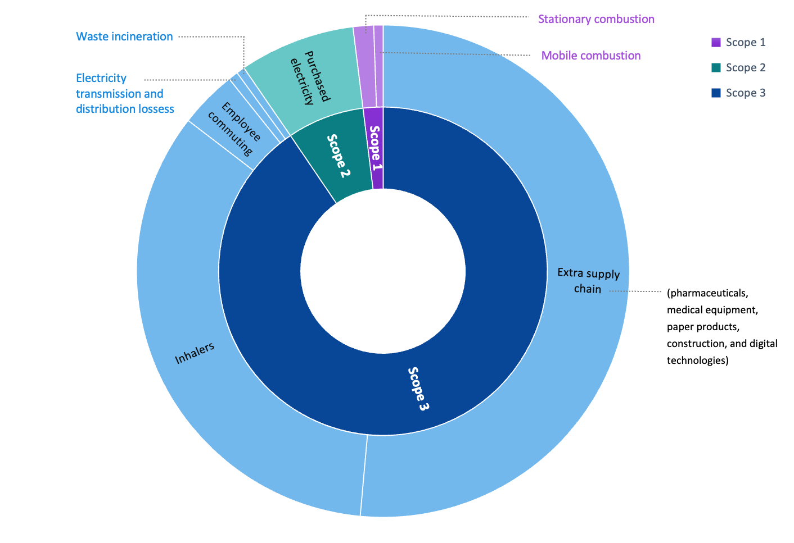
Results Cederberg primary care facilities
10.5Kg eCO2/ consultation
Notes:
Example of the Cederberg primary care footrprint. Note huge % from inhalers and supply chain. 10.5KgeCO2 per consultation is probably less than in high income countries, but one needs to ensure footprint calculations are comparable in the method and items included.

Slide 46
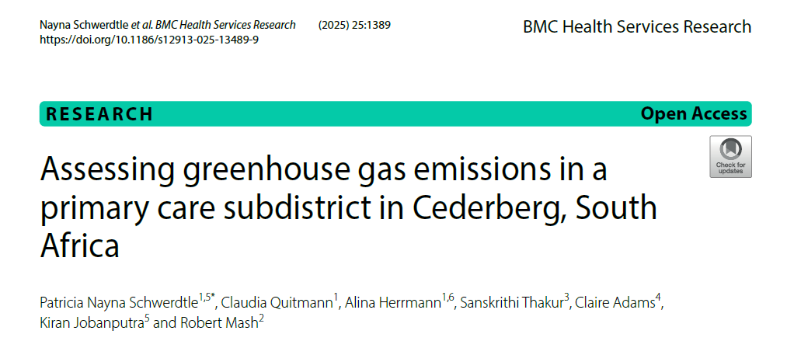
Notes:
See the published research

Slide 47


Questions / discussion

