Slide 1

Malnutrition and climate change: resources for CPD

Slide 2
Climate change impact on Malnutrition
Climate change predictable food system failure undernutrition (underweight, stunting, wasting), overweight and micronutrient deficiencies
By 2050, East Africa is projected to experience:
- 1.8–3.0 °C warming
- 13–22% declines in staple crop yields
- Large cereal deficits:
Clinical translation
- Reduced availability + higher prices → energy and protein insufficiency
- Dietary diversity declines → micronutrient deficiency
- Food insecurity amplifies infection risk → malnutrition–infection cycle
- Health systems face rising demand for nutrition support and acute care
Agriculture productivity and chronic food scarcity
Notes:
Poor infrastructure hampers food storage, transportation, and distribution, leading to significant post-harvest losses
Limited access to agricultural technology and inputs like improved seeds and fertilizers constrains productivity gains.
Weak governance and institutional capacity impede effective policy implementation and the mobilization of resources to combat hunger
References:
1. Fanzo J. Carducci B. Climate Change, Extreme Weather Events, Food Security and Nutrition: Evolving Relationships and Critical Challenges. Annu Rev Nutr. 2025 (45):335-360
https://doi.org/10.1146/annurev-nutr-111324-111252
2. Klapka CS. Barbosa BB. Magalhães AR. Exploring the Effects of Climate Change on Child Malnutrition: A Scoping Review. Journal of Human Nutrition and Dietetics 2026; 39:e70220
https://doi.org/10.1111/jhn.70220
3. Nucci D. Pennisi F. Pinto A. Impact of extreme weather events on food security among older people: a systematic review. Aging Clinical and Experimental Research (2025) 37:137
https://doi.org/10.1007/s40520-025-03050-3
4. Simane B. Berhane K. Samet J. Food Security Outlook for Eastern Africa by 2050: Climate Change Impacts and Population-Driven Demand Gaps. Current Environmental Health Reports (2026) 13:8
https://doi.org/10.1007/s40572-026-00528-8

Slide 3
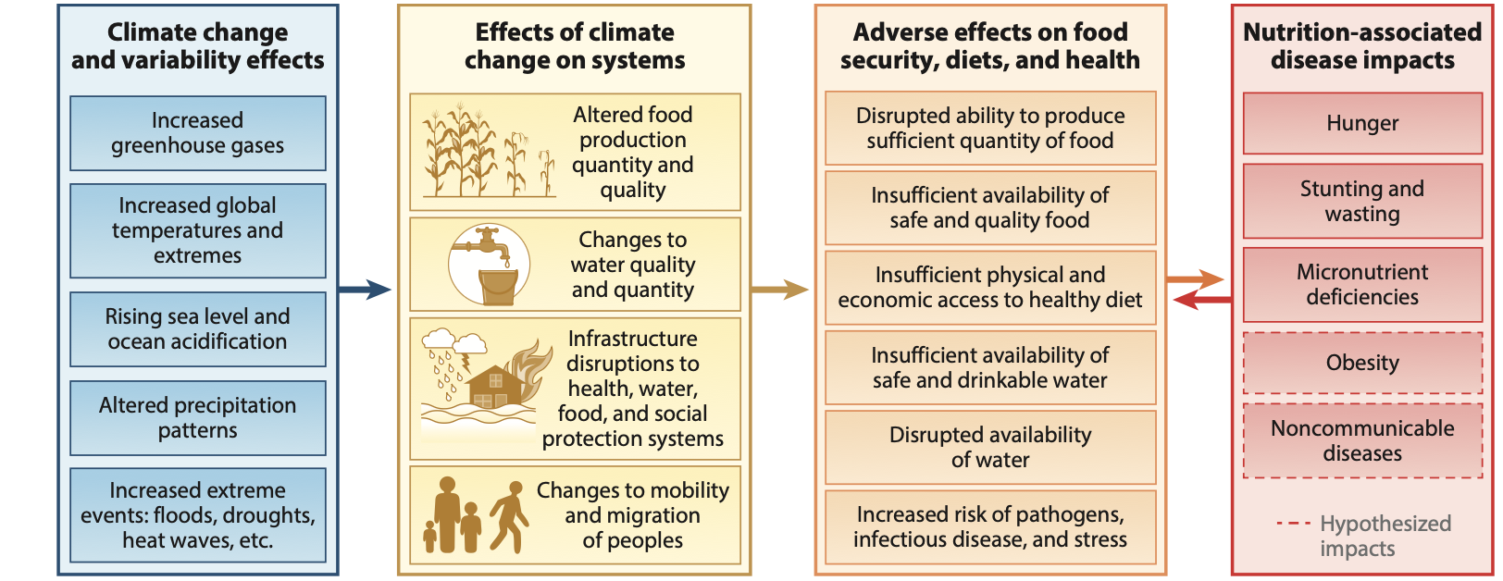
Effects of climate change on extreme weather events on nutrition outcomes
Notes:
References:
1. Fanzo J. Carducci B. Climate Change, Extreme Weather Events, Food Security and Nutrition: Evolving Relationships and Critical Challenges. Annu Rev Nutr. 2025 (45):335-360

Slide 4
Why and how children are most affected
Children under 5 years most affected, especially in Eastern Africa and South Asia
Socioeconomic vulnerability, including poverty, limited care giver education, and inadequate living conditions
Highest vulnerability in rural, grain‑fed, low‑income households
Dominant nutritional outcomes:
  Stunting : Most consistently climate‑associated outcome. Reflects chronic food insufficiency + repeated infection
  Wasting: Strongly associated with drought, flooding, and heat extremes
  Micronutrient deficiencies: Iron, zinc, vitamin A deficiencies linked to reduced dietary diversity
  Overweight: consumption of ultra‐processed foods (high energy, low nutrient) and reduced physical activity CVD and cancer
Notes:
Socio‐economic factors, such as caregiver education and social vulnerability—including access to sanitation, electricity, and proximity to water—are closely linked to low‐ income households and further mediate the effects of climate change on child nutrition.
Maternal illiteracy and limited access to clean water and high‐polluting cooking fuels—such as kerosene, coal, charcoal, wood, straw, crop waste, and dung —are more prevalent in low‐income families and are associated with higher rates of stunting, wasting, and underweight in children in rural areas of South and Southeast Asia.
Maternal education, in particular, is a key determinant of child nutrition, as it influences dietary practices, health‐seeking behaviours, and the ability to adapt to climate variability.
Stunting: This can be explained by linear growth reflecting cumulative nutritional status over time, making it a sensitive marker of adverse environmental conditions that affect long‐term child nutrition. Moreover, once a population demonstrates a significant prevalence of stunting, this is a highly stable indicator, one that does not fluctuate easily due to short‐term interventions, unlike underweight. The sensitivity of stunting to climate change appears to result from its dependence on a broad range of socio‐environmental determinants, including food security, economic conditions, and health status—all of which are influenced by climate variability
Overweight: Emerging evidence suggests that climate change affects food systems by reducing dietary diversity and nutrient quality, which are crucial for preventing the double burden of malnutrition—where undernutrition coexists with overweight and obesity. The industrialization and globalization of food systems have contributed to the widespread availability of high‐energy, low‐ nutrient foods, which are linked to rising obesity rates, even as undernutrition persists due to inadequate access to nutritious foods, including for children
References:
1. Fanzo J. Carducci B. Climate Change, Extreme Weather Events, Food Security and Nutrition: Evolving Relationships and Critical Challenges. Annu Rev Nutr. 2025 (45):335-360
https://doi.org/10.1146/annurev-nutr-111324-111252
2. Klapka CS. Barbosa BB. Magalhães AR. Exploring the Effects of Climate Change on Child Malnutrition: A Scoping Review. Journal of Human Nutrition and Dietetics 2026; 39:e70220
https://doi.org/10.1111/jhn.70220
3. Nucci D. Pennisi F. Pinto A. Impact of extreme weather events on food security among older people: a systematic review. Aging Clinical and Experimental Research (2025) 37:137
https://doi.org/10.1007/s40520-025-03050-3
4. Simane B. Berhane K. Samet J. Food Security Outlook for Eastern Africa by 2050: Climate Change Impacts and Population-Driven Demand Gaps. Current Environmental Health Reports (2026) 13:8
https://doi.org/10.1007/s40572-026-00528-8

Slide 5
Climate‑specific risk pathways for children
Heat exposure
Impairs fetal and early childhood growth
Associated with higher stunting prevalence
Rainfall extremes
- Drought → food shortage→ wasting
- Floods → water quality → bacteria and waterborne diseases acute malnutrition
Food price inflation
- Forces reliance on low‑nutrient staples: iron, zinc, folate and Vitamin D deficiencies (also pregnant women)
Clinical implications
- Growth faltering following climate events may present weeks–months later
- Stunting is largely irreversible once established
- Failure to thrive after drought or flood = nutrition emergency, not “social problem”

Slide 6
Why older adults are also high‑risk
Reduced physiological reserve
Reduced metabolic efficiency: diminished appetite and nutrient absorption
Multimorbidity
Limited mobility
Socio-economic factors:
  Unreliable or low income
  Difficult access to healthcare
  Food insecurity, especially if poor social support

Slide 7
How the elderly are affected
Clinical outcomes
Protein‑energy malnutrition:
  - Physical and cognitive impairments
Chronic energy/caloric deficiency (prolonged drought)
Functional decline
  Weight loss, sarcopenia, frailty, delayed recovery
Clinical red flags
- Unintentional weight loss after heat events
- Reduced intake following supply disruptions
Recurrent admissions with “non‑specific decline”
Malnutrition in older adults is often misattributed to ageing

Slide 8
Implications
Malnutrition and diet-related illnesses will affect resource-constrained health systems
Therapeutic and emergency nutrition interventions will divert resources away from preventive and primary care
Maternal and child health outcomes are likely to worsen, as malnutrition increases pregnancy risks and affects fetus into childhood

Slide 9



Acknowledgements
Thanks to the Global Consortium on Climate and Health Education for use of their Climate Resources for Health Education https://climatehealthed.org/about/
Thanks to Dr Sheron Forgus for adapting and expanding these resources for use by the PRIMAFAMED network in sub-Saharan Africa as part of a research and educational project at Stellenbosch University.
This project is a collaboration between the Division of Family Medicine and Primary Care at Stellenbosch University, South Africa and Departments of Public Health and Primary Care & Economics at Gent University, Belgium
The project is funded by a TEAM grant from the VLIR-UOS the Flemish Interuniversity Council (ZA2022TEA526A103)
For more information contact Prof Bob Mash on rm@sun.ac.za

