Slide 1

Mental health and climate change: resources for CPD

Slide 2
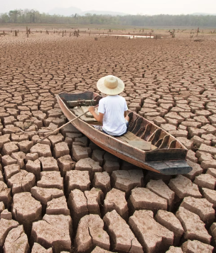
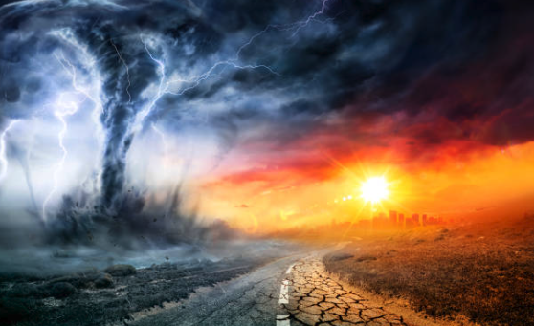
Pathways to Climate Anxiety or Eco-Anxiety
Direct Experiences
Climate Change
Threats to Livelihoods
Worry About Future Generations
What sort of world are we leaving for our children and grandchildren?
Will future generations be able to live in my community?
Threat of Apocalypse
Collapse of Food Systems (Famine)
Collapse of Ecosystems, Planetary Biodiversity
Collapse of Society (Unrest, War)
Perceived Lack of Response to Crisis
Individual
Family
Community
Regional/State
National
International
Business/Economy
Competing Problems or “Life”
Food Security
Housing Security
Economic Security
Energy Security
Transportation
Physical & Mental Health
Occupation Security
Extreme Weather Events
Event Specific Mental Health Disorders
Anxiety, Depression, Aggression, Violence, PTSD and suicide
Eco-Anxiety: “a chronic fear of environmental doom”; worry about the future for oneself, children, and later generations due to watching the slow and seemingly irrevocable impacts of climate change unfold
Soutar et al. Int J Environ Res Public Health. 2022
Notes:
[Pathways to Climate Anxiety]
Learning Objective: Describe how climate change can contribute to climate or eco-anxiety among individuals
Speaker’s Notes:
Climate anxiety can be the result of direct or indirect experiences as visualized above. For example, there are people who experience anxiety due to directly experiencing an extreme weather event. However, there is growing recognition of anxiety that stems from indirectly experiencing (via media, first hand accounts, etc.) or from worrying about perceived threats/problems - more commonly referred to as ECO-ANXIETY. People can experience both, they are not mutually exclusive. However, eco-anxiety is seen as NORMAL, and NON-PATHOLOGIC. It is a normal stress response to the largest, serious, complex problem that humanity has yet faced as a species.
Climate Anxiety or Eco-Anxiety is multi-faceted and is often the result of individual circumstances & may manifest differently in each person. One of many definitions of eco-anxiety is provided on the slide above.
Eco-anxiety can stem from multiple pathways - every person you speak with that experiences climate related anxiety likely has multiple worries and most fit within the broad categories visualized on the slide.
Anxiety levels are influenced by individual factors (demographics, prior experiences, mental illness, economic resources, biological vulnerabilities, personality, coping, emotion regulation, and social support) as well as family and community factors (interpersonal and societal cohesion, community-level socioeconomic status, and rates of employment and crime). From Chen 2022.
The 5 categories above have been identified in the context of eco-anxiety (Soutar 2022)
Threats to Livelihoods: changes in the economic system (especially for farmers), worry about migration (having to migrate, but also the worry of people (often in high-income countries) about climate migrants to their country. Worry about how extreme weather events may affect their job (outdoor workers, indigenous communities), and worry about how individuals, families or communities insufficiently plan for disasters (Western communities without wildfire planning, not having a hurricane evacuation plan along the East Coast).
Worry About Future Generations: worry (often by the older generation) about the state of the world for future generations - often people who express these worries seem climate change as distant or non-applicable to their current lives (does not affect them), but not universally true
Threat of Apocalypse: Worrying about the worst aspects of climate change - will global systems/the Earth collapse (most scenarios do not envision this occurring but cannot be ruled out)
Perceived Lack of Response to Crisis: People can feel guilt/shame/anger/worry (components of anxiety) - due to perceived (which is usually also reality though this is starting to change) lack of response to the climate crisis - within their own homes (not recycling or reducing carbon footprint), at the community level (towns not planting trees, supporting diversity, education, disaster preparedness planning), and at regional/national/international levels (lack of divestment of energy from fossil fuels and transition to renewable energy, inability to pass climate legislation (American federal government), inability to adhere to climate pledges from international conferences (majority of countries around the world).
Competing Problems/Life: Climate change is either not a worry, or the least worry in a series of problems (most common in minority communities and those with low socioeconomic status). Why worry about climate change when I can’t put food on the table today? Issues with the social determinants of health (housing food, economic, energy, transportation security) as well as access to high quality physical and mental healthcare may supercede worries about climate change or may also exacerbate existing climate worries.
References:
Soutar, C.; Wand, A.P.F. Understanding the Spectrum of Anxiety Responses to Climate Change: A Systematic Review of the Qualitative Literature. Int. J. Environ. Res. Public Health 2022, 19, 990. https://doi.org/10.3390/ ijerph19020990
Chen S, Bagrodia R, Pfeffer CC, Meli L, Bonanno GA. Anxiety and resilience in the face of natural disasters associated with climate change: A review and methodological critique. J Anxiety Disord. 2020 Dec;76:102297. doi: 10.1016/j.janxdis.2020.102297. Epub 2020 Sep 13. PMID: 32957002.
Clayton, S., Manning, C. M., Krygsman, K., & Speiser, M. (2017). Mental Health and Our Changing Climate: Impacts, Implications, and Guidance. Washington, D.C.: American Psychological Association, and ecoAmerica.
1st image: https://www.istockphoto.com/photo/tornado-in-stormy-landscape-climate-change-and-natural-disaster-concept-gm1333043586-415701684
2nd image: https://bipartisanpolicy.org/blog/who-are-climate-migrants/

Slide 3
Climate change and psychological distress
Climate change causes psychosocial stress in already vulnerable families and communities with increased risk of mental health problems
Loss of livelihoods – e.g. heat, drought, floods, storms disrupt pastoralism and farming
Loss of home and community e.g. displacement or migration, living in refugee camp, social isolation
Conflict e.g. conflict over resources such as water or pastureland, jobs, xenophobia with migration
Bereavement e.g. deaths from extreme weather events
Injury and trauma e.g. from extreme weather events, gender-based violence in camps or during migration
Worsen pre-existing mental disorders
Weak mental health care services

Slide 4
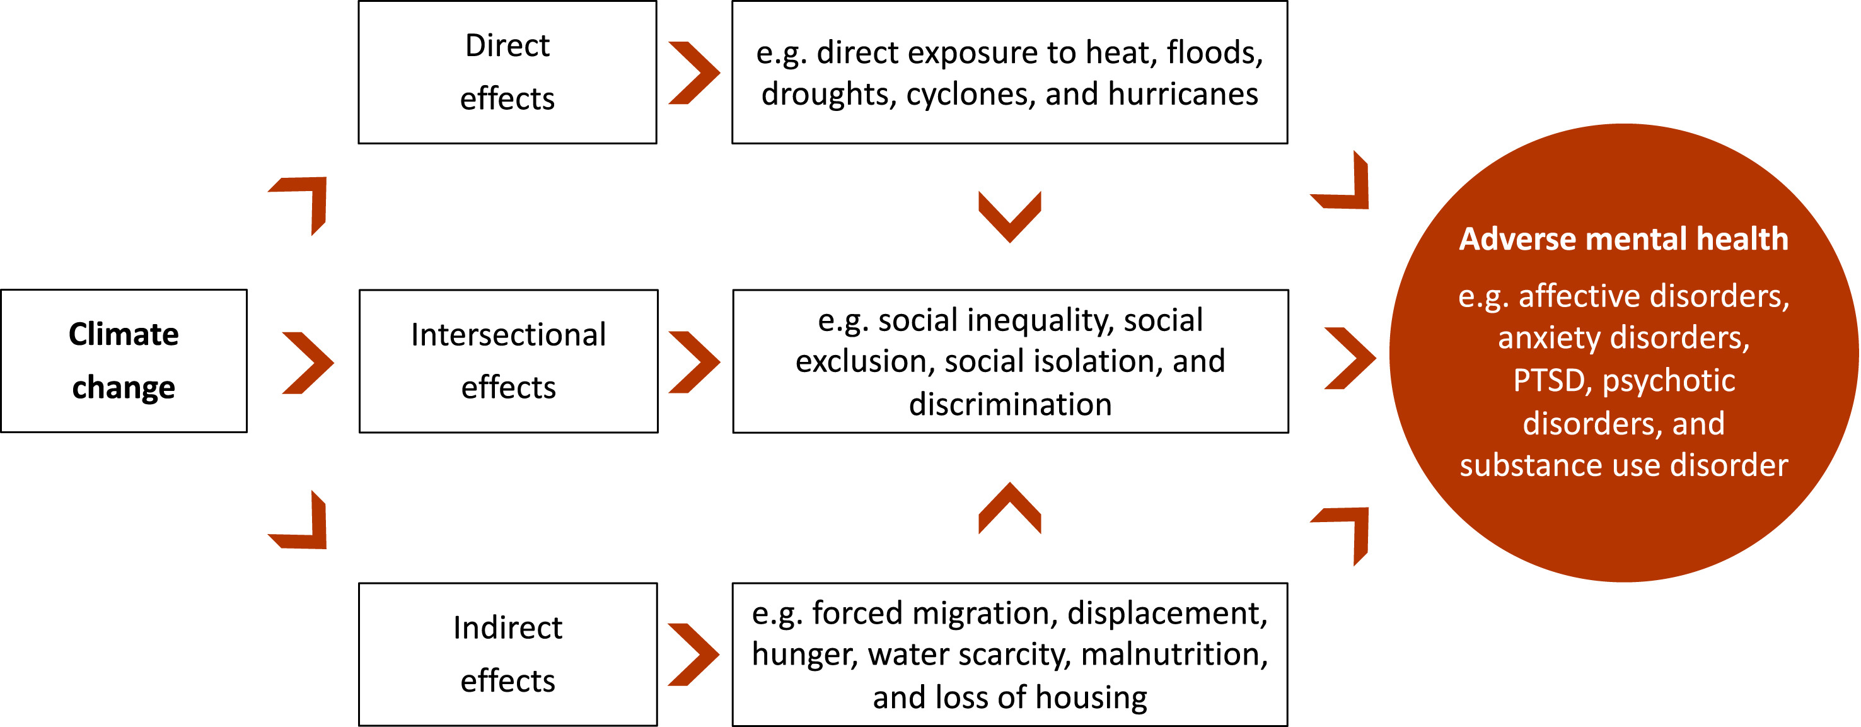
Climate change and mental health
The Lancet Regional Health – Europe 2024 43DOI: (10.1016/j.lanepe.2024.100969)
Notes:
The Lancet Regional Health – Europe 2024 43DOI: (10.1016/j.lanepe.2024.100969)
Subramaney U, Iyaloo S, Morar T, et al. Climate change and mental health implications in South Africa. Wits J Clin Med. 2022;4(3):151–156. https://doi. org/10.18772/26180197.2022.v4n3a4
Ambient temperatures a 1 °C increase in temperature is associated with a 0.9% increase in mental health-related morbidity based on data from Asia, Oceania, Europe, and North and South America.¹

Slide 5
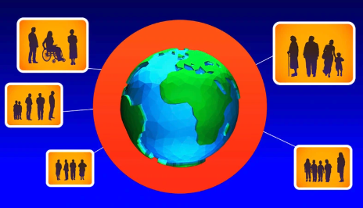
Ecosystem resilience
Vulnerability and resilience are not mutually exclusive
  Aging adults: rich life experience, can act as community leaders, mentors and caregivers
  Youth: build resilience for the lifespan
  Indigenous communities: leaders in nature, agriculture, sustainability
Chen et al. J Anxiety Disord. 2022
Notes:
[Vulnerable Populations at High Risk for Psychological Distress]
Learning Objective: Discuss how climate change disproportionately impacts vulnerable populations
Speaker’s Notes:
While climate change will affect all people in all communities on the planet, there are certain populations and communities that are vulnerable and higher-risk for psychological distress and development of eco-anxiety and are visualized on the slide above.
Explanation of each group:
Youth: infants and toddlers are unable to remove themselves from high risk situations and rely on their caregivers. In older children and adolescents, disruptions to their routines and social systems (school, after school activities) place them at higher risk. In addition, youth are the adults of tomorrow, and realize that their quality of life will likely not be the same as their parents and grandparents. They will be responsible for dealing with a problem that previous generations have chosen not to act decisively on for political and economic reasons.
Aging Adults: Pre-existing health conditions, sensory or cognitive impairments, and reliance on others puts older adults at higher risk for eco-anxiety given the complexities of managing those conditions (more difficult with climate change) and due to reliance on others for care in some situations (similar to young children). Mobility impairments also raise risk (example: aging adults worried about how they will evacuate in extreme weather events). Aging adults are twice more likely to develop posttraumatic stress symptoms and 1.7x more likely to develop adjustment disorders after natural disasters, compared to younger adults (Parker et al., 2016).
Girls & Women: pregnant women, peripartum, and women with families are at highest risk within this category. Mothers and caregivers are more likely to experience stress and develop eco-anxiety in the setting of try to plan and care for their families, both in and out of emergency scenarios.
Low Income Communities: Low-income families and communities are at higher risk because they often lack the economic resources to respond, adapt and mitigate climate change scenarios. This puts them at higher risk for eco-anxiety (sense of helplessness in the face of adversity)
Communities of Color: due to the pervasive effects of systemic and environmental racism in communities of color, which may also be low-income communities (also secondary to systemic racism) and have high burdens of chronic disease - communities often have multiple systemic issues that put them at higher risk for eco-anxiety and to be impacted by climate events. Minority populations are most likely to currently live in areas with the highest projected levels of climate change impacts with 2°C of global warming or 50 cm of global sea level rise (EPA, 2021).
Indigenous communities: for groups that livelihoods, as well as cultural, spiritual, and economic identities that are closely tied to the land and the environment are at higher risk as these identities are endangered due to climate change. Indigenous communities often also experience higher levels of poverty and levels of chronic disease.
Populations with pre-existing mental health conditions: those with an existing burden of mental health disease are likely at higher risk of experiencing psychiatric comorbidities, including eco-anxiety. In addition, psychotropic medications have known side effects that impair thermoregulation and may cause health issues during climate events, or supply of medications may be disrupted.
At risk populations can often be models for building resiliency in communities and should be included in the decision making process around climate solutions and experts in their own communities
Aging adults have rich life experiences and may have experienced previous environmental events or have been thinking about climate change for the past several decades. They can serve as community leaders, mentors, and caregivers in emergency situations. Many elders are retired and can volunteer in the community to improve resiliency and educate families.
Youth: many climate activists come from the younger generation and are active in their communities (especially adolescents but also younger school aged children). Youth that can build mental health resiliency at a young age gain these skills for across the lifespan and are a benefit to their families and communities.
Indigenous communities are experts in their environments, traditional agricultural and food systems, and in sustainable living with the environment.
References:
Chen S, Bagrodia R, Pfeffer CC, Meli L, Bonanno GA. Anxiety and resilience in the face of natural disasters associated with climate change: A review and methodological critique. J Anxiety Disord. 2020 Dec;76:102297. doi: 10.1016/j.janxdis.2020.102297. Epub 2020 Sep 13. PMID: 32957002.
Parker G, Lie D, Siskind DJ, et al. Mental health implications for older adults after natural disasters--a systematic review and meta-analysis. Int Psychogeriatr. 2016;28:11-20
Soutar C, Wand APF. Understanding the Spectrum of Anxiety Responses to Climate Change: A Systematic Review of the Qualitative Literature. Int J Environ Res Public Health. 2022;19:990. https://doi.org/10.3390/ ijerph19020990
U.S. Environmental Protection Agency. 2021. Climate Change and Social Vulnerability in the United States: A Focus on Six Impacts. U.S. Environmental Protection Agency, EPA 430-R-21-003: https://www.epa.gov/cira/social-vulnerability-report (accessed June 26, 2022).
Image: https://fox4kc.com/weather/who-is-most-vulnerable-to-impacts-of-climate-change/

Slide 6



Acknowledgements
Thanks to the Global Consortium on Climate and Health Education for use of their Climate Resources for Health Education https://climatehealthed.org/about/
Thanks to Dr Sheron Forgus for adapting and expanding these resources for use by the PRIMAFAMED network in sub-Saharan Africa as part of a research and educational project at Stellenbosch University.
This project is a collaboration between the Division of Family Medicine and Primary Care at Stellenbosch University, South Africa and Departments of Public Health and Primary Care & Economics at Gent University, Belgium
The project is funded by a TEAM grant from the VLIR-UOS the Flemish Interuniversity Council (ZA2022TEA526A103)
For more information contact Prof Bob Mash on rm@sun.ac.za

