Slide 1

Cardiovascular disease, diabetes and climate change: resources for CPD

Slide 2
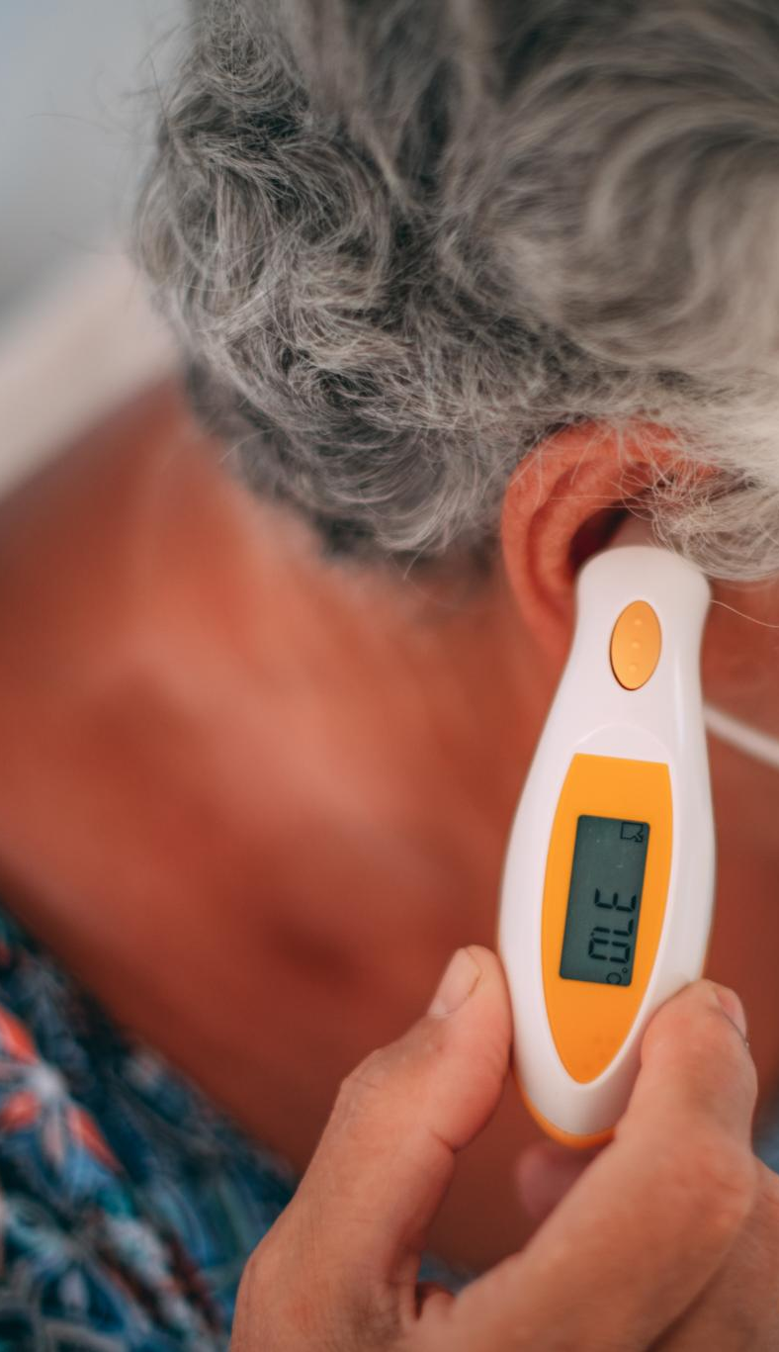
Why adults over 65 are more susceptible to heat-related cardiovascular exacerbations
Age-related Heat Vulnerability
  -Impaired sweating, reduced surface blood circulation and diminished thirst, limiting heat dissipation and increasing risk of heat exhaustion, especially in diabetes
  -Increasing dehydration risk, especially in diabetes
  -Blood redirected from organs to skin; requires increased cardiac output (higher heart rate & contractility) and risk of MI, especially if also diabetic
  -Salt depletion
  -Haemo-concentration risk of thrombosis and stroke
Chronic Conditions and Medication Risks
  Medications like diuretics and beta blockers worsen heat tolerance and increase cardiovascular strain.
  In diabetes poor temperature regulation may affect insulin leading to swings in blood glucose
Notes:
Rise of 1°C temp increase → ~2% higher myocardial infarction risk
Heatwaves → ~64% increase in hospitalizations due to MI

Slide 3

Effects of heat, air pollution, and cold on blood pressure, cholesterol, and cardiovascular disease
Heat Exposure Effects
  Heat causes peripheral vasodilation lowering blood pressure but may increase cardiovascular strain in vulnerable groups.
Air Pollution and Cardiovascular Risk
  Air pollution, especially PM2.5, raises blood pressure and promotes arterial inflammation increasing heart disease risk.
Cold Exposure Effects
  Cold activates vasoconstriction and increases blood pressure, leading to higher cardiovascular events during winter (cardiac failure and pulmonary oedema).
Cholesterol and Seasonal Changes
  Cold weather raises cholesterol, fibrinogen levels and platelet counts, contributing to increased myocardial infarction rates in winter.

Slide 4
Indirect effects of climate change on diabetes
Indirect effect | Impact on diabetes
Extreme weather events disrupt supply chain of medication and testing equipment | Poor control and glycaemic emergencies due to lack of medication
Changes to food production and food insecurity | Limited food supply with inability to follow a health diet leading to poor control
Extreme weather events disrupt access to primary care | Higher rates of hospitalisation
Heatwaves and urban heat islands | Older adults with social isolation and decreased mobility may become more vulnerable and delay seeking care for heat or diabetes related problems
Notes:
Mihail Zilbermint Diabetes and climate change JOURNAL OF COMMUNITY HOSPITAL INTERNAL MEDICINE PERSPECTIVES 2020, VOL. 10, NO. 5, 409–412 https://doi.org/10.1080/20009666.2020.1791027
Penn DBEI | Rising Temps, Rising Risks: How Climate Change Impacts Diabetes - Penn DBEI

Slide 5
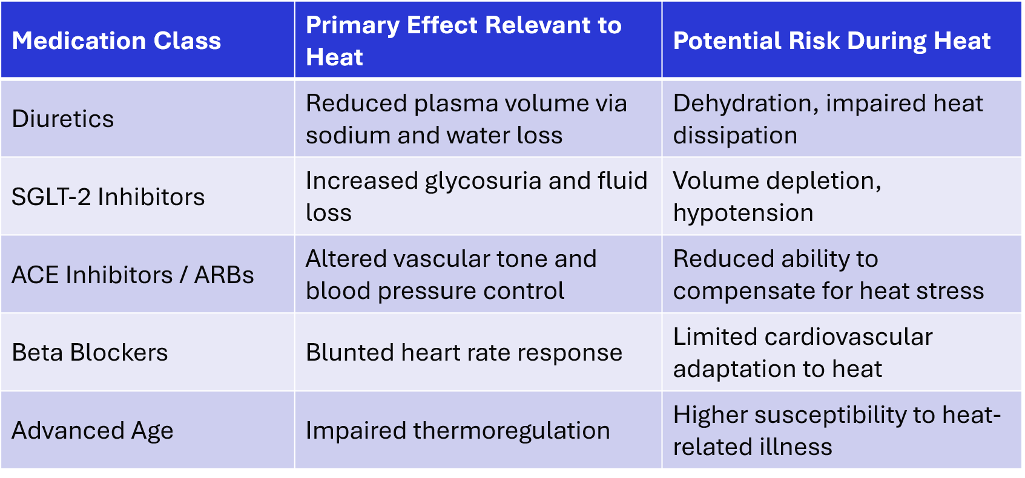
Why Certain Cardiovascular Medications Increase Heat Vulnerability

Slide 6
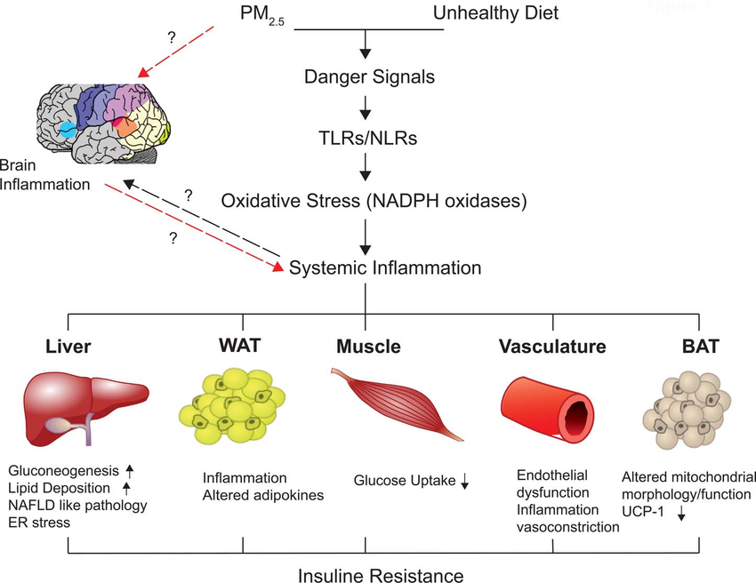
How particulate matter increases Type 2 diabetes Risk
Notes:
​
PM is a climate-related risk as it is also related to the burning of fossil fuels in industry, vehicles, coal fired power stations, etc.
PM2.5 is considered to be a pro-inflammatory trigger in the lungs that results in the release of danger associated molecular patterns (DAMPs) that activate the innate immune system, including toll-like receptors (TLR) and nucleotide oligomerization domain receptors (NLR).³ Activation of the innate and adaptive immune system results in oxidative stress and increased inflammatory signaling. There is some evidence that the increased inflammatory response in the lungs is associated with an elevated systemic inflammatory response, as well.³ For example, PM2.5 exposure has been shown to increase innate immune cells and inflammatory cytokines in white adipose tissue (WAT), as well as increase fat content itself, in preclinical models. Also in preclinical models, PM2.5 exposure has been shown to impair insulin signaling pathways in the liver, muscle, WAT, and vasculature, which reduces insulin sensitivity and impairs glucose uptake.² Hepatic insulin resistance results in increased gluconeogenesis, as well as hepatic lipid deposition, which is a precursor to non-alcoholic fatty liver disease (NAFLD). In brown adipose tissue (BAT), PM2.5 exposure has been demonstrated to cause mitochondrial dysfunction that results in decreased uncoupling protein 1 (UCP1) expression, decreased O2 consumption and heat production, and decreased metabolism.² Lastly, PM has been shown to enter the central nervous system through the olfactory bulb, and has been shown to cause oxidative stress and neuroinflammation.² Whether this affects the regulation of appetite and metabolism at the level of the central nervous system, e.g. the hypothalamus, remains to be determined.

Slide 7
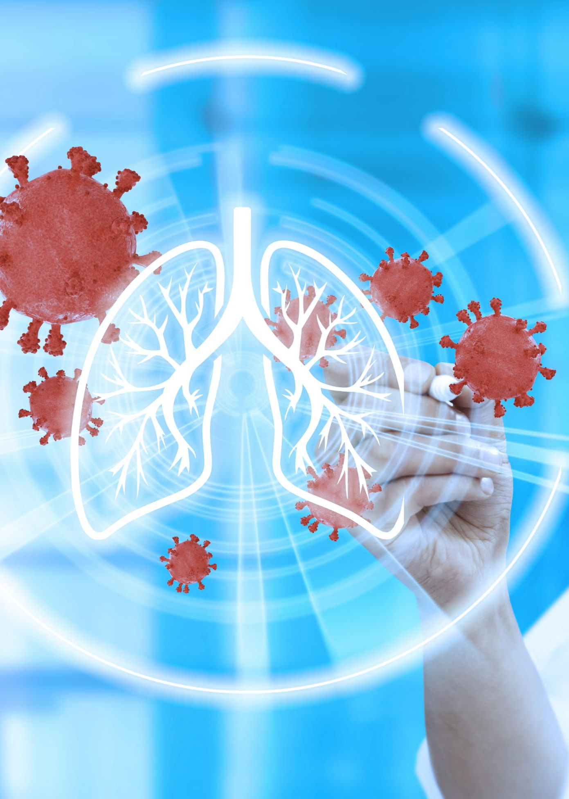
Strategies to manage climate-related cardiopulmonary risk at individual, clinical, and community levels
Individual-Level Protective Measures
  Improving indoor air quality and using HEPA filters reduce exposure to harmful particles. Protective masks and cooling strategies help manage heat and pollution risks.
Clinical Risk Reduction
  Healthcare professionals educate patients on air quality and risks, adjust medications during extreme weather, and monitor vital health functions.
Community and Structural Interventions
  Clean cooking fuels, improved ventilation, urban planning, and heat action plans reduce population-level cardiopulmonary risks effectively.

Slide 8



Acknowledgements
Thanks to the Global Consortium on Climate and Health Education for use of their Climate Resources for Health Education https://climatehealthed.org/about/
Thanks to Dr Sheron Forgus for adapting and expanding these resources for use by the PRIMAFAMED network in sub-Saharan Africa as part of a research and educational project at Stellenbosch University.
This project is a collaboration between the Division of Family Medicine and Primary Care at Stellenbosch University, South Africa and Departments of Public Health and Primary Care & Economics at Gent University, Belgium
The project is funded by a TEAM grant from the VLIR-UOS the Flemish Interuniversity Council (ZA2022TEA526A103)
For more information contact Prof Bob Mash on rm@sun.ac.za

