Slide 1

COPD, fossils fuels and climate change: resources for CPD

Slide 2
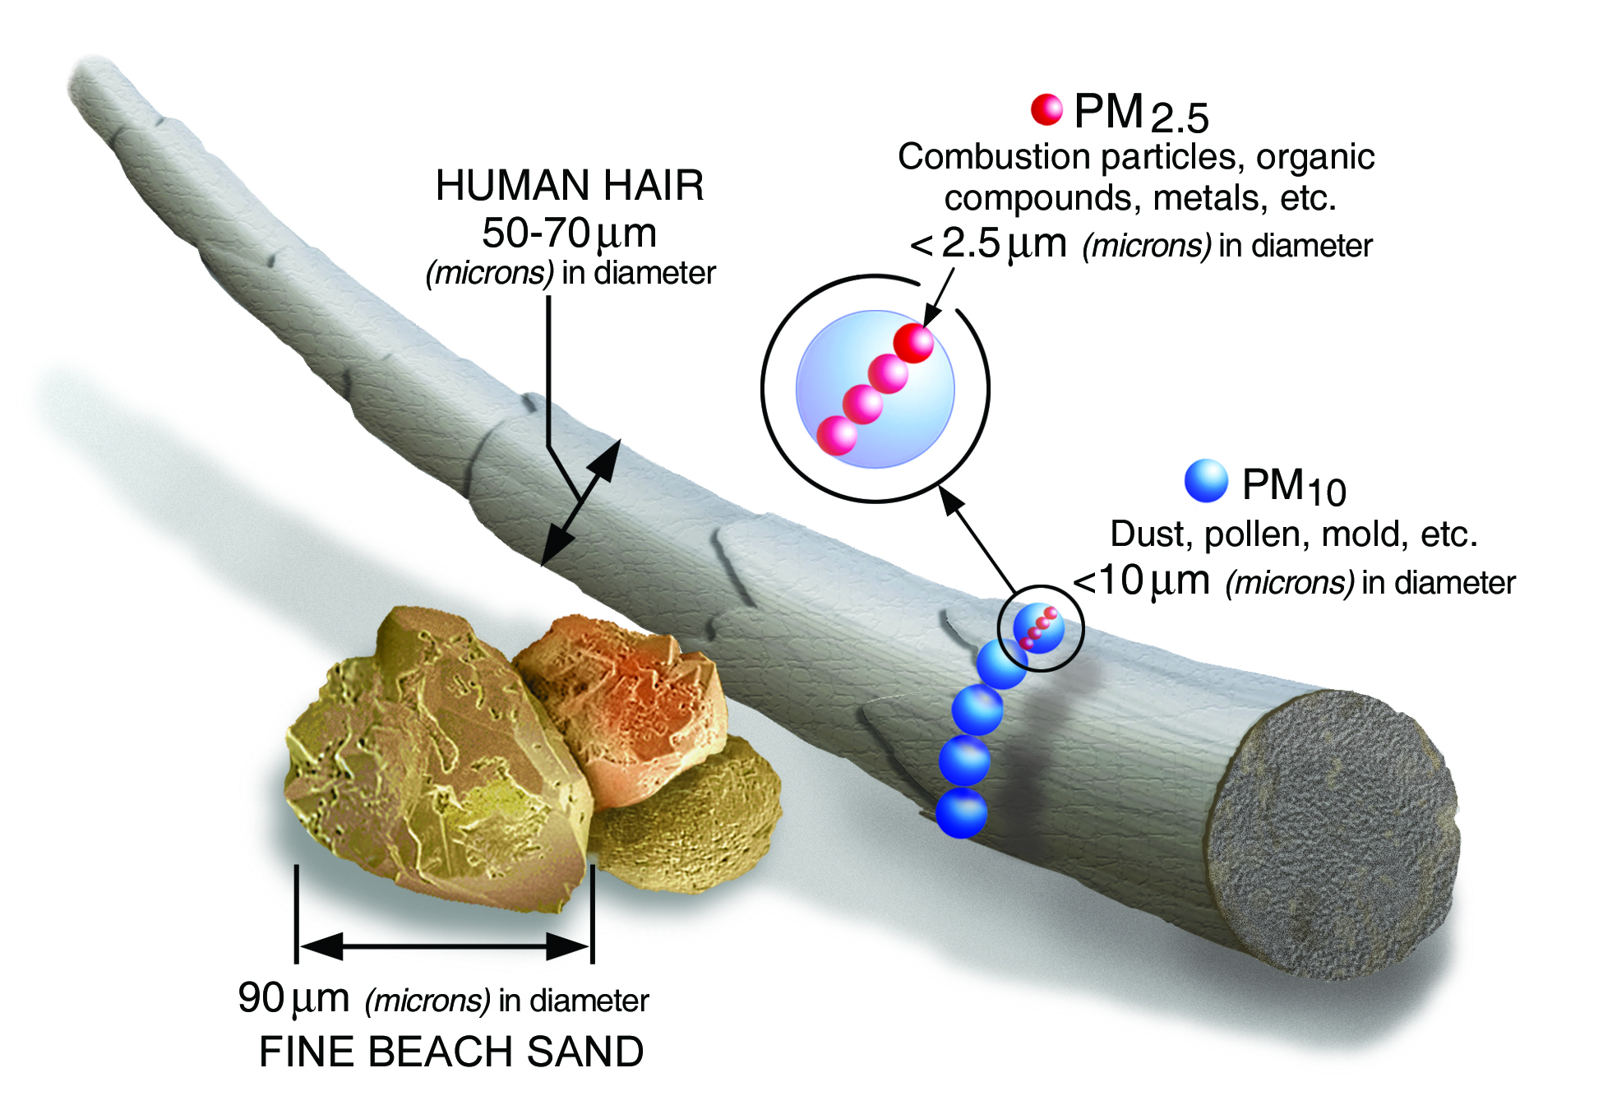
What is Particulate Matter?
All air we breathe contains particulate matter (PM)
PM is a mixture of solid and liquid droplets suspended in air
Incomplete combustion of biofuels is a significant contributor to PM
Smaller particles can travel deeper into the small airways and can enter the systemic circulation.
PM is defined by the size of the particle:
PM_{2.5} - PM₁₀: coarse particles (2.5 µm -10 µm)
PM_{2.5}: fine particles (D < 2.5 µm)
PM_{0.1}: ultrafine particles (D < 0.1µm)
Source: EPA What is Particle Pollution
Notes:
Learning Objective: Background on PM
Speaker’s Notes:
All of the air we breath, whether indoors or outdoors, contains particulate matter, also referred to as PM
Particulate matter is a general term referring to the mixture of solid and liquid droplets suspended in air. PM consists of particles of many different sizes, shapes and are composed of various components including dust particles, biological materials (mold, pollen), chemicals and other compounds
PM that are 10 micrometers in diameter or smaller have the greatest health impact, because these particles are small enough to enter the respiratory tract during inhalation, and the smallest particles are able to enter systemic circulation, thus the specific health risks of PM are related to their size. We will talk about pathophysiology later on in the presentation
Some terminology to be familiar with, PM ranging from 2.5-10 micrometers are referred to as coarse particles, PM less than 2.5 micrometers are referred to as fine particles, and PM less than 0.1 micrometers are referred to as ultrafine particles. PM10 refers to all PM less than 10 micrometers while PM2.5 refers to all PM less than 2.5 micrometers
PM can be directly emitted from construction, roads, wildfires, fireplaces, gas stoves, woodstove (primary particles) or secondary to reactions between pollutants such as sulfur dioxide, nitrogen oxides and volatile organic compounds (VOC) emitted from factories, power plants and vehicles (secondary particles)
References:
https://www.epa.gov/pmcourse/what-particle-pollution
https://www.nature.com/articles/s12276-020-0403-3

Slide 3
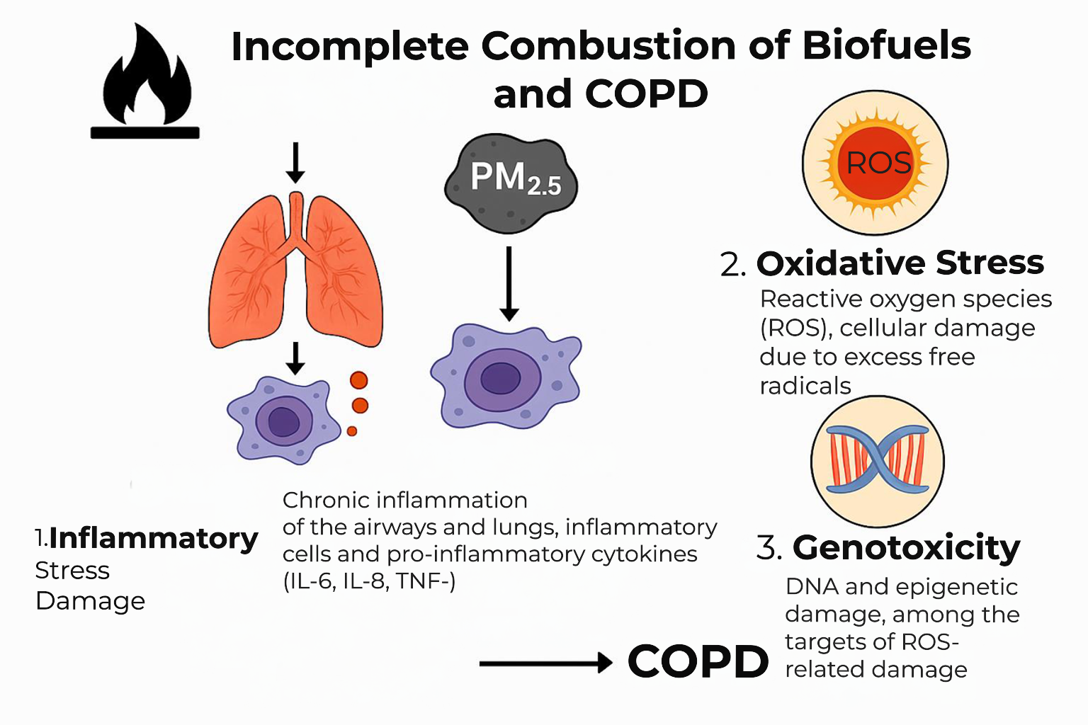
Notes:
Learning Objective: Pathophysiology of PM
Speaker’s notes:
Pathophysiology still being studied, however believed that there are multiple mechanisms by which PM impact respiratory physiology (Duan et al., 2020; Ni et al., 2015; Medina-Ramon et al., 2006)
Inflammation - PM2.5 exposure leads to local inflammation via activation of inflammatory cells (e.g. alveolar macrophages) and release of pro-inflammatory cytokines as well as systemic inflammation by release and activation of WBCs and platelets and creates a prothrombotic state; Airway inflammation can also induce epigenetic changes that may play a role in pathogenesis of COPD
Oxidative stress - PM2.5 & PM10 have also been shown to stimulate reactive oxygen species which damage respiratory epithelium, impair lung function, increase mucous secretion & lead to additional inflammation. OS can also lead to DNA damage and changes in gene expression
Immune dysfunction - PM2.5 carry bacteria and bacteria-derived components and alter distal airway microbiome making patients more susceptible to infections while also suppressing function of immune cells (one example is impaired phagocytosis of macrophages) diminishing ability to fight infections, PM exposure also leads to enhanced viral adhesion and thus increase susceptibility to respiratory viruses
Altered airway epithelial structures - PM2.5 deposits damage airway cilia and reduce ability to perform timely airway clearance
Irritation - It has also been proposed that PM10 acts as an irritant and leads to increased mucous secretion and increased bronchial hyperreactivity

Slide 4

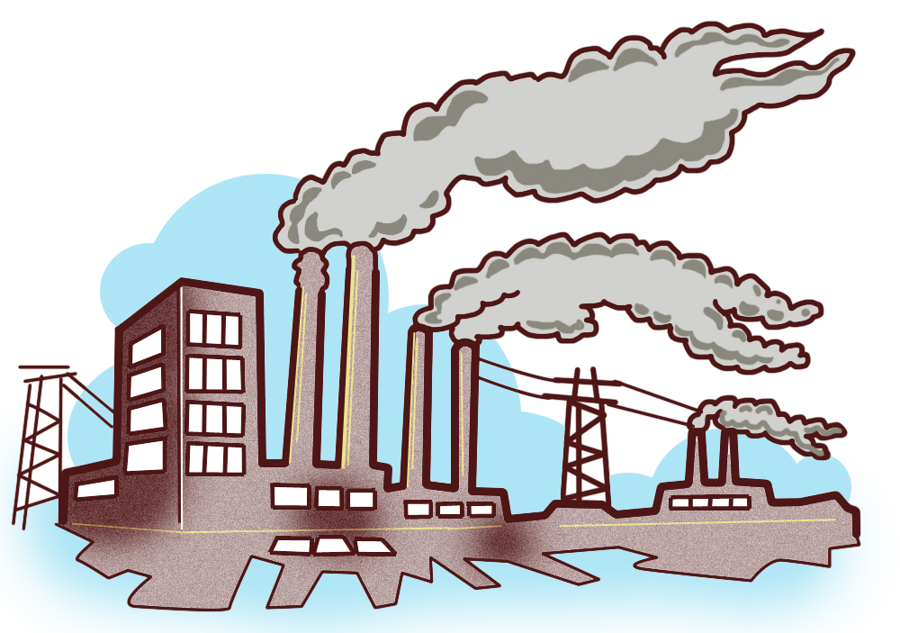


Climate Change and COPD
Chronic: Increased prevalence COPD
(Ko et al., 2012; Han et al., 2019)
Acute: COPD exacerbations & hospitalizations
(Duan et al., 2020; Ko et al., 2012)
PM_{2.5}
PM₁₀
Low income households rely on biomass fuels
Wood, charcoal, animal dung, and crop materials common sources
Mostly wood stove emissions
Women at greater risk
GHG
Wildfires major source of PM emissions and increase COPD mortality
(Doubleday et al.,, 2020)
Modifying Factors
- Housing quality
- Access to air filtration & AC
- Health comorbidities
- Age
- Work exposure
- smoking
Heat increases COPD morbidity & mortality & acts synergistically with PM, O₃ & other pollutants
(Monteiro et al., 2013; Bernstein & Rice, 2013)
Extreme weather events disproportionately impact patients with COPD
(Bernstein & Rice, 2013)
Notes:
[Climate Change & COPD]
Learning Objective: Describe the association between climate change, heat and COPD exacerbations
Speaker’s Notes:
Fossil fuel burning from industrial combustion, traffic, agricultural activities etc leads to increased PM as discussed on prior slide
Increased chronic exposure to PM10 (Ko et al., 2012) and PM2.5 (Han et al., 2019) is associated with increased prevalence of COPD in populations while acute exposure to both PM10 and PM2.5 is associated with increase in COPD exacerbations & hospitalizations (Ko et al., 2012; )
Fossil fuel and wood pellet burning also leads to greenhouse gas emissions which are the primary driver of climate change
As a result, we are seeing temperatures and extreme heat events. People with COPD are especially susceptible to heat, e.g. during 2006 heat wave in Portugal each 1C degree increase led to 5.4% increase in COPD morbidity (Monteiro et al., 2013). Temperature, PM and air pollution such as ground level ozone (which is an air pollutant generated by chemical reactions b/w nitrogen oxides and volatile organic compounds that happens when pollutants emitted by cars, power plants, etc react in presence of sunlight) also act synergistically such that their combined effect on mortality and morbidity related to COPD is greater than the sum of their parts (Bernstein & Rice, 2013)
Extreme weather events such as typhoons, hurricanes, floods are also increasing as a result of climate change which have been shown to disproportionately impact COPD patients carrying increased mortality and and morbidity, perhaps because can lead to increase transmission of respiratory viruses and pneumonia (Bernstein & Rice, 2013)
Wildfires are also increasing in frequency and intensity, they are a major source of PM emissions contributing to the exposure pathway & COPD patients are also disproportionately by wildfire smoke and found to have increased mortality rates compared to non-COPD patients (Doubleday et al, 2020)
Some examples of factors that may mediate this pathway include housing quality, access to air filtration and/or AC, comorbidities, age, and workplace exposures
References:
Bernstein AS, Rice MB. Lungs in a warming world: climate change and respiratory health. Chest. 2013;143(5):1455-1459. doi:10.1378/chest.12-2384 https://www.sciencedirect.com/science/article/pii/S0012369213603463?casa_token=c4Oz7XYTTEcAAAAA:5di7NLfuR0705j6G4UIaOqNtm7nNKRg7gH-dZXXgKB2S91TlgkYll5KeOcAbMljVuzUEhyPNFA#bib41
Doubleday, Annie, et al. "Mortality associated with wildfire smoke exposure in Washington state, 2006–2017: a case-crossover study." Environmental health 19.1 (2020): 1-10.
Duan RR, Hao K, Yang T. Air pollution and chronic obstructive pulmonary disease. Chronic Dis Transl Med. 2020;6(4):260-269. Published 2020 Jul 11. doi:10.1016/j.cdtm.2020.05.004 https://medcentral.net/doi/full/10.1016/j.cdtm.2020.05.004
Han F, Yang X, Xu D, Wang Q, Xu D. Association between outdoor PM2.5 and prevalence of COPD: a systematic review and meta-analysis. Postgrad Med J. 2019;95(1129):612-618. doi:10.1136/postgradmedj-2019-136675 https://pmj.bmj.com/content/postgradmedj/95/1129/612.full.pdf
Ko FW, Hui DS. Air pollution and chronic obstructive pulmonary disease. Respirology. 2012;17(3):395-401.https://onlinelibrary.wiley.com/doi/full/10.1111/j.1440-1843.2011.02112.x
Medina-Ramón M, Zanobetti A, Schwartz J. The effect of ozone and PM10 on hospital admissions for pneumonia and chronic obstructive pulmonary disease: a national multicity study. Am J Epidemiol. 2006;163(6):579-588. doi:10.1093/aje/kwj078 https://academic.oup.com/aje/article/163/6/579/87717?login=true
Monteiro A, Carvalho V, Oliveira T, Sousa C. Excess mortality and morbidity during the July 2006 heat wave in Porto, Portugal. Int J Biometeorol. 2013;57(1):155-167. doi:10.1007/s00484-012-0543-9 https://link.springer.com/article/10.1007/s00484-012-0543-9
Ni L, Chuang CC, Zuo L. Fine particulate matter in acute exacerbation of COPD. Front Physiol. 2015;6:294. Published 2015 Oct 23. doi:10.3389/fphys.2015.00294 https://www.ncbi.nlm.nih.gov/pmc/articles/PMC4617054/#:~:text=PM2.5%20exacerbates%20COPD%20systemic,function%20leading%20to%20increased%20white
Clip art factory - http://clipart-library.com/clipart/1627463.htm
APA

Slide 5
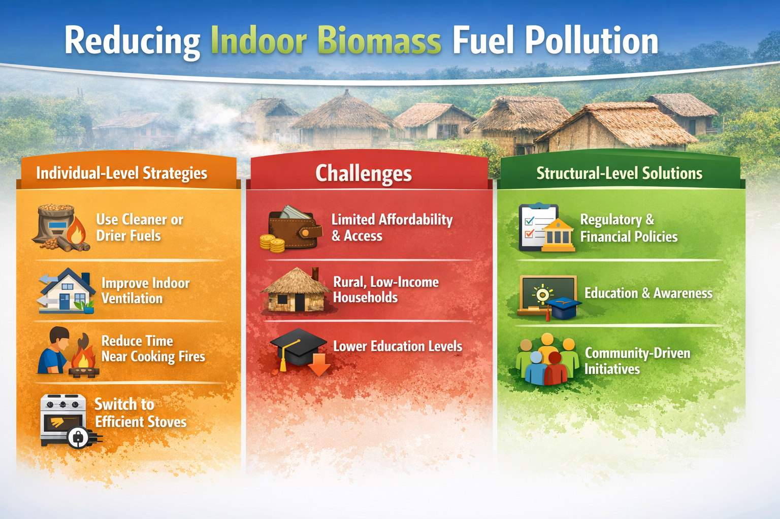

Slide 6
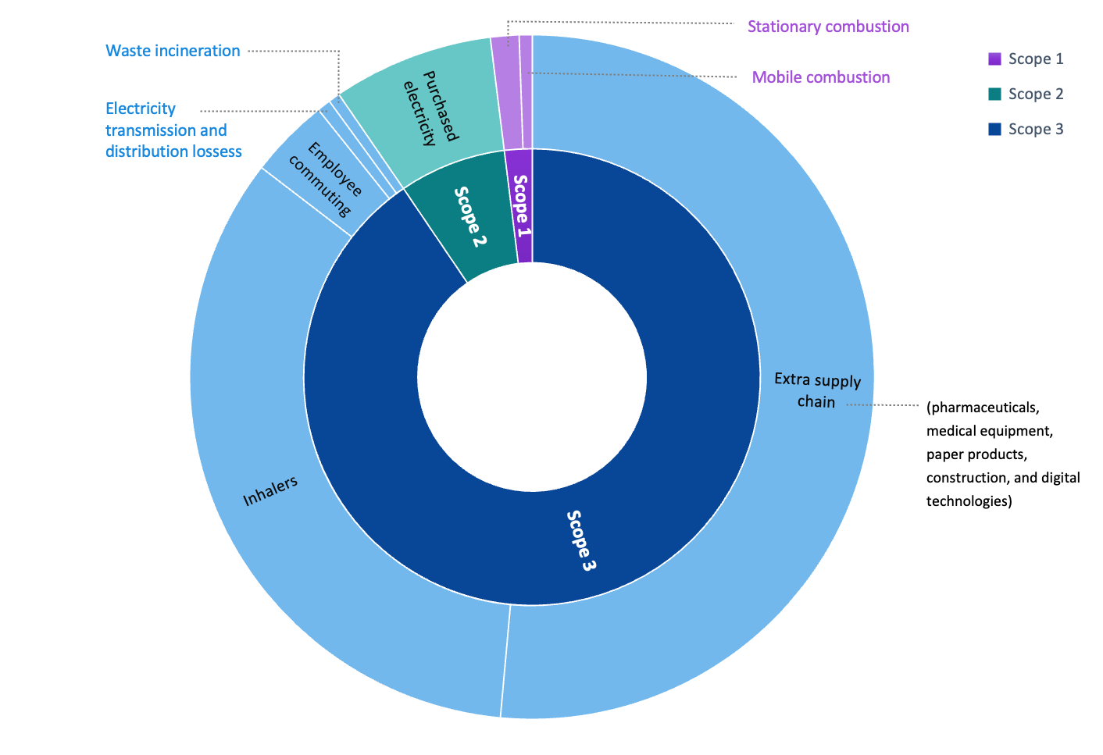
Environmental impact of inhaler prescribing
Notes:
Learning Objective: Prescribing metered dose inhalers in COPD is a cause of climate change
Speaker’s Notes:
The figure shows the carbon footprint of primary care facilities in the Cederberg, South Africa. 34% of the footprint is from inhalers.
Metered dose inhalers contain hydrofluorocarbon propellants that are potent greenhouse gases (12–14,800× CO₂ potency; persist in atmosphere for 1.4–270 years)
Optimise MDIs: lower volume propellant inhalers (e.g. Airomir vs Ventolin), fewer puffs (1 puff BD of higher strength vs 2 puffs BD or lower strength) or combination inhalers
Switching to dry powder inhalers significantly reduces the carbon footprint
Dry powder inhalers are easier to use and better adherence may also lead to better asthma control (and fewer expensive emergency visits)
The higher cost of DPIs however, is a potential barrier to their use. In high income countries such as UK, the cost is the same, but in a country such as South Africa DPIs are more expensive and not yet available in the public sector.
DPIs cannot be used by small children (under 7 years of age)
References:
Nayna Schwerdtle et al. Assessing greenhouse gas emissions in a primary care subdistrict in Cederberg, South Africa BMC Health Services Research (2025) 25:1389 https://doi.org/10.1186/s12913-025-13489-9
Therapeutics Initiative | [143] Reducing the adverse environmental impacts of prescribing

Slide 7



Acknowledgements
Thanks to the Global Consortium on Climate and Health Education for use of their Climate Resources for Health Education https://climatehealthed.org/about/
Thanks to Dr Sheron Forgus for adapting and expanding these resources for use by the PRIMAFAMED network in sub-Saharan Africa as part of a research and educational project at Stellenbosch University.
This project is a collaboration between the Division of Family Medicine and Primary Care at Stellenbosch University, South Africa and Departments of Public Health and Primary Care & Economics at Gent University, Belgium
The project is funded by a TEAM grant from the VLIR-UOS the Flemish Interuniversity Council (ZA2022TEA526A103)
For more information contact Prof Bob Mash on rm@sun.ac.za

