Slide 1

Asthma, fossils fuels and climate change: resources for CPD

Slide 2
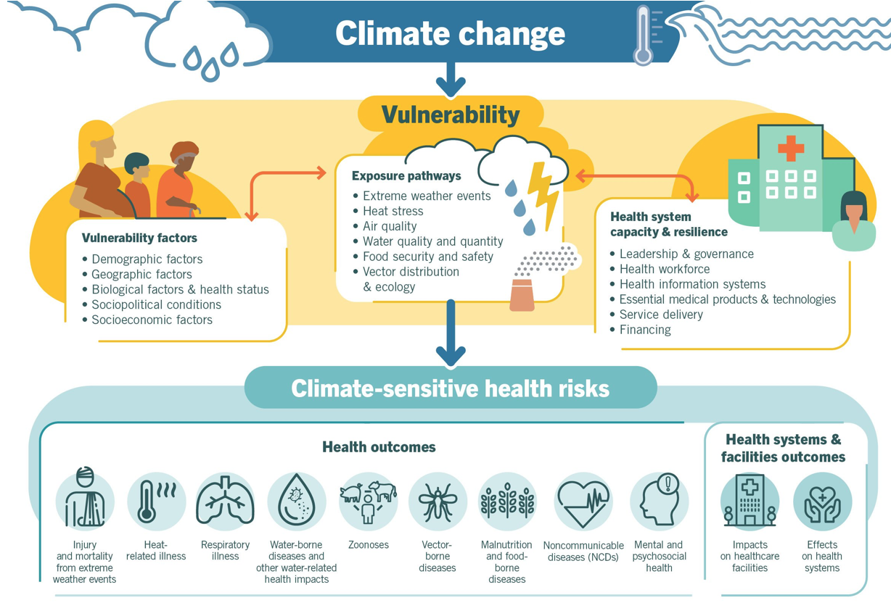
Asthma is a climate-sensitive disease
World Health Organization, 30 Oct. 2021
Notes:
Learning Objectives and notes:
1. Asthma is a climate-sensitive disease and climate change impacts asthma through extreme weather events, heat stress and changes in air quality
2. Certain populations are more vulnerable and have more environmental determinants of illhealth that are exacerbated by climate change – such as poorer or informal communities, high levels of indoor (e.g. burning wood) and outdoor (e.g. burning waste) air pollution, high pyscho-social stress, more vulnerable to heat (e.g. heat inside shacks) and lack of shade (e.g. no trees), more vulnerable to flooding and damp (e.g. living in flood plains), dificult access to primary care and less availability of treatment.
References:
Zahran HS, Bailey CM, Damon SA, Garbe PL, Breysse PN. Vital Signs: Asthma in Children — United States, 2001–2016. MMWR Morb Mortal Wkly Rep 2018;67:149–155. DOI: http://dx.doi.org/10.15585/mmwr.mm6705e1external icon
Climate Changes Health: Vulnerable Populations. Accessed August 2nd, 2022. https://www.apha.org/topics-and-issues/climate-change/vulnerable-populations
Climate change and health. World Health Organization. Accessed August 2, 2022. https://www.who.int/news-room/fact-sheets/detail/climate-change-and-health.
Federico MJ, McFarlane AE 2nd, Szefler SJ, Abrams EM. The Impact of Social Determinants of Health on Children with Asthma. J Allergy Clin Immunol Pract. 2020 Jun;8(6):1808-1814. doi: 10.1016/j.jaip.2020.03.028. Epub 2020 Apr 12. PMID: 32294541.
Cabello, M. These US states are the most vulnerable to climate change. CNET. Accessed August 9th, 2022. https://www.cnet.com/personal-finance/these-us-states-are-the-most-vulnerable-to-climate-change/
EPA Report Shows Disproportionate Impacts of Climate Change on Socially Vulnerable Populations in the United States. United States Environmental Protection Agency. Accessed August 9th, 2022. https://www.epa.gov/newsreleases/epa-report-shows-disproportionate-impacts-climate-change-socially-vulnerable

Slide 3
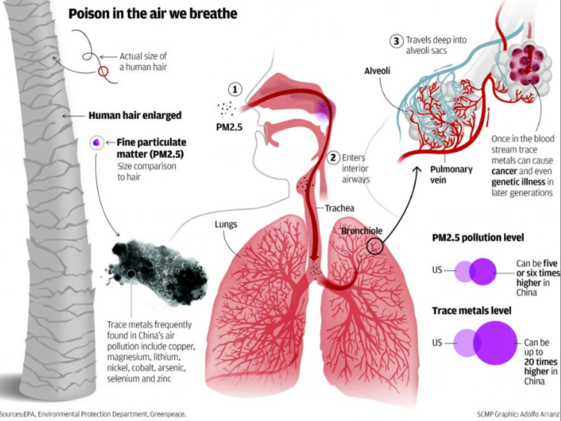
Particulate matter and asthma
Notes:
Learning Objective: Understand the mechanism by which particulate matter contributes to exacerbations of asthma
Speaker’s Notes:
Particulate matter (PM) can be inhaled into the lungs if small enough (PM2.5 and PM10 are small enough) and cause exacerbation of asthma through enhancing inflammation and oxidative stress.
Particles contain a variety of substances, including transition metals, hydrocarbons, and endotoxins that are deposited in the alveoli and bronchioles and may contribute to trace metals in the blood that are linked to cancer and systemic inflammation.
PM is created by the burning of fossil fuels in industry, coal power stations, vehicles, construction sites and from reactions in the atmosphere.
Some PM has been shown to absorb heat, contributing to increasing local temperatures. Other particles are able to interact with clouds and contribute to cooling temperatures.
References:
Particulate Matter (PM10) Trends | US EPA
Particulate Matter (PM10) Trends. EPA. https://www.epa.gov/air-trends/particulate-matter-pm10-trends. Accessed August 2, 2022.
Particulate Matter (PM) Basics | US EPA
What is PM, and how does it get into the air? EPA. https://www.epa.gov/pm-pollution/particulate-matter-pm-basics#PM. Accessed August 2, 2022.
https://www.ncbi.nlm.nih.gov/pmc/articles/PMC59535/
Donaldson K, Gilmour MI, MacNee W. Asthma and PM10. Respir Res. 2000;1(1):12-15. doi:10.1186/rr5
The Interplay of Climate Change and Air Pollution on Health | SpringerLink
Orru H, Ebi KL, Forsberg B. The interplay of climate change and air pollution on health. Current Environmental Health Reports. 2017;4(4):504-513. doi:10.1007/s40572-017-0168-6

Slide 4
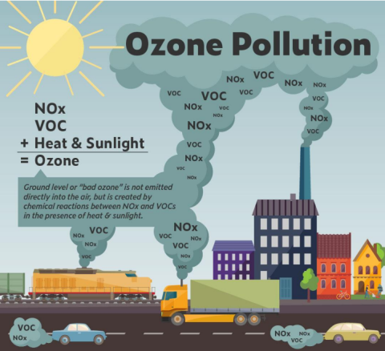
Ozone pollution and asthma
Notes:
Learning Objective: Ground level ozone triggers asthma by irritating airways
Speaker notes:
Ground level ozone is made by reactions of oxides and nitrogen and organic compounds that are volatile
Volatile Organic Compound’s (VOCs)+ Nitrous Oxide (Nox) + sunlight = Ozone
Examples of VOCs: car emissions, paint, glue, cleaning agents, acetone
Nitrous oxide is produced in nature but 40% is anthropogenic i.e. pollution caused by humans such as cars and power plants
Worse on hot and windy days, climate change will exacerbate heat and production of ground level ozone

Slide 5
Extreme weather, climate change and asthma
Environmental changes | Health outcomes
More frequent heatwaves, wildfires, higher temperatures | More exacerbations of and deaths from asthma
More intensive rain and flooding | Damp households and poorer indoor air quality with proliferation of molds and cockroaches
Thunderstorms can release massive amounts of aero-allergens | More exacerbations of and deaths from asthma
Notes:
Learning Objective: Understand how changes in weather from climate change can impact asthma
Speaker’s Notes:
References:
Eguiluz-Gracia, I., Mathioudakis, A. G., Bartel, S., Vijverberg, S. J. H., Fuertes, E., Comberiati, P., Cai, Y. S., Tomazic, P. V., Diamant, Z., Vestbo, J., Galan, C., & Hoffmann, B. (2020). The need for clean air: The way air pollution and climate change affect allergic rhinitis and asthma. Allergy, 75(9), 2170-2184. https://doi.org/10.1111/all.14177

Slide 6
Allergens, climate change and asthma
Environmental changes | Health outcomes
More intense and prolonged pollen seasons and possibly similar changes for other allergens e.g. fungi | More exacerbations of and deaths from asthma
Alteration of local vegetation patterns, changes in geographical spread, migration of new species | Increased prevalence and severity of allergic rhinitis and asthma
Notes:
Learning Objective: Understand how changes in allergens from climate change can impact asthma
Speaker’s Notes:
References:
Eguiluz-Gracia, I., Mathioudakis, A. G., Bartel, S., Vijverberg, S. J. H., Fuertes, E., Comberiati, P., Cai, Y. S., Tomazic, P. V., Diamant, Z., Vestbo, J., Galan, C., & Hoffmann, B. (2020). The need for clean air: The way air pollution and climate change affect allergic rhinitis and asthma. Allergy, 75(9), 2170-2184. https://doi.org/10.1111/all.14177

Slide 7
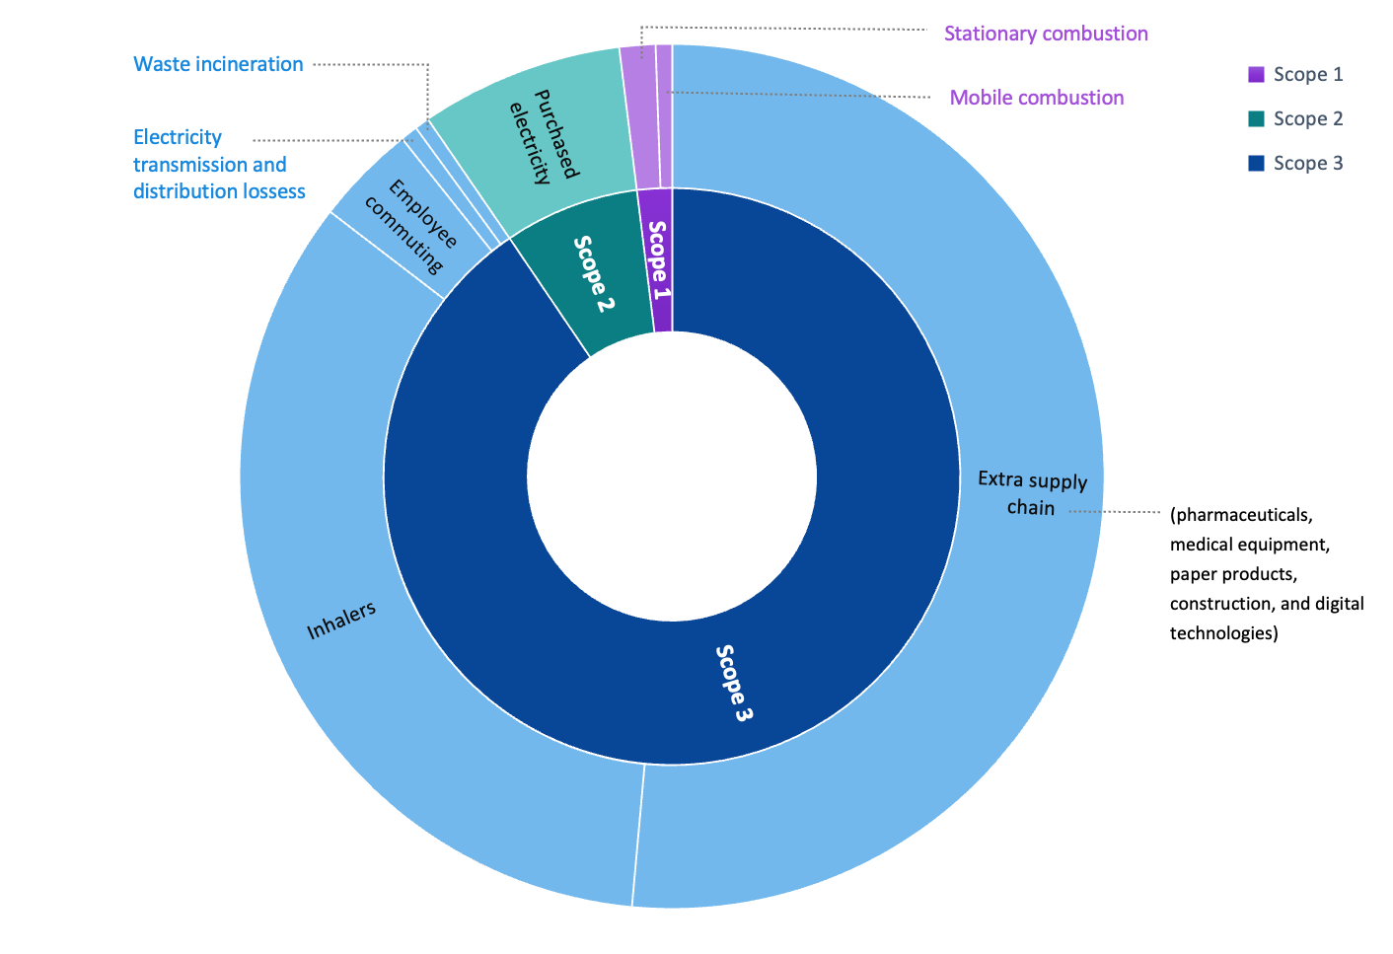
Environmental impact of inhaler prescribing
Notes:
Learning Objective: Prescribing metered dose inhalers in asthma is a cause of climate change
Speaker’s Notes:
The figure shows the carbon footprint of primary care facilities in the Cederberg, South Africa. 34% of the footprint is from inhalers.
Metered dose inhalers contain hydrofluorocarbon propellants that are potent greenhouse gases (12–14,800× CO₂ potency; persist in atmosphere for 1.4–270 years)
Optimise MDIs: lower volume propellant inhalers (e.g. Airomir vs Ventolin), fewer puffs (1 puff BD of higher strength vs 2 puffs BD or lower strength) or combination inhalers
Switching to dry powder inhalers significantly reduces the carbon footprint
Dry powder inhalers are easier to use and better adherence may also lead to better asthma control (and fewer expensive emergency visits)
The higher cost of DPIs however, is a potential barrier to their use. In high income countries such as UK, the cost is the same, but in a country such as South Africa DPIs are more expensive and not yet available in the public sector.
DPIs cannot be used by small children (under 7 years of age)
References:
Nayna Schwerdtle et al. Assessing greenhouse gas emissions in a primary care subdistrict in Cederberg, South Africa BMC Health Services Research (2025) 25:1389 https://doi.org/10.1186/s12913-025-13489-9
Therapeutics Initiative | [143] Reducing the adverse environmental impacts of prescribing

Slide 8
Implications for clinical practice
Monitor the weather
  High temperatures: increased morbidity
  Increased rain and flooding: indoor mould and air quality concerns
  Thunderstorm related asthma episodes
  Wind: increase in allergens and nitrous oxide
Monitor pollen counts
Monitor air quality index:
  Avoid busy roads and highways on poor quality days
  Limit outdoor activities
  Keep windows closed
  Wear an N 95 mask
Ensure medication refills are kept stocked
Notes:
Learning Objective: Learn how and when to deliver anticipatory guidance to patients at high risk of developing asthma or COPD exacerbations.
Speaker’s Notes:
Climate change is a recognized inducer and exacerbator of respiratory illnesses:
Higher temperatures and increased heat wave frequency → increased rate, morbidity, mortality of respiratory disease
Paralleled by levels of pollution in local air
Increased rain and flooding → indoor mould and air quality concerns
Extreme climate events such as thunderstorms → thunderstorm-related asthma episodes
Global warming alters the predominant plant allergen species, which show seasonality and act synergistically with air pollutants.
Allergenic plants such as ragweed produce more pollen when grown at higher CO2 concentrations.
References: https://www.ncbi.nlm.nih.gov/pmc/articles/PMC7737930/
Eguiluz-Gracia I, Mathioudakis AG, Bartel S, Vijverberg SJH, Fuertes E, Comberiati P, Cai YS, Tomazic PV, Diamant Z, Vestbo J, Galan C, Hoffmann B. The need for clean air: The way air pollution and climate change affect allergic rhinitis and asthma. Allergy. 2020 Sep;75(9):2170-2184. doi: 10.1111/all.14177. Epub 2020 Jan 30. PMID: 31916265.

Slide 9



Acknowledgements
Thanks to the Global Consortium on Climate and Health Education for use of their Climate Resources for Health Education https://climatehealthed.org/about/
Thanks to Dr Sheron Forgus for adapting and expanding these resources for use by the PRIMAFAMED network in sub-Saharan Africa as part of a research and educational project at Stellenbosch University.
This project is a collaboration between the Division of Family Medicine and Primary Care at Stellenbosch University, South Africa and Departments of Public Health and Primary Care & Economics at Gent University, Belgium
The project is funded by a TEAM grant from the VLIR-UOS the Flemish Interuniversity Council (ZA2022TEA526A103)
For more information contact Prof Bob Mash on rm@sun.ac.za

