Slide 1
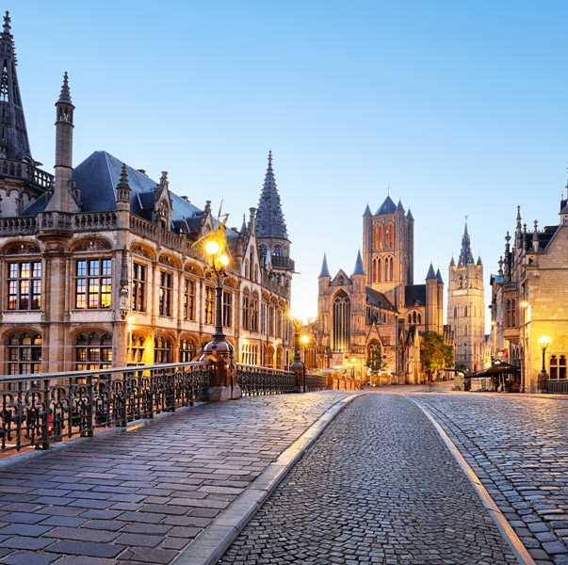
WHOCC on Family Medicine and PHC- Ghent University (since 2010)
Multidisciplinary team working on research,
education and policy
Head Prof Em. Jan De Maeseneer
Coordinator Dr Anna Galle

Slide 2
Place of the center within the university
UGent
11 faculties
Central support services:
HR department
Finance department
Research department
Educational department
Communications department
…
Faculty of Medicine and Health Sciences
10 departments (vakgroepen)
Department of Public Health and Primary Care
Vakgroep Volksgezondheid en Eerstelijnszorg
13 units
Unit Family Medicine
WHO-Collaborating Centre
Family Medicine & Primary health Care

Slide 3
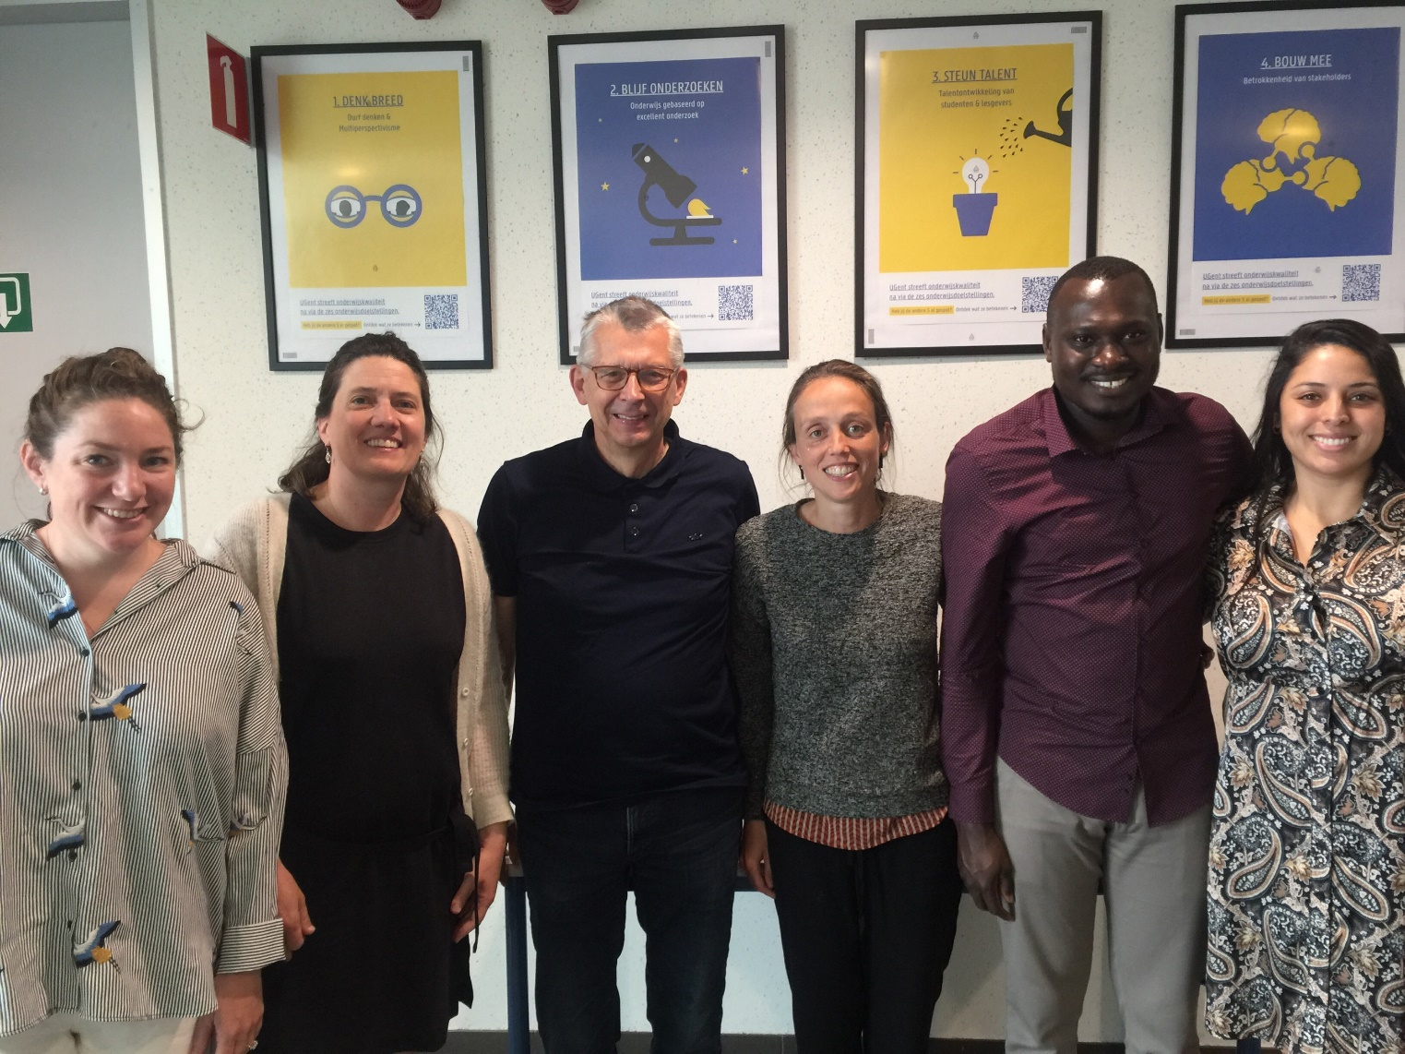
WHOCC on Family Medicine and PHC- Ghent University (since 2010)
Members:
Prof em. Jan de Maeseneer (Head)
dr. Anna Galle
Bianca Silva MSc, Family Physician
Janique Lobbestael, Family Physician
Fiorella De La Farje (Sociologist)
Prof An de Sutter
Prof Pauline Boeckxstaens
Department of Public Health and Primary Care
Unit Family Medicine
Diverse expertise in the unit and the broader department

Slide 4
Goal & mission
Strengthening primary health care worldwide by: lobbying, research, networking
=> Strong partnerships with African Universities (such as Stellenbosch University and the Primafamed network)

Slide 5
Goal & mission
To support WHO's development of global goods (norms, standards, guidelines) on primary care and family medicine. The WHO-CC is responsible for knowledge generation and management in the area of public health services, primary care and their integration under WHO leadership. The WHO-CC provides technical assistance at the request of WHO to promote primary care-based health systems, as appropriate at regional or country level.
Furthermore the WHO-CC assists WHO by providing expertise in the training of family physicians and inter-professional collaboration in primary care.

Slide 6
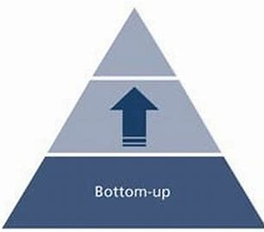
Current Projects
Project: WHOCCs in African Region
30 by 2030 campaign: www.30by2030.net
Supporting PRIMAFAMED-network in SSA
Links with CliMigHealth
Integration of Public Health and Primary Care
Measuring postnatal care: measures & indicators for WHO Guideline
Strengthening health systems in Mozambique
EFPC Conference
Consultancies/Advisory Boards/Quality Improvement Initiatives
…

Slide 7
WHO-CCs in African Region
Problem
13 different WHO Collaborating Centres on primary health care and family medicine globally:
4 in Europe
5 in Asia
4 in North America
0 in Africa
Importance
Facilitate the set-up of capacity building programs to strengthen the local health workforce, improve service delivery and disseminate expertise
Play a role at global level and influence the global agenda of health priorities and challenges

Slide 9
https://30by2030.net/

Slide 11
Recently launched Guidelines
Published in March 2022
63 specific recommendations
Divided into women/newborn/health system & health promotion
Review of existing measures to assess quality of PNC

Slide 12
Steering Committee
Dr Xarifo (SPS Tete); Prof Wim Van Damme (ITG Antwerp); Representative FDFA
Overal supervision and advice. Meet every 6 months
Please check roles and names
ITM Development Office and Dptmnt of Public Health (DO-DPH)
Names? Heleen + Willem? Higher up?
Responsibilities:
Semi-annual Balance of the Project Share with IMT/Flanders annual semiannual and financial narrative report; Coordinator's Semiannual Performance Evaluation; Audits; Evaluation of the Project at the end of the 3-year cycle
Technical Group
SPS/DPS Directors, Provincial Chief Medical Officer, Project Coordinator and Managers Dra Xarifo?
Responsibilities:
Semi-annual Balance of the Project Share with IMT/Flanders annual semiannual and financial narrative report; Coordinator's Semiannual Performance Evaluation; Audits; Evaluation of the Project at the end of the 3-year cycle
Project operational committee
day-to-day planning, communications, supervision activities
Team Tete
Dra Carla, Dra Rosa, Dr Narguisse
Team Antwerp
Heleen A, John DM, Tom DC,
PCT
To be recruted by SPS
PCA
W van de Put & Anna Galle
Project
implementation team
Support group ITM
Lenka/Anteneh: SRHR-Maternal Health; Tom Decroo: Clinical HIV/Aids expert with extensive experience in Tete; Natou (?), health finance
Budget SPS
Budget ITM
Finance
Dr Tomas? Prepare Financial Reports
B u d g e t a l i g n m e n t a n d f i n a n c i a l r e p o r t i n g
Finance
An Ielegems. Prepare Financial Reports
Beneficiaries
Technical group Tete: responsible for project implementation Tete, delegates responsibility to Team Tete.
Team Tete: day-to-day planning, communications, supervision activities – delegates tasks to PCT.
PCT: Project coördinator Tete. Responsible Project Management/Follow-up of programs/Prepare Narrative Reports.
Finance officer: Prepare Financial Reports
ITM DO-DPH: responsible for project implementation and grant management, delegates tot Team Antwerp.
Team Antwerp: Planning, communications, supervision activities, prepare Narrative Reports
Support Group ITM: technical advice at request project operational committee
PCI = Project coördinator Antwerp. Project Management; Follow-up of the programs; key point of contact with the TA in Tete Finance officer: Prepare Financial ReportsProject implementation team: researchers, designated health staff Tete
Project implementation team: health staff Tete province, researchers Tete and ITM
Beneficiaries will be engaged in participative action research,

Slide 13
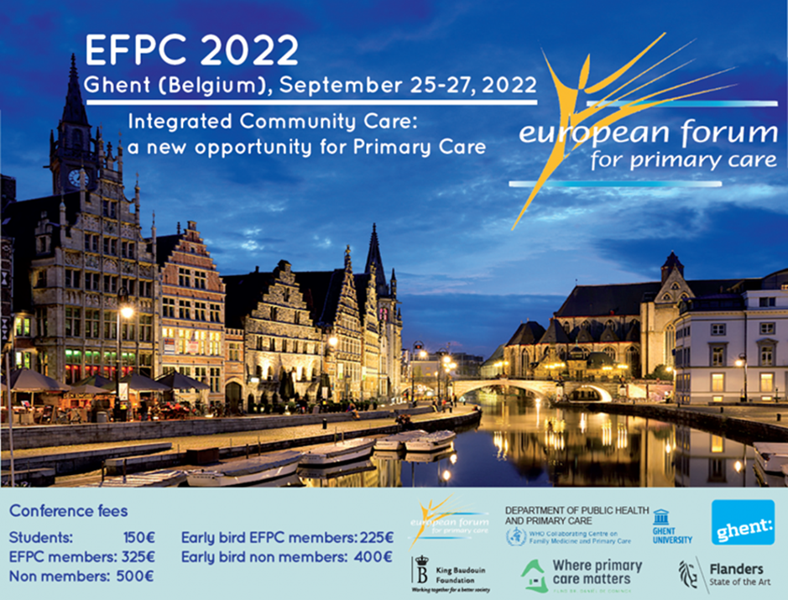

Slide 14
Future
Strategy on research and education
Increase Visibility
Invest in long term research agenda
Continue to make linkages between partners,
expand ongoing research/innovations to global levels

Slide 15
anna.galle@ugent.be

