Slide 1
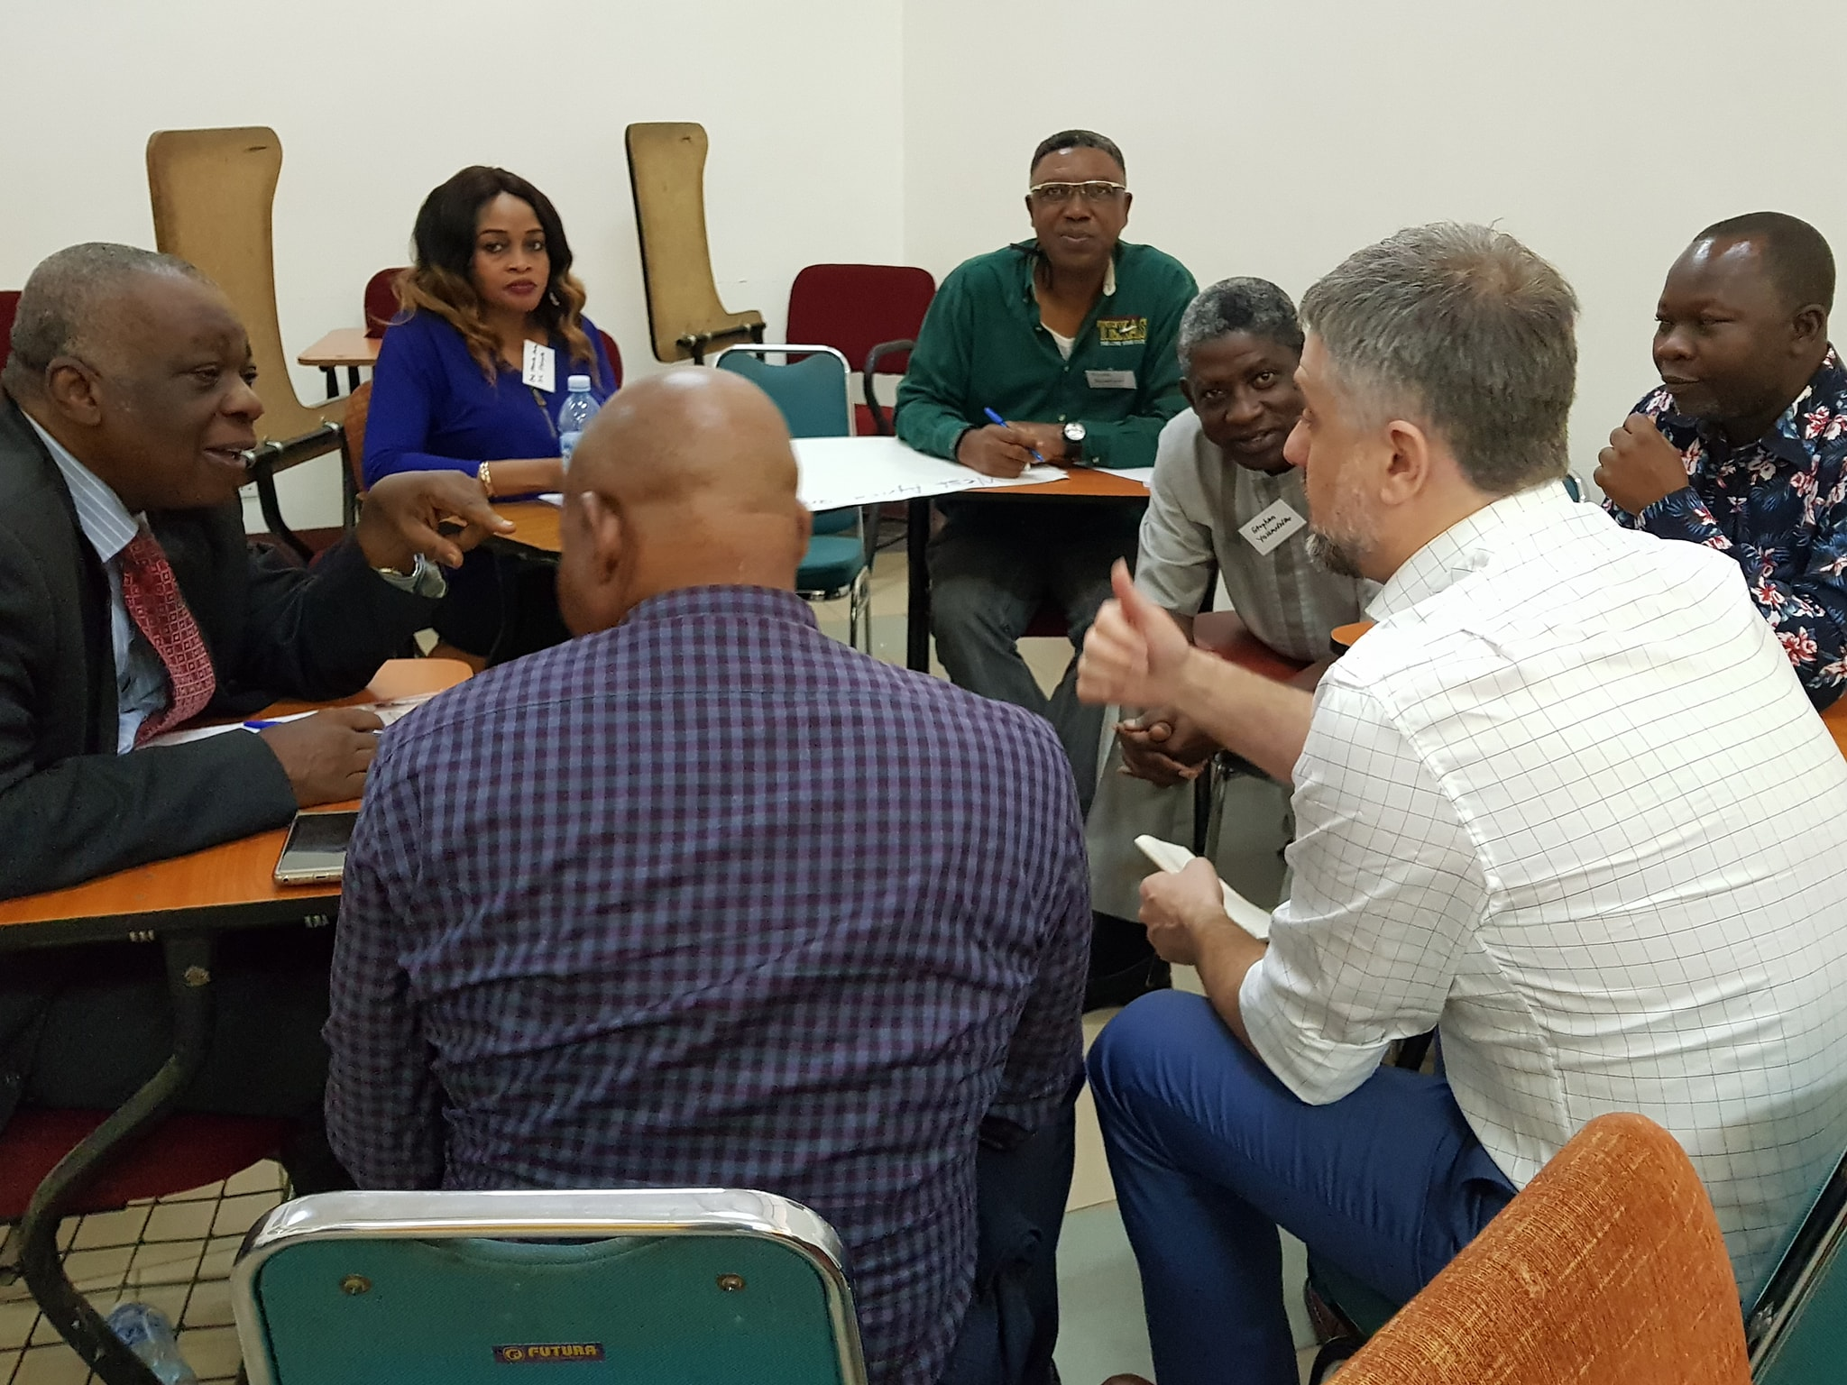
The State of the Network
Prof Bob Mash
PRIMAFAMED coordinator
Stellenbosch University, South Africa

Slide 2
Our mission in sub-Saharan Africa
PRIMAFAMED is an international institutional network that aims to develop and strengthen family medicine higher education and training through capacity building, curricula enhancement and academic research development. Due attention is paid to inter-professional training and training of other professionals in primary health care, such as nurses, mid-level care workers and community health workers. The network pursues a strategy of South-South-North cooperation.

Slide 3
Our organisation

Slide 4
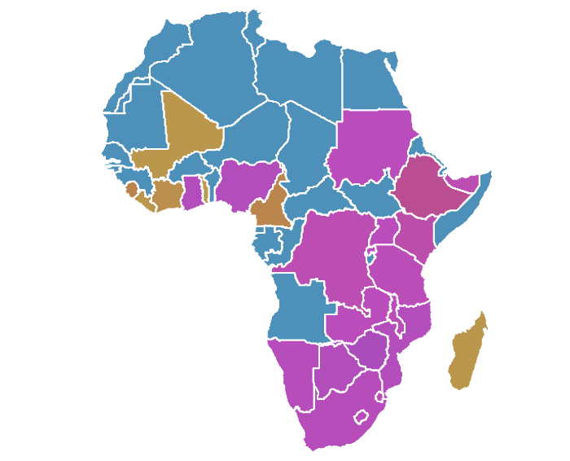
Members of Primafamed
25 countries, 40 institutions

Slide 5
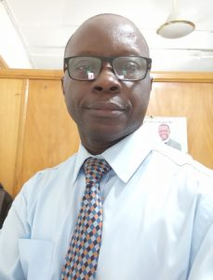
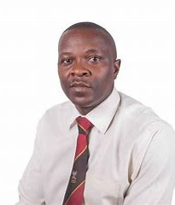
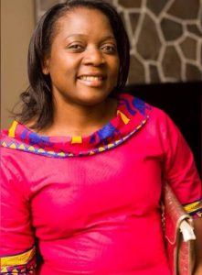
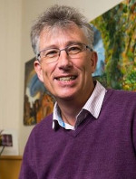
Primafamed Executive
Akye Essuman (West Africa)
Innocent Besigye (East Africa and Wonca link)
Martha Makwero (Southern Africa)
Bob Mash (Coordination)

Slide 6
Primafamed Board
Vincent Setlhare, Botswana
Assegid Geleta, Ethiopia
Akye Essuman, Ghana
Jeremiah Laktabai, Kenya
Sebaka Malope, Lesotho
Ramanampamonji Rado, Madagascar
Martha Makwero, Malawi
Yolanda Fernandes, Mozambique
Felicia Christians, Namibia
Stephen Yohanna, Nigeria
Vincent Cubaka, Rwanda
Kazeem Adekunle, Sierra Leone
Bernhard Gaede, South Africa
Paulos Beshah, Eswatini
Riaz Ratansi, Tanzania
Innocent Besigye, Uganda
Mpundu Makasa, Zambia
Edward Chagonda, Zimbabwe

Slide 7
Strategic international partners
Active
Less (in)active
Ghent University
University of Bergen
PHCRC
Wonca
Besrour Centre, Canada
Academics Without Borders
Aarhus University, Denmark
Royal College of GPs, UK
Towards Unity For Health
University of Heidelberg, Germany
University of Maastricht, Netherlands
WHIG (Dutch platform for FM international)
Afrehealth

Slide 8
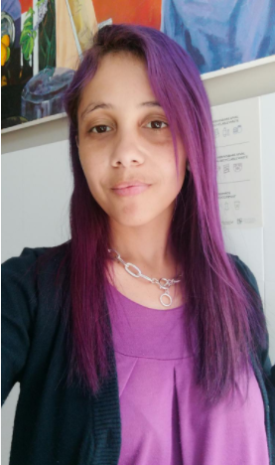
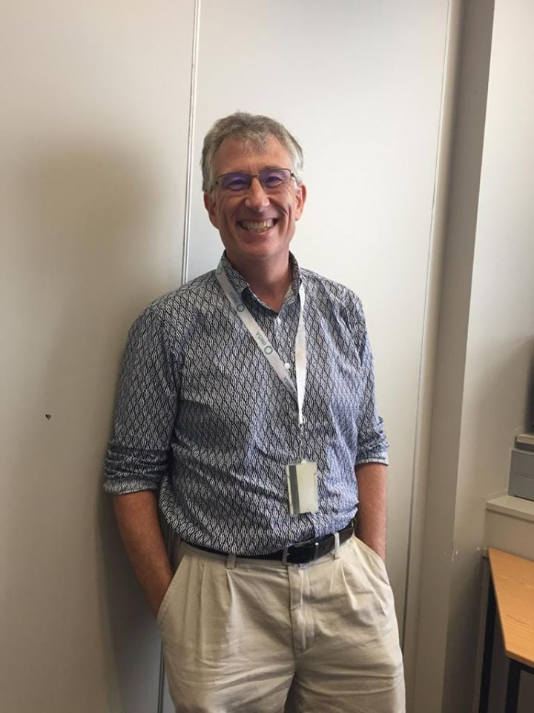
Organisational core
Cindy Harley –Administration
cindyp@sun.ac.za (on maternity leave – Ursula Cicilie ursulac@sun.ac.za)
Bob Mash - Coordinator
rm@sun.ac.za

Slide 9
Our progress in 2022 against the goals set

Slide 10
Network goals for 2022
Goals | Activity
Increase awareness of Primafamed in departments / registrars | Disseminated explanatory video in English and French https://youtu.be/euj1eZkKl9M https://youtu.be/bNreXOPU2lw
Connecting with people – making contacts available and mapping expertise | New section of the website to map institutions, people and expertise
Increase participation and inclusivity | New connections – Somaliland Still weak connections to French and Portuguese speaking countries Face to face meeting in October 2022 in Malawi
Harness resources and capacity in strategic partners more | PHCRC - research projects with Uganda and Malawi, research application with South Africa and Malawi, support for AfriWon Research Collaboration Ghent University – engagement with CliMigHealth network, new TEAM project, new WHO CC project University Bergen - PRICE project in Zambia and Malawi Academics Without Borders - Zimbabwe

Slide 11
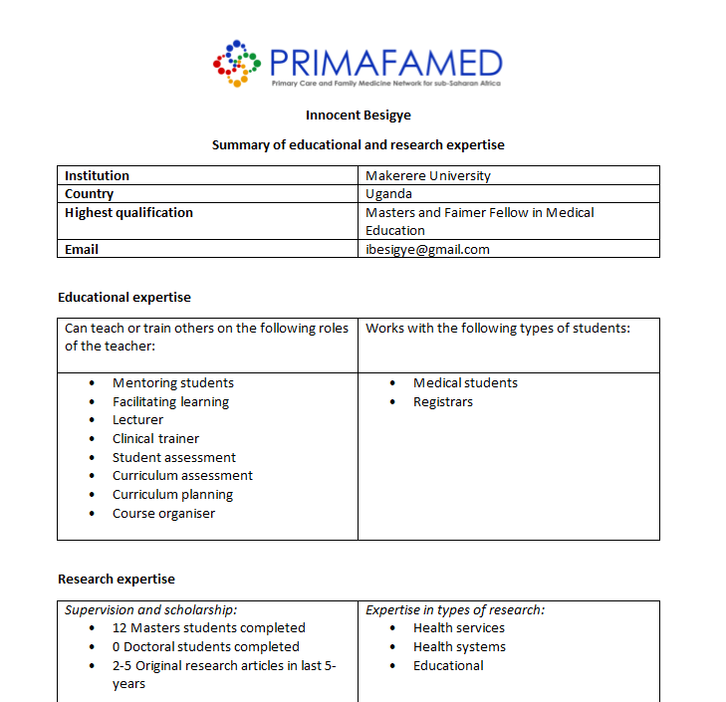
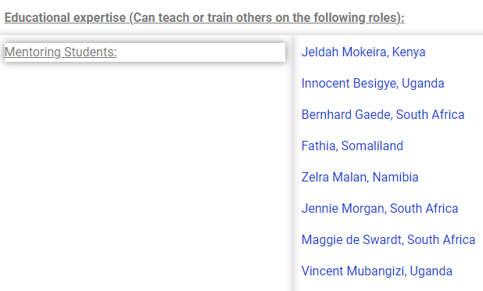
Mapping expertise

Slide 12
Research goals for 2022
Goals | Activity
Identifying expertise in the network and supporting south-south collaboration | New section of the website to map institutions, people and expertise
Departments with more research capacity to support other members with capacity building, supervision and funding opportunities | Participation in AfriWon Research Collaboration as faculty and peer mentors E-workshops on research topics (Manuscript writing and getting published, approach to educational primary care research, quantitative data analysis and reporting, research synthesis)
Promote family physician research networks | None known
Explore supervision across universities and institutions where needed | None known

Slide 13
Educational goals for 2022
Goals | Activity
E- workshops were very useful, expand, facilitate linkages between people and institutions, involve strategic partners, public health, hybrid meetings/hubs, use the time to also enable connections and communication | E-workshops (Conducting OSCEs, the learner in difficulty, practical tools for workplace based assessment)
Look at ways of restarting Training of Clinical Trainers initiative and collaborate with W Africa initiative also | None known
Support development of Diploma in PHC in the region | Support to Namibia from South Africa

Slide 14
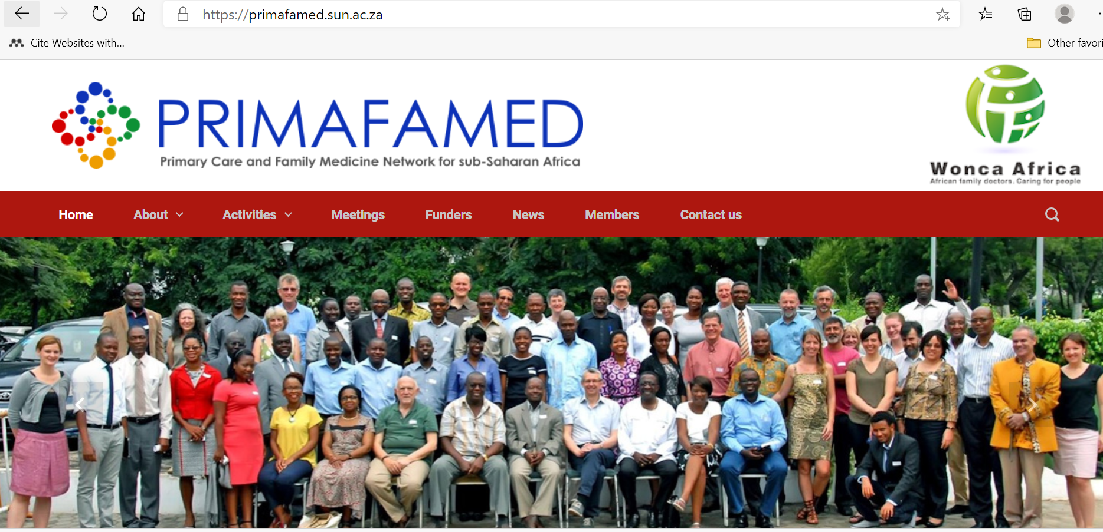
Remember…
Our listserv which you can also use! primafamed@list.sun.ac.za
Our website with news, resources and information

Slide 15
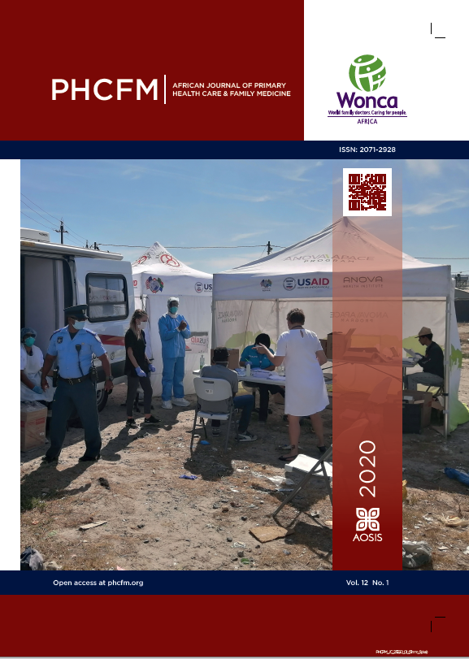
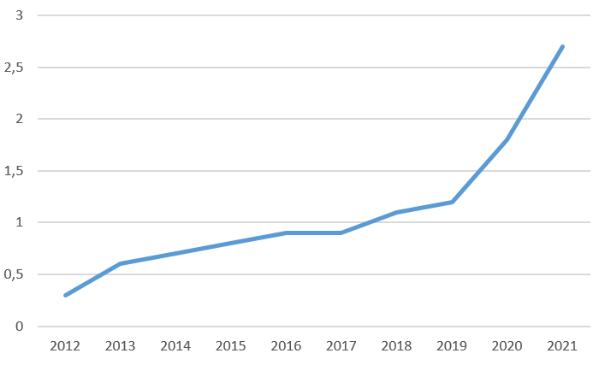
Our PHCFM journal – impact by citescore

Slide 16
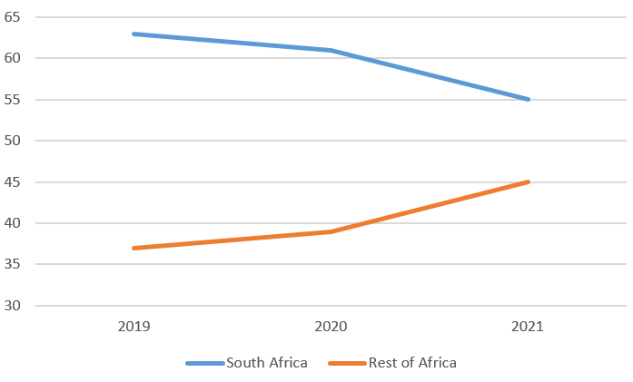
Our PHCFM journal – origin of publications

Slide 17
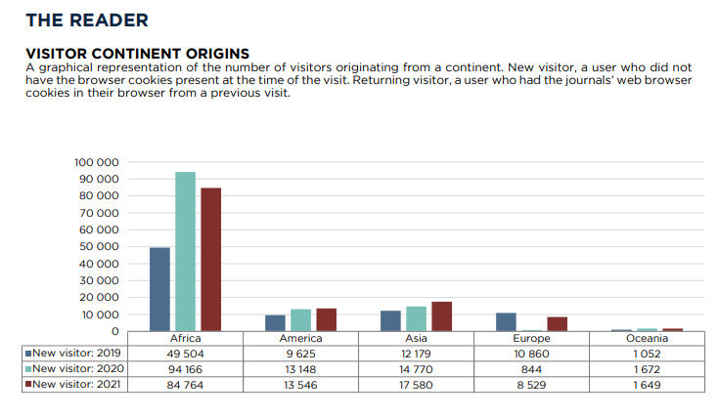
Our PHCFM journal –engagement

Slide 18
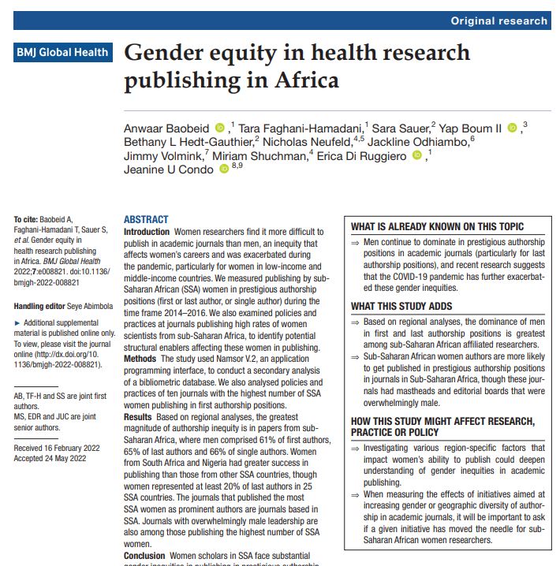
Our PHCFM journal – and gender equity
The PHCFM journal had the highest proportion of Sub-Saharan African (SSA) women as 1st authors, and it also had the highest proportion of SSA women as last authors.

Slide 19
Thank you
rm@sun.ac.za

Slide 20
Questions for discussion
What are the priorities for the primafamed network in the next year?
For the network itself
For education
For research
What are the likely challenges to be faced (and how to overcome)?

Slide 21
Your feedback
On your piece of paper make 3 headings:
1. Three things I learnt/’take home’ messages from the conference?
2. Three things I enjoyed about the conference (keep doing it)?
3. Anything we could have done better?

