Slide 1
International and Transdisciplinary Thematic Network on Climate change-Migration-Health(care)
Hosted at Ghent University: Five-year project, founded in 2020.
Director: Ilse Ruyssen; Coordinator: Charlotte Scheerens
More information: www.climighealth.com

Slide 3
Strategic revision of Vision and Mission
CliMigHealth’s vision is to render broad societal impact by generating knowledge on the interactions between climate change, migration and health(care).
Ultimately, the goal is to better adapt to, mitigate and prepare for current and future effects of climate change; to have a greater understanding of the role of migration and its impact; and to develop resilient, inclusive and responsive health systems.
To realise our vision, our mission is to guide more comprehensive and sustainable responses to address the complex migration and health(care) patterns arising from and contributing to climate change.
CliMigHealth is an international, transdisciplinary network, integrating diverse expertise and better representing the Global South, through strengthening research, educational and knowledge translation capacity.
CliMigHealth aims to form a collaborative and knowledge platform between academic institutions, non-profit organisations and individual experts.

Slide 4
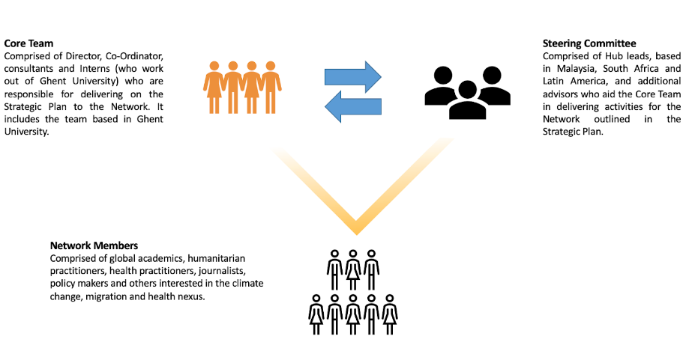
Network structure 2022-2025

Slide 5
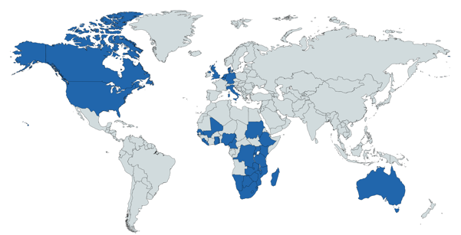
Current steering committee CliMigHealth
Including Primafamed members
Bob Mash
Akye Esuman
Innocent Besigye
Martha Makwero
Mpundu Makasa
Jan De Maeseneer
Christian Lokotola
Fin. Support for Primafamed conferences

Slide 6
Regional approach of CliMigHealth
We will launch three regional hubs in 2023 in addition to the ‘European’ hub at Ghent.
Africa hub hosted at the School of Climate Studies, Stellenbosch University, Cape Town, South Africa.
Latin America hub co-hosted by Lancet Migration in Lima, Peru.
Asia hub hosted at United Nations University International Institute for Global Health (UNU-IIGH) in Kuala Lumpur, Malaysia
AIM: To enable more horizontal collaboration and local agency, and to encourage the formation of regional priorities for climate-migration-health research/education and translate these into community-based and regional-level actions, considering the local contexts and language:

Slide 7
Guiding principles
Enable researchers, NGOs, practitioners and journalists to explore the climate change, migration and health(care) nexus.
Communicate research findings to allow for policy reform, to be accessible to the broader public and be visible.
Break down silos that exist between research areas and enable cross-cutting education and research.
Build up early career researchers through the internship program and by allowing them into a network of globally recognised institutions and leaders.
Advocate for a climate-resilient future.
Notes:
As the Network moves past its first foundational years since inception, the following five priorities will help guide network members through the next three years from Sept 2022 till Sept 2025.

Slide 8
Cooperation & Activities
RESEARCH
Several research projects ongoing: VLIRUOS teams, Horizon 2023 (planetary health), ePlanet Erasmus+, Enlight projects, Climate Resilience project (West-European floods and psychosocial impacts)
Wonca-Environment Planetary Health for Primary Care Course; CC and Migrant Health Module
PUBLIC AWARENESS
CliMigHealth at COP27 Networking and Advocacy
NatGeo freshwater grant proposal on access to water
Art exhibition on the interactions between migration and health(care) in the Western Cape (hosted in Ghent and Stellenbosch 2022-2023)
Junior researcher seminar program
Expert seminar sessions including senior researchers and policy makers
Interdisciplinary Doctoral Schools on Climate Change, Migration and Health (2023)
EDUCATION
Planetary health curricula at Stellenbosch
Notes:
What is it that this network then actually does? Well in terms of research it ...
But it is not only focussing on excellenc in research, but also education.

Slide 9
The Theme...
Notes:
The theme of CliMigHealth concerns the nexus between climate change, migration and health(care). The international community increasingly acknowledges that apart from conflict and human rights violations, climate change forms an important driver of migration. Not only does it affect agricultural production and income, leading to food insecurity; it also adversely affects health and puts pressure on health care systems in the South, particularly in Sub-Saharan Africa (SSA). To escape these adverse effects, migration is often a strategy of last resort. However, it can also form an adaptive health-seeking response. Migration may in turn have implications on health and access to health services of migrants, as well as of their home communities and of those where they migrate to. Yet, SSA’s weak health systems (which are constrained, understaffed, concentrated mainly in urban areas, and unbalanced in terms of appropriate skill-mix), further undermine the needed capacity to respond to climate change risks. An adequate and sustainable response or solution to the adverse human health effects of climate change in SSA requires thus a better understanding of how climate change (or environmental stress in general) impacts human health and health care and how both interact with migration. The consequences of COVID-19 add a new layer of vulnerability on already fragile populations, from which we still don’t know the LT impact on migration.
The nexus between climate change, migration and health(care) is complex, and interactions, effects and feedback loops are not always well understood. As a result, effective solutions to this complex problem are not readily available. Moreover, the Global South is highly underrepresented in this research field. Given the degree of urgency to understand and address the adverse impacts of climate change, especially in light of the current COVID-19 pandemic and its consequences on the different dimensions of the nexus, we want to align the different research centers working on these topics.
This is where the network aims to make a contribution.

Slide 10
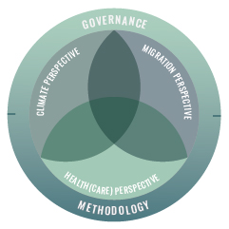
Five research streams 2022-2025
Stream 1: Methodology | Measure and monitor the interactions between climate change, migration and health(care) using systems thinking and interdisciplinary approaches
Stream 2: The climate perspective | Detect and understand climate change and the impact on migration and health
Stream 3: The health(care) perspective | Prepare for and respond to climate change and migration by developing health interventions
Stream 4: The migration perspective | Study the drivers of migration and its association with climate change and health
Stream 5: Governing factors | Identify and act upon the governing factors that impact climate change, migration and health

Slide 11
The health(care) perspective
Refers to the impact of climate change and migration on health and how to prepare for and respond to climate change and migration with health(care) interventions.
Studies in this stream aim to mitigate and adapt healthcare, and health systems resilience will be a major point of focus helping align health policy research to implementation on the ground.
Psychosocial impacts related to climate change and migration
Preparing the primary health care sector (integrated primary care and public health) to respond to migration and climate change-related challenges
Solutions for an intersectoral approach to connect the health sector with other (health-determining) sectors

Slide 12
Methodology
Crosses many boundaries and provides the groundwork for future research within the nexus. In addition to that, advancing the current research at the core of the nexus will be essential, for which novel methodological approaches that focus on systems thinking and complexity, and transdisciplinary collaborations are indispensable.
Embracing and understanding the complexity of responding to climate change through interdisciplinary collaboration on methodologies
Developing novel methodologies for policy reform in climate change, migration and health sectors + to tackle the lag from when research is published to when it can have impact
Understanding ‘climate philosophy’ – is our approach to climate science working?

Slide 13
Governance
Refers to the macro-level factors such as human rights, economic actors and the geopolitical agenda related to the nexus. Studies in this stream can contribute by identifying the governing factors that impact climate change, migration and health and investigate how research can benefit global diplomacy efforts.
Translating global governance into community interventions using the climate change, migration and health(care) perspective
Understanding and disentangling governance structures for creating climate resilient systems.
Conducting research to have impact on policy and legal decisions

Slide 14
The climate perspective
Refers to detecting and understanding how climate change impacts migration patterns, health outcomes and healthcare services. Studies in this stream help to understand how abovementioned impacts interact with each other, including its mediating factors. This can provide evidence to foster mitigation and adaptation, as well as loss and damage of climate change.
Stakeholder mapping of climate change actors and communicating climate science to policy
Understanding disaster risk reduction, response, recovery and preparedness
The impact of loss and damage due to climate change and human action/inaction

Slide 15
The migration perspective
Refers to the role of climate change and health(care) as drivers for migration and the impacts of migration for health(care) and the environment. Studies in this stream add to the ongoing debate concerning the impact of climate change on migration patterns around the world and explore how climate change may affect migration through other transmission channels – like through health(care) – than the well-studied agricultural income channel. Moreover, it covers studies considering health(care)-related migration drivers, as well as the impact on health and healthcare access among (climate) migrants and their host communities worldwide.
Policy framing in the context of climate-influenced mobility and coherence in policies related to migration, climate change, and health
Cumulative impacts from climate change and migration for health and relation with demographics
Voluntary and forced immobility in the context of climate shifts and the role of demographics

Slide 16
Prof. dr. Ilse Ruyssen dr. Charlotte Scheerens Department of Economics, Ghent University E ilse.ruyssen@ugent.be E charlotte.scheerens@ugent.be www.ugent.be www.climighealth.com

Slide 17
VLIRUOS TEAMS Project
Title: Fostering the development of planetary health research and education in Africa towards climate-resilient primary health care
Overall aim: how to build more climate-resilient PHC in Africa by integrating the emerging discipline of planetary health in education and research within African Universities.
Five-year project 2022-2027, incl. funding for Primafamed conferences.
Collaboration between Stellenbosch and Ghent University and the Master of Philosophy in Family Medicine (MPhil) program with Master student participation.
Promotor: Prof. Bob Mash (SU) and Prof. Ilse Ruyssen (GU). Co-promotor: Dr. Charlotte Scheerens (GU).
Collaborators (among others): Dr. Christian Lokotola (SU), Jan De Maeseneer (GU), Dr. Anna Galle (GU).

Slide 18
Research program
Two applied studies to the Western Cape Climate Change Forum and the local Dep. of Health on (i) a tool to measure preparedness and resilience of PHC, and (ii) expanding HIS to with CC-related indicators, integrating data, as well as early warning indicators.
Two scoping reviews on (i) PHC and climate change, and (ii) PHC and Migration within Africa: working on the identified knowledge gaps, with Primafamed:
What do PHC need to know about building climate-resilient facilities and services, and how to address?
How can PHC providers identify and respond to the climate-related vulnerabilities of communities in their catchment areas ?
Five case studies in different African contexts on PHC resilience in the context of climate change.
Creating an active discourse by publishing original research, conference/short reports, and opinion pieces in the African PHCFM Journal and other journals.

Slide 19
Case studies on PHC resilience and climatic events
Builds further on family doctor insights on the climate-migration-health nexus (Kampala, Primafamed 2019).
Case studies including short perspectives published in the PHCFM.
South Africa: Flash floods in Durban
Mozambique: Cyclone Idai and displacement in Beira (short report in AJPCFM in press)
Kenya: Frequent and severe droughts in the Khaliffi district (short report in AJPCFM)
Nigeria: sea-level rise, frequent heavy rains, extreme droughts
Mixed methods approach: Surveys of local healthcare workers and routinely collected health information for quantitative data, and in-depth individual and focus group interviews to explore the impact further.
Colllaboration with Primafamed
What data needs to be collected, and how can PHC contribute to that?
Strategies for building partnerships and capacity building in local partners
Strategies for knowledge dissemination.
Local support with Mphil program students, who will execute the case studies

Slide 20
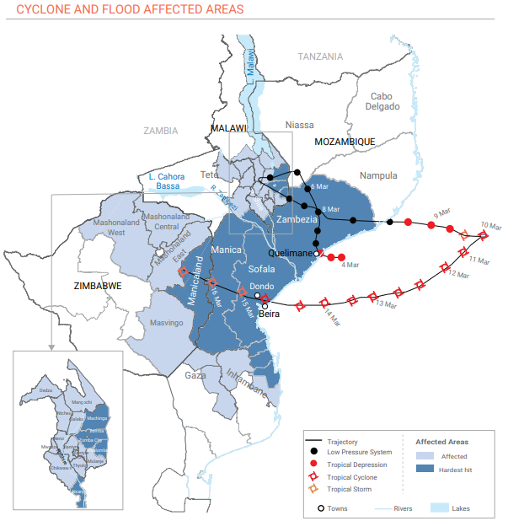
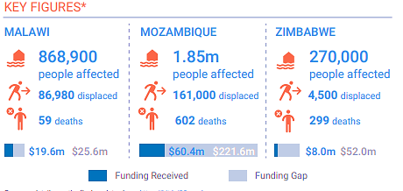
Cyclone Idai Beira, 2019
Beira was struck by cyclone Idai in 2019 with devastating impacts, including disruption of primary care by destroying facilities and road infrastructure. Patients were unable to get to health facilities and suffered major injuries and displacement.
Worst weather-related disaster to hit the Southern Hemisphere: said to be a combination of El Niño-induced drought intensified by climate change.
In settings with high risks but low adaptive capacity, dedicated efforts are need to strengthen primary care to prepare for disasters and related displacement.
Source: https://reliefweb.int/sites/reliefweb.int/files/resources/SA_Cyclone_and_Flooding_Snapshot_09042019.pdf

Slide 21
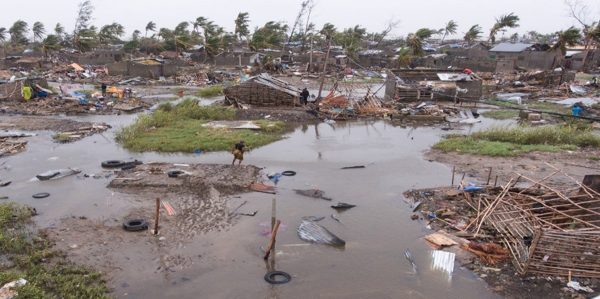
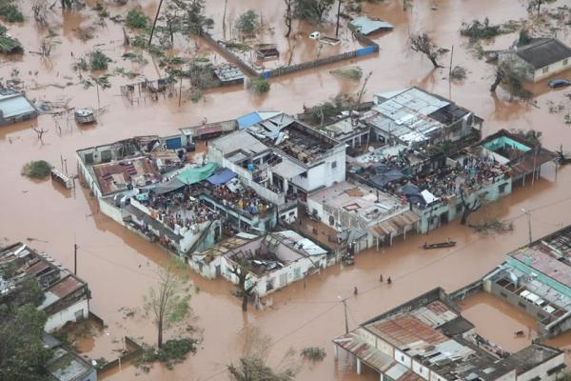
“We’ve had cyclones before, but this one was really horrific. What pains me … is the government did nothing about warning people to move to higher safer grounds.
“The cyclone struck down the roads and people’s houses were swept [away] overnight, some communities vanished completely and bodies could not be retrieved…
[There was] a lot of anxiety, depression amongst relatives in [countries] with very weak health system[s] right now.

Slide 22
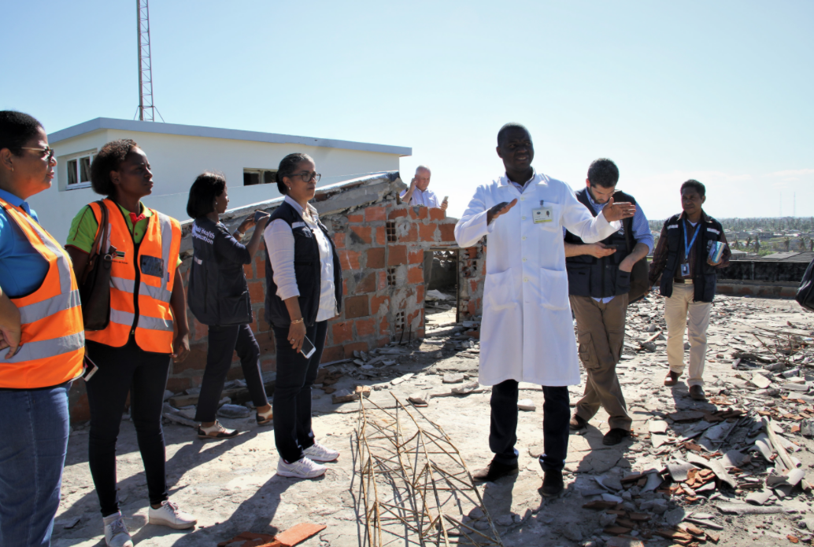
To … help those people was not easy. We [have] a high prevalence of HIV. Some whose homesteads were swept away … did not have access to their antiretroviral medication.
The government took too long to respond … people [did not have access to] clean water, which means a whole lot of water-borne diseases coming from that place (1420 cases of cholera were notified).
My main worry is it is going to take a long time before the infrastructure is repaired and the clinics are revived.
What if another catastrophe hits the same area? You can imagine people migrating from that region to [another] one. How is that health system going to cope? There [will] be infectious diseases arising from that.
And we have lost a lot of doctors, also they leave the country to look for greener pastures.” (quote from FP in Mozambique)

Slide 23
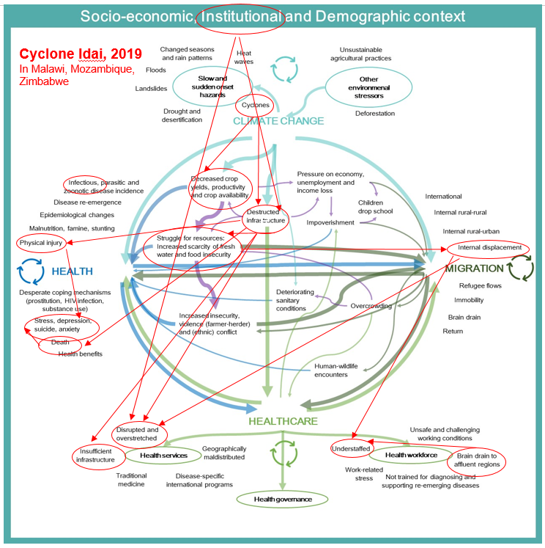
Reference: Charlotte Scheerens et al. (2021).

Slide 24
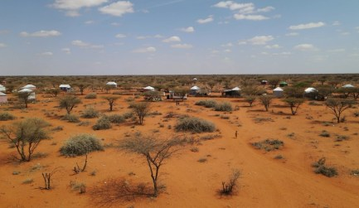
Droughts in small villages of Chakama, Kilifi County, Kenya
Climate change led to frequent, longer drought in this semi-arid region and locust invasions.
Led to lack of water, with rivers drying up and poor water quality due to pollution of river water.
Failure of the crops and loss of livestock. Pastoralists and farmers lost their livelihood.
Wild animals from nature reserves into conflict with the community over water scarcity.
Many families have migrated in search of water and income.
https://phcfm.org/index.php/phcfm/article/view/3670/5654

Slide 25
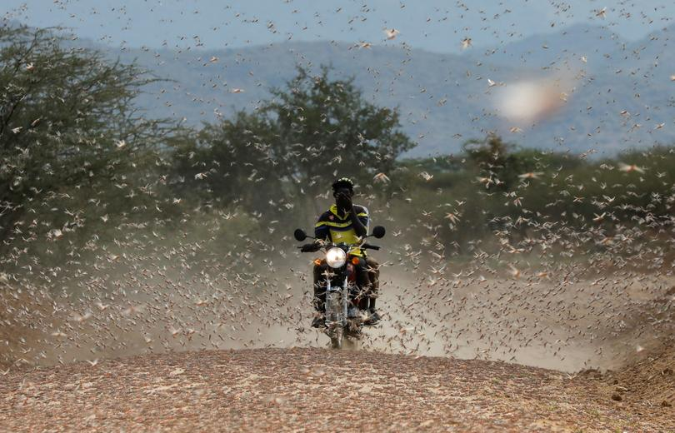
Droughts in small villages of Chakama, Kilifi County, Kenya
The health effects are seen in the rising number of people suffering from malnutrition and gastroenteritis as well as in terms of mental health problems.
Primary health care services are not always available, and the quality of such services is poor.
Facilities and healthcare workers struggle to be resilient in the face of these challenges.
Local nongovernment organisations are attempting to assist through health and social services, community engagement and multisectoral action.
https://phcfm.org/index.php/phcfm/article/view/3670/5654

Slide 26
Education program
Implement planetary health education at SU in the curricula. This will also deliver on the graduate attribute of environmental stewardship.
Assessment of introducing planetary health education in Master of Medicine (MMed) degree into modules on community-oriented primary care, leadership and governance.
Support other under- and postgraduate programs to embed planetary health education in their curricula (e.g. nursing, physiotherapy, occupational theray).
Continuing professional development on climate-resilient primary health care for health professionals/FDs.
Collaborate with the special interest group on education for sustainable healthcare of Southern African Association of Health Educationalists (SAAHE) on integrating planetary health and environmental stewardship into African health professions education curricula.
Share all these educational initiatives with sub-Saharan African institutions via Primafamed and support at least 3 institutions in other countries to incorporate the material into under- or postgraduate education.

Slide 27
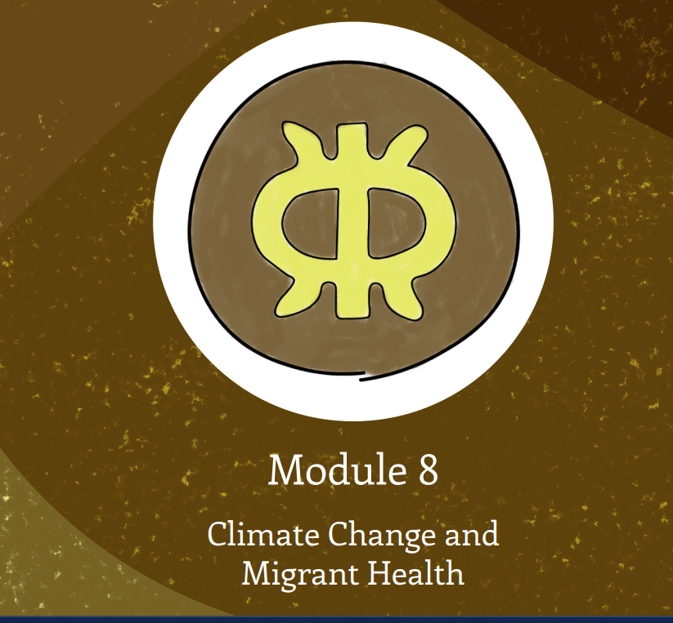
WONCA-environment planetary health for primary care course
Module on Climate Change and Migrant Health
This module introduces and explores how climate change, migration and health interact, explore relevant clinical case studies and discuss health system solutions, including the role of family doctors and primary care professionals.
Module will be available for Primafamed to use in their curricula, and/or have the developers of the module present it during guest lectures.
https://www.ufrgs.br/telessauders/documentos/cursos/course_manual_wonca_.pdf.

Slide 28
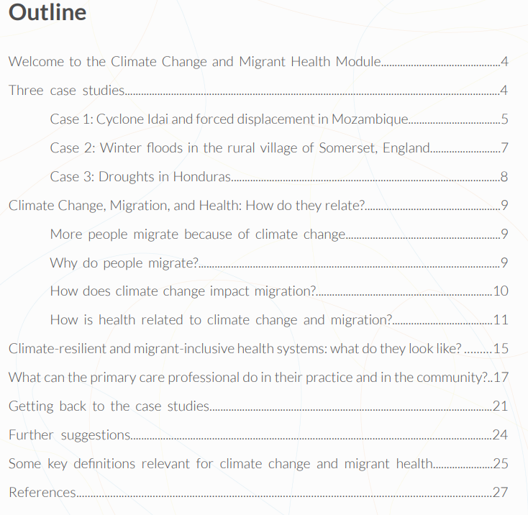
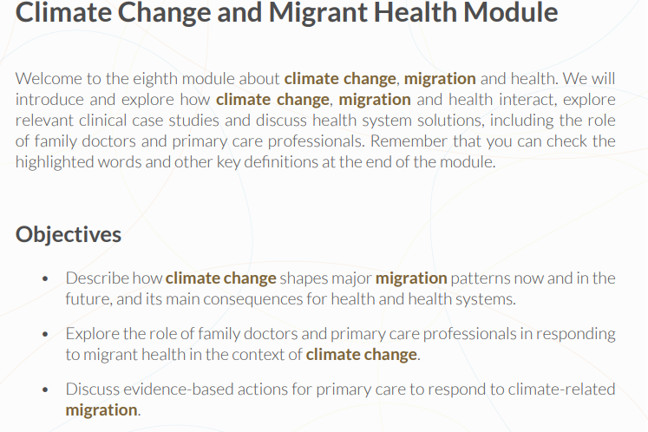

Slide 29
Annual Online CliMigHealth event
Launch of the CliMigHealth Project Seed Funding Competition for partners in our network (research, education or public awareness).
Organise an interactive session to work with our strategic research framework.
Interact with stakeholders from the policy field to reflect on applicability of our work into practice.
December 16, 2022
10am-12pm CET.
We hope to see you there!
Contact: charlotte.Scheerens@ugent.be

