Slide 1
Introduction to the Primary Health Care Research Consortium
Prof Bob Mash
Chair of PHCRC steering committee. Sub-Saharan African Primary Care and Family Medicine (PRIMAFAMED) network and Family Medicine and Primary Care, Stellenbosch University, South Africa
Notes:
Maybe you would want to put in your role as Chair, PHCRC steering committee

Slide 2
The idea 2016
Identify priority areas for research designed to drive better policy, measurement, service delivery for primary health care in low- and middle-income countries
Build a network to collaboratively address these priorities
Perform research to accelerate progress in the field

Slide 3
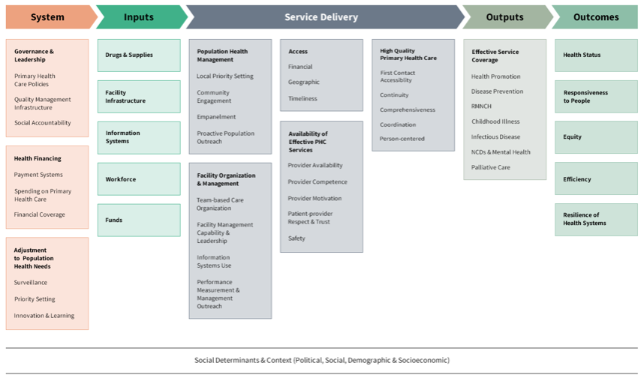
The initiators
The Primary Health Care Performance Initiative
The WHO Alliance for Health Policy and Systems Research
The Bill and Melinda Gates Foundation
Ariadne Labs

Slide 4
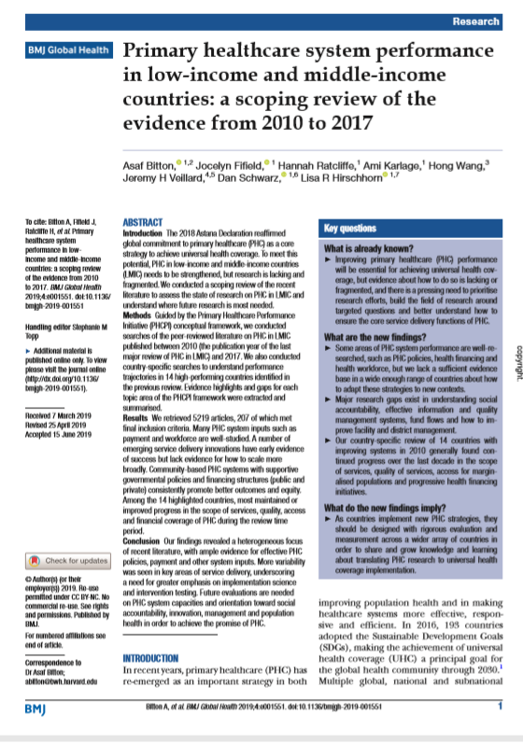
The call 2017
Scoping review
Priority setting meeting
Delphi consensus building
Call for proposals and identification of priorities
Policy and governance
Financing
Quality and performance management
Models of care

Slide 5
Initial work on research priorities 2018-2019
Health Systems Global symposium, Liverpool
BMJ Global Health 2019 Supplement: https://gh.bmj.com/content/4/Suppl_8

Slide 6
The founders of the PHCRC 2020
American University of Beirut, Lebanon
International Centre for Diarrhoeal Disease Research, Bangladesh
Primary Care and Family Medicine Network (Primafamed), sub-Saharan Africa
The George Institute for Global Health, India (core organizational hub) and Australia.
World Organization of Family Doctors (WONCA); global network with core in Bangkok, Thailand.
George Washington University, United States of America

Slide 7
PHCRC vision and mission
Vision
Improving health through strengthening high quality, person-centered, primary health care in low and middle-income countries.
Mission
We will achieve this through:
developing, capacitating, conducting, and disseminating LMIC-led research
driving research to action by addressing priority knowledge gaps
catalysing a global network of collaborating partners

Slide 8
Initial research studies 2020-2021
How are different LMICs implementing PHC team integration to support comprehensive primary health care? A multi-country mixed methods study – Mexico, Uganda, India
Characterizing the Use of Primary Health Care (PHC) Performance Information: A multiple case study in El Salvador, Lebanon and Malawi
An International Survey on the Integration of Public Health and Primary Care in COVID-19 Vaccination Campaigns (with Besrour Centre)
Identifying effective primary health care service delivery models for integrated management of non-communicable chronic diseases in resource-constrained settings (with GACD)
Delhi 2020

Slide 9
Communications, networking and capacity building
www.phcrc.world
Delhi 2020

Slide 10
The next phase
No further funding from BMGF
Dissemination grant with PHCPI
Publish work to date
Partial funding for core from NIHR grant on community engagement with Peru and India
Re-applying for NIHR grant on community-orientated primary care (South Africa, Malawi, Bangladesh)
Further grants?

