Slide 1
Family Medicine in Zambia
Mpundu Makasa

Slide 2
Zambia
Population 20,017,675
Life expectancy 64.4 years
Main Diseases
Communicable - Malaria, TB, HIV
NCDs – CVD, DM, Ca
Emerging Diseases- COVID 19
1,956 health facilities
Public (90%) – 3 tier system service provision
Mines, Private, Faith-based (10%)
Primary level
District hospitals (84)
Health centres (1540) - UHC-409; RHC-1,131
Health posts (307)
Secondary/Provincial hospitals (34)
Tertiary - National referral hospitals (8)
Medical Schools
Public Medical Schools 4
Private – 4*

Slide 3
Human Resources for Health in Zambia
Zambia continues to face a human resource crisis
Physicians, Nurses & Midwives per 1,000 population ratio was 1.2 (2017)
WHO standard is 2.3 per 1,000 population
The gap is greatest in rural areas
1.12 Health Care Workers per 1,000 in rural
1.87 per 1,000 in urban areas

Slide 4
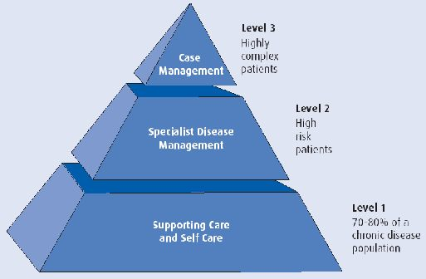
Health Service Delivery & Family Physicians
Doctor population ratio per 1,000 population is 0.12
WHO standard is 1 per 1,000 population
Primary Health Care is the main vehicle of service delivery in Zambia
Needs strengthening
Can help to resolve HRH crisis
Can help address PH problems
Zambia now has prioritized Family Medicine in the National Training Operational Plan 2019-2024
National target to graduate 40 Family physicians in first 5 years
From three out four public health universities
Targets will continue to roll over time

Slide 5
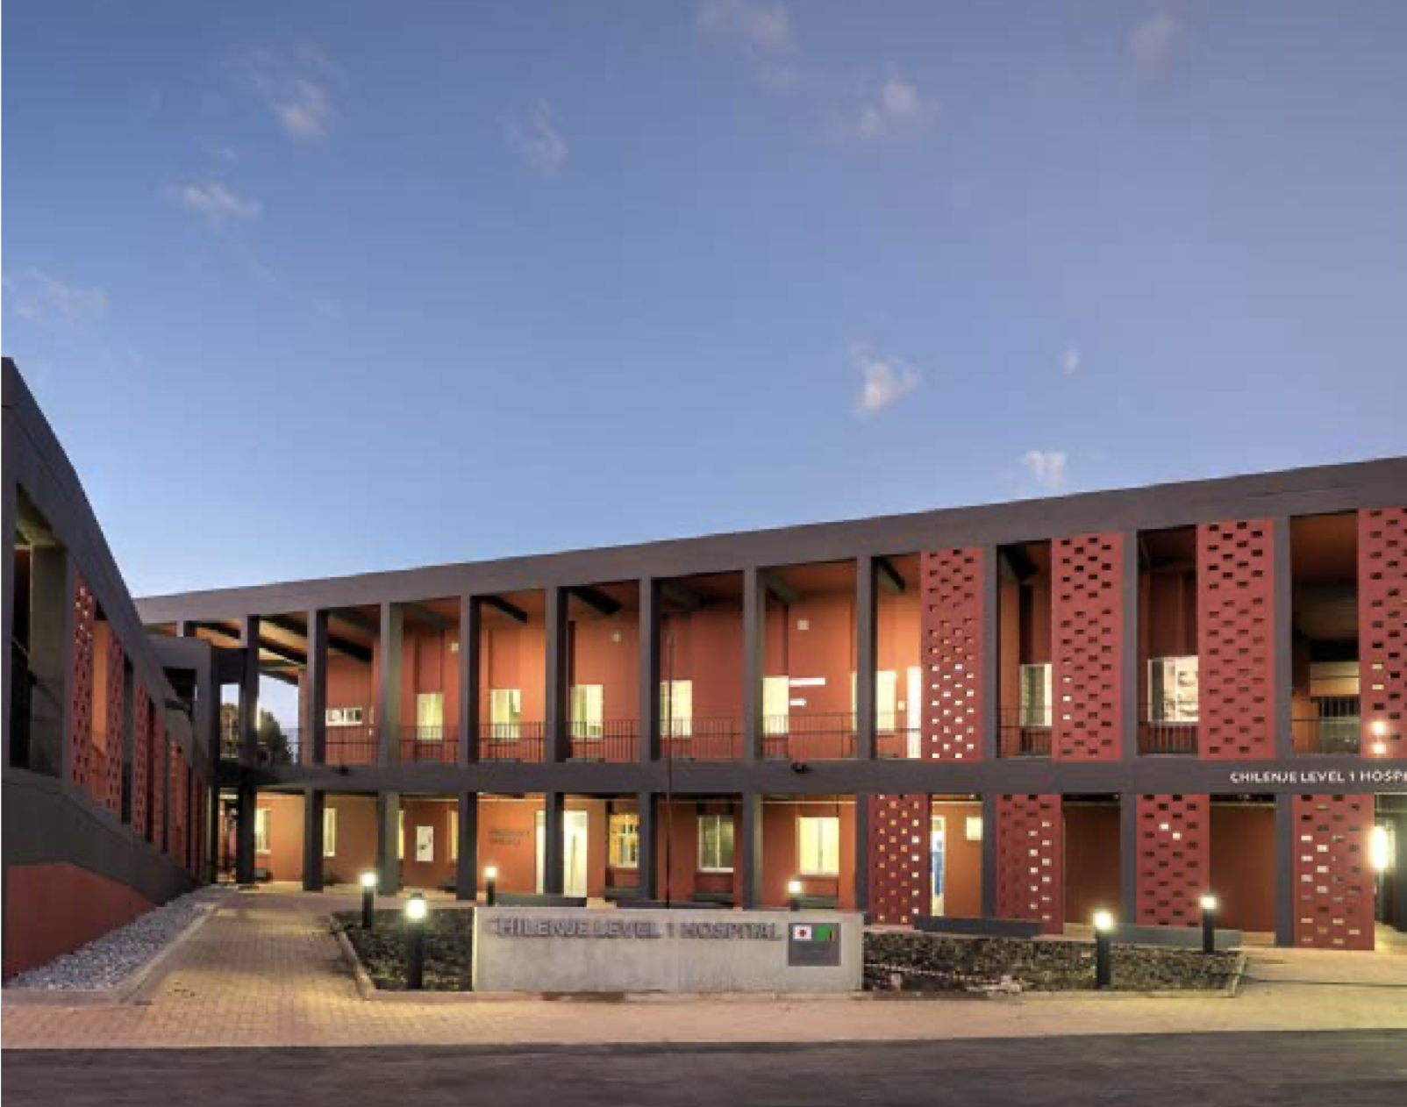
Family Medicine Training in Zambia
University of Zambia started the first FM programme in the country 2018/19
Housed in School of Public Health
Department of Community & Family medicine
Four year MMed programme
Training sites District/General
Tertiary Hospitals specialist rotations
Now graduating the first registrars

Slide 6
Timeline & Stages of Change
Stage of change | Cycle 1 MMed District Health Medicine | Cycle 2 MMed Family Medicine
Precontemplation | - | -
Contemplation | Early 90’s | 2012 -2013
Preparation | Early 90’s | 2013 -2015
Action | Mid 90’s | 2018 -date
Relapse | Mid 90’s | 2015 - 2018
Maintenance | ------ | 2022 …….

Slide 7
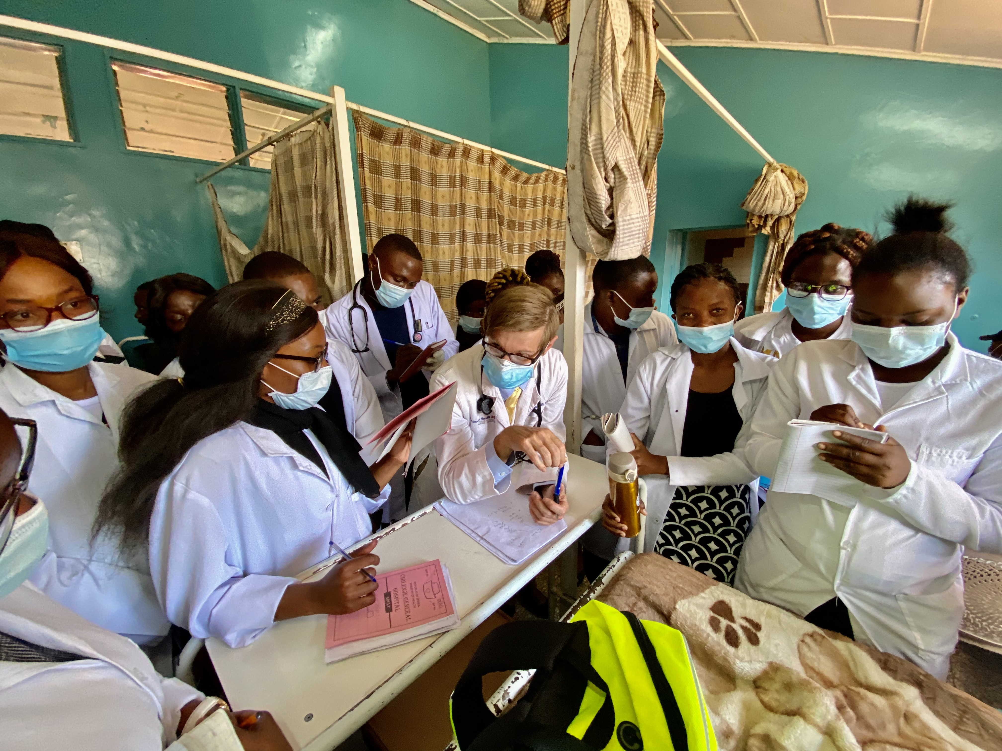
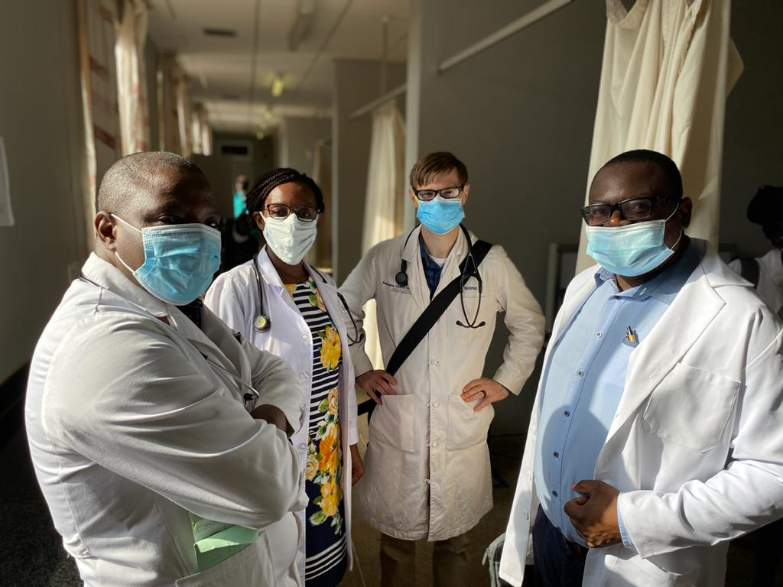
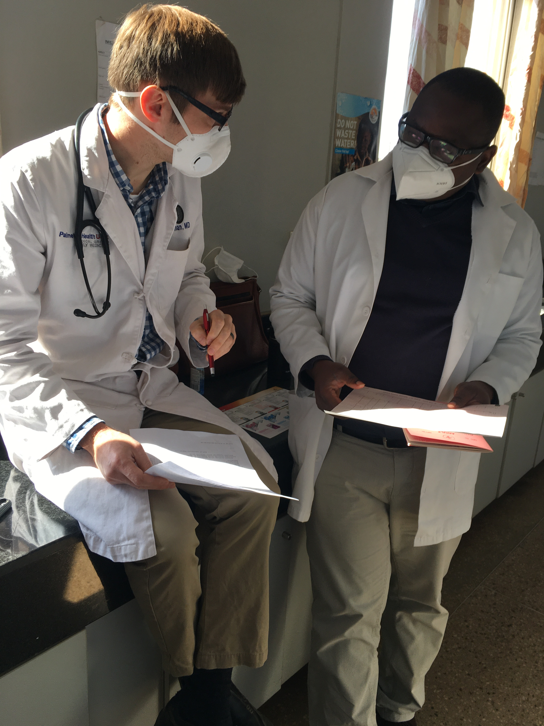
Learning and Teaching
Bedside Clinical Teaching /daily clinical supervision & mentorship
Outpatient Clinic registrars & preceptors
Rotations through surgical departments (Ob/Gyn, Surgery)
Didactic sessions Friday am & Wednesday pm 3 hours each in designated classroom on campus away from hospital
Periodic workshops

Slide 8
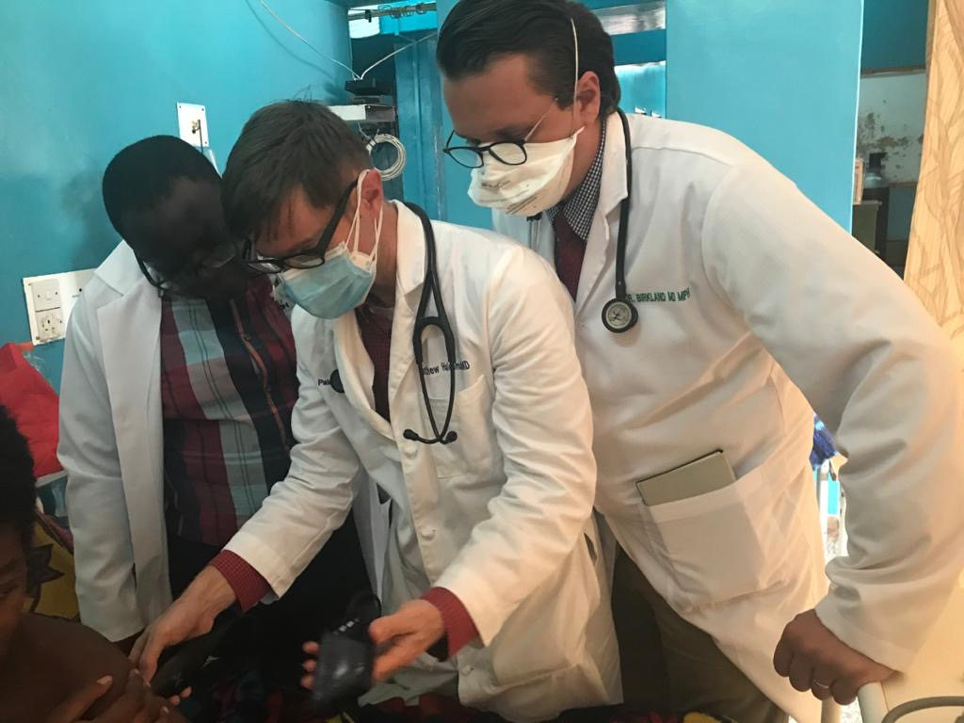
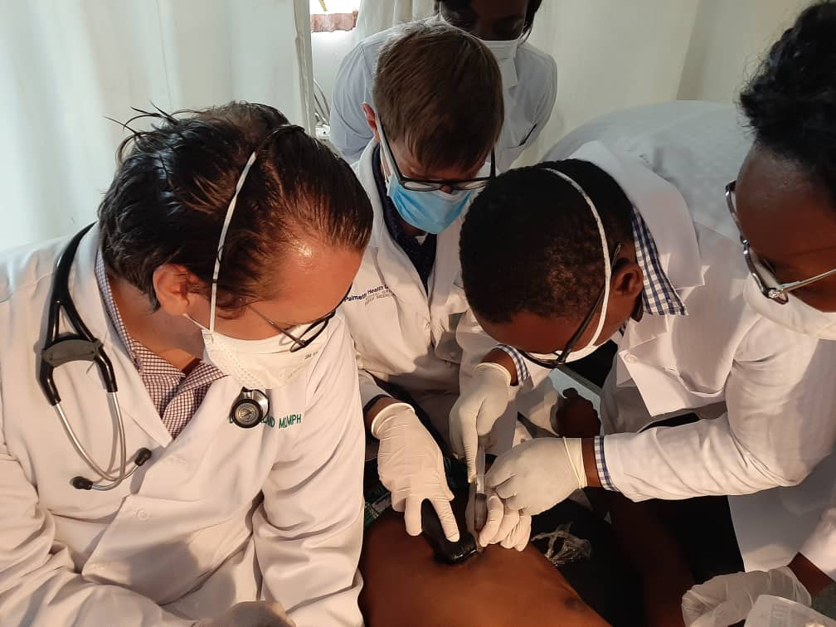
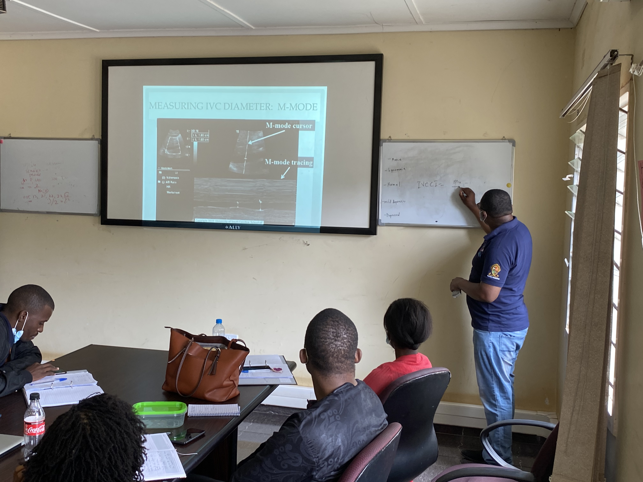
Innovations of MMed Program
Point Of Care Ultrasound (POCUS)
Integration of Point of Care Ultrasound into the Program
Didactics + hands-on workshops + quiz

Slide 9
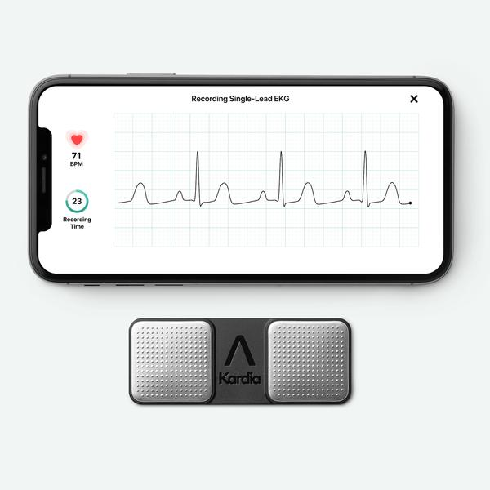
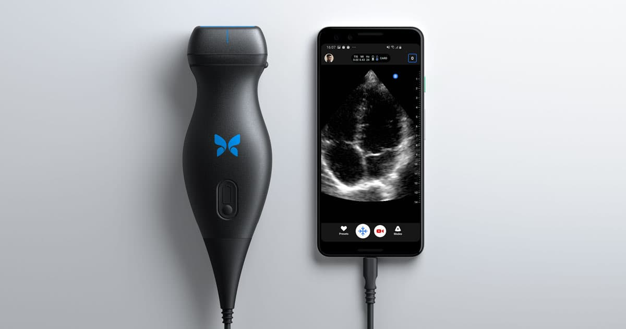
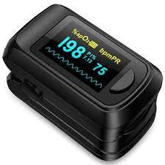
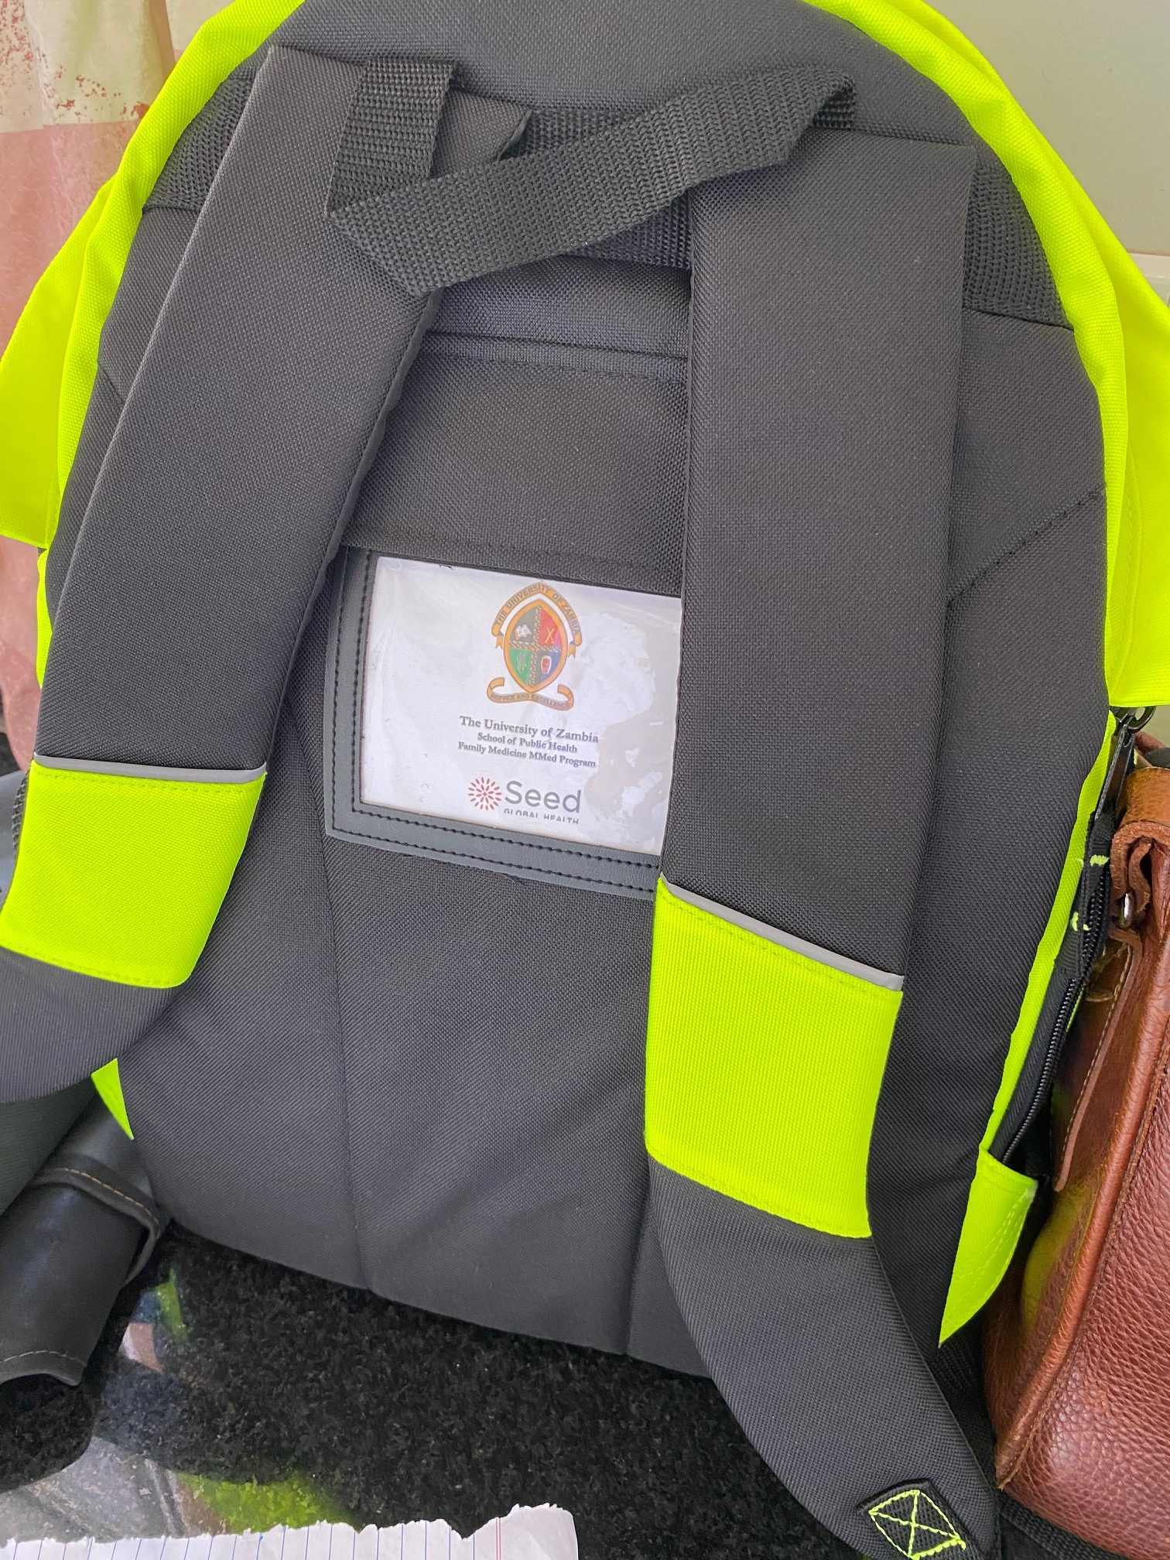
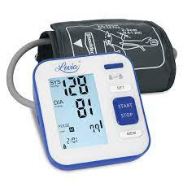
Innovations of MMed Program
Create a family medicine “Doctors Bag”
Quick access to basic medical equipment diagnostics
Diagnostic set, U/S probe, portable ECG – pocket size,
BP machine with different size cuffs, pulse oximeter

Slide 10
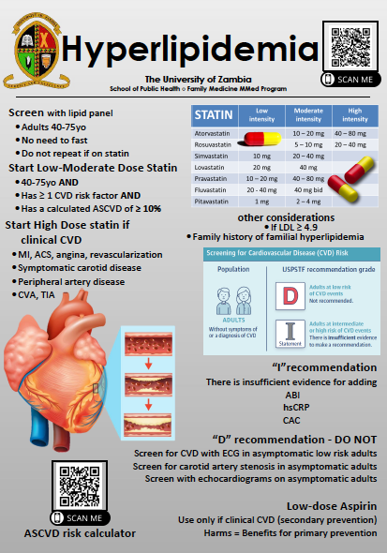
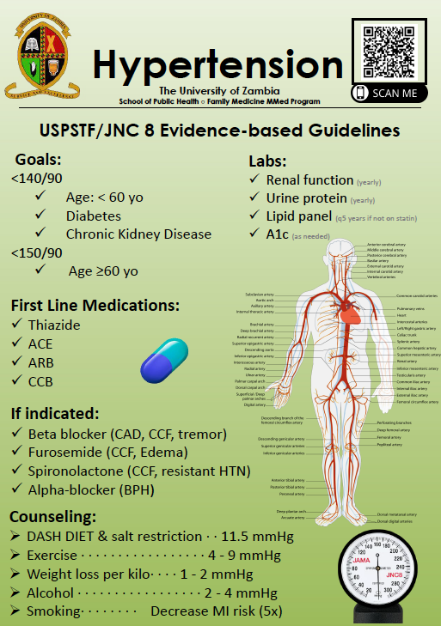
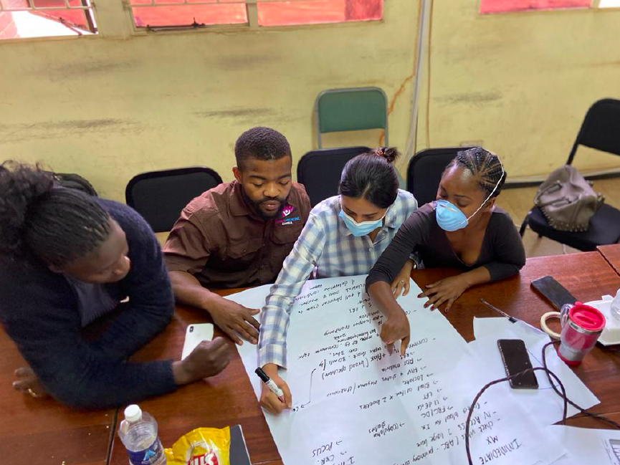
Innovations of MMed Program -
Creation of Posters
Development of posters
For common conditions
Quick reference
Improve management
Standardise care

Slide 11
PRICE PROJECT 5 year project 2021-2026
A training grant to train PC providers & build leaders at PHC level
To create a pool of highly trained HRH for PHC
To strengthen Health Systems
Target group
Family Medicine training (PC clinicians)
Public Health (practitioners/researchers)
Level of training
Masters & PhD
Kamuzu University of Health Sciences

Slide 12
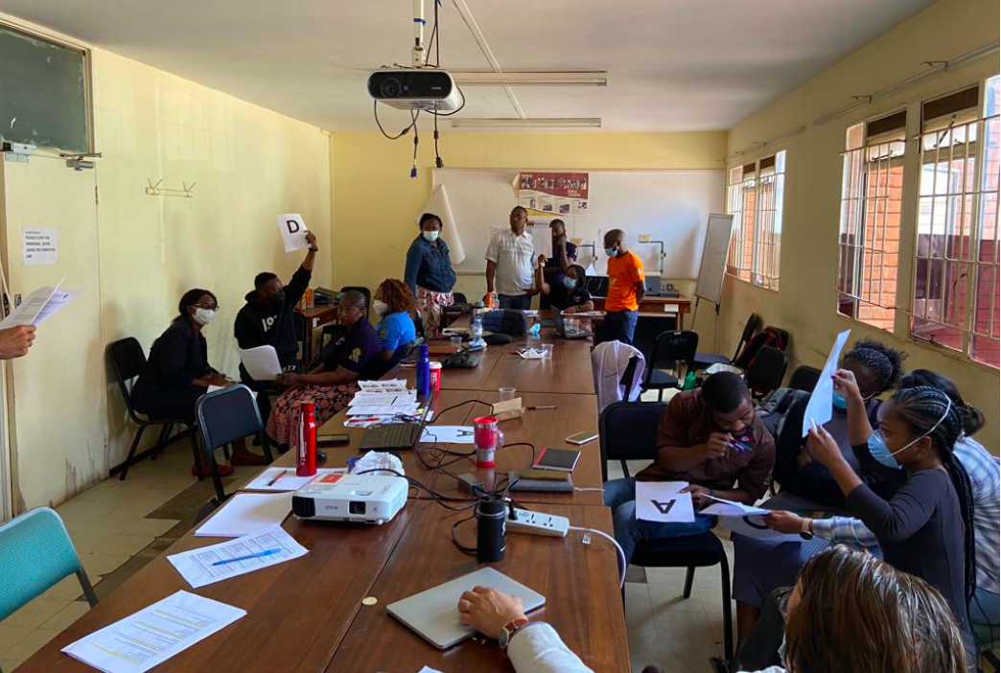
Activities under PRICE PROJECT
Student scholarships (tuition & research)
MMed Family Medicine
MPH/MSc Epi
PhD (Local and double degree)
Strengthen training programmes
Module development
Support academic activities/writing workshops/exchange programmes
Improve learning environment
Infrastructure
Equipment
Internet installation
Dissemination activities
Conferences/e.g. Primafamed
Encouraging South to South collaboration
Joint activities/exchange programmes

Slide 13
Thank you

