Slide 1
Introduction to the Primary Health Care Research Consortium
Prof Bob Mash
Chair PHCRC steering committee

Slide 2
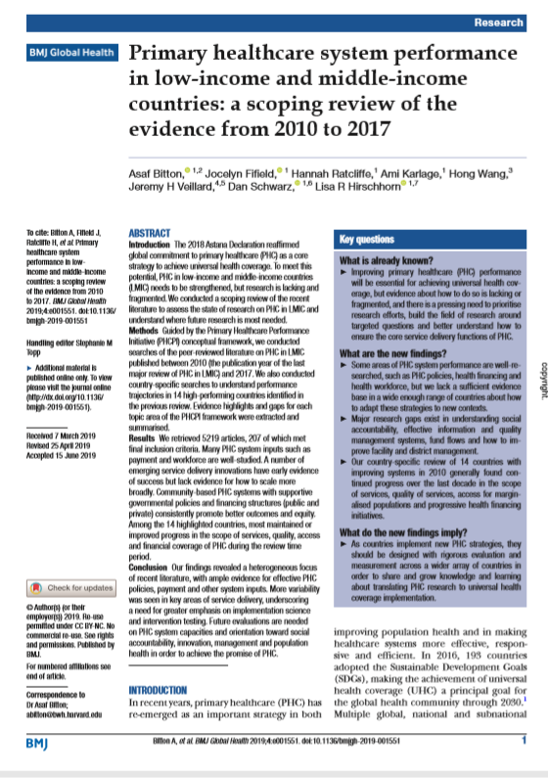
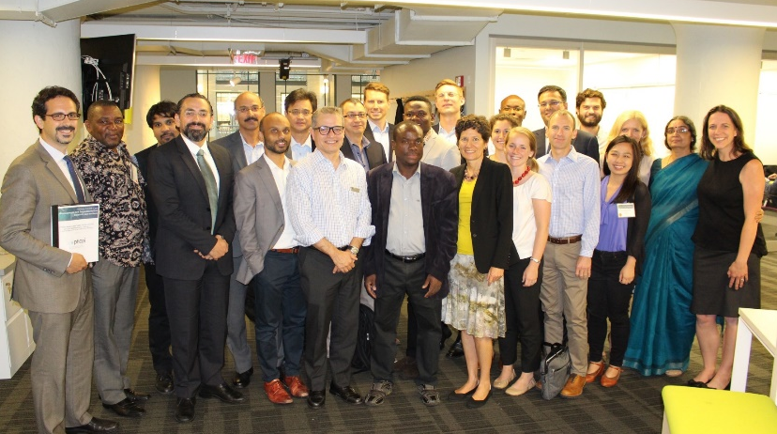
Preliminary steps 2016-18
Scoping review
Priority setting meeting
Delphi consensus building
PHC research priorities identified

Slide 3
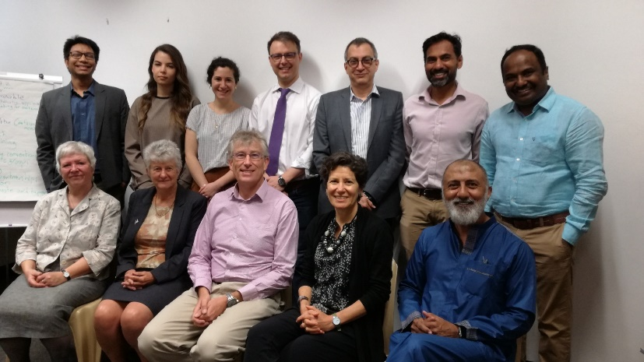
Six founding members
American University of Beirut, Lebanon
International Centre for Diarrhoeal Disease Research, Bangladesh
Primary Care and Family Medicine Network (Primafamed), sub-Saharan Africa, with core at Stellenbosch University, South Africa
The George Institute for Global Health, India and Australia.
World Organization of Family Doctors (WONCA); global network with core in Bangkok, Thailand.
George Washington University, United States of America

Slide 4
Presentation of evidence gaps and priority PHC research questions 2019
Health Systems Global symposium, Liverpool
BMJ Global Health 2019 Supplement: https://gh.bmj.com/content/4/Suppl_8

Slide 5
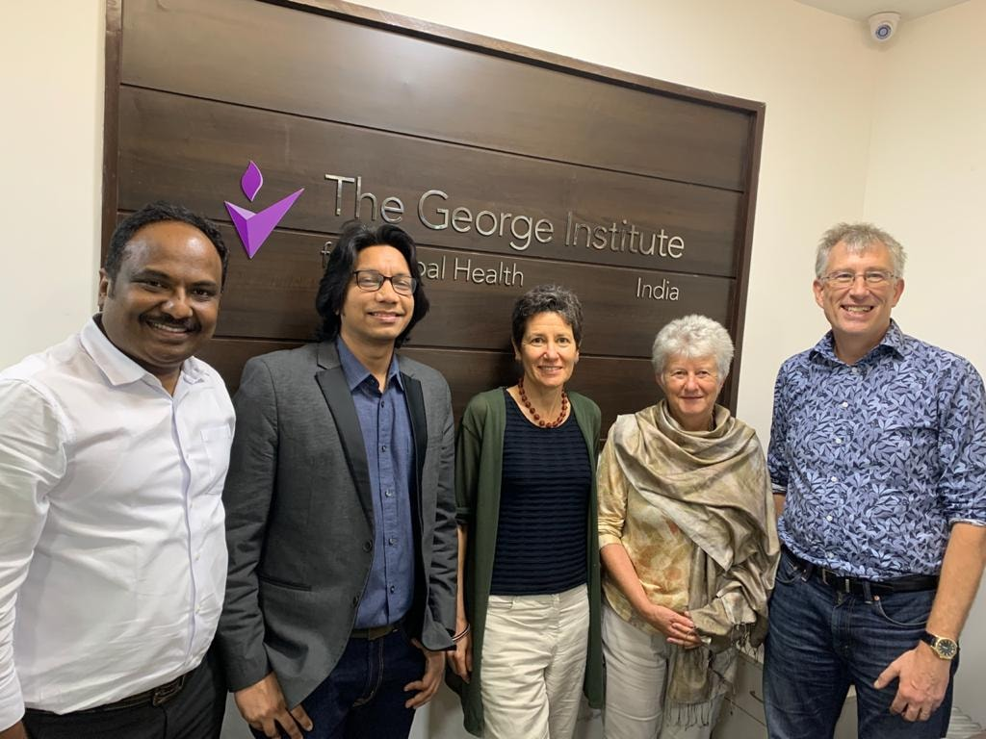
Vision and mission
Vision
Improving health through strengthening high quality, person-centered, primary health care in low and middle-income countries.
Mission
We will achieve this through:
developing, capacitating, conducting, and disseminating LMIC-led research
driving research to action by addressing priority knowledge gaps
catalysing a global network of collaborating partners

Slide 6
Initial research 2021
How are different LMICs implementing PHC team integration to support comprehensive primary health care? A multi-country mixed methods study – Mexico, Uganda, India
Characterizing the Use of Primary Health Care (PHC) Performance Information: A multiple case study in El Salvador, Lebanon and Malawi
Identifying effective primary health care service delivery models for integrated management of chronic diseases in resource-constrained settings
An International Survey on the Integration of Public Health and Primary Care in COVID-19 Vaccination Campaigns
Delhi 2020

Slide 7
Funding application
NIHR Global Health Research Group on community-orientated models of primary health care in low and middle-income countries - COHERENT – Malawi, South Africa, Bangladesh, India and UK
Implementation of the COmmunity HEalth System InnovatiON Project in low- and middle- income countries, COHESION - I -Peru, Nepal, Mozambique, India

Slide 8
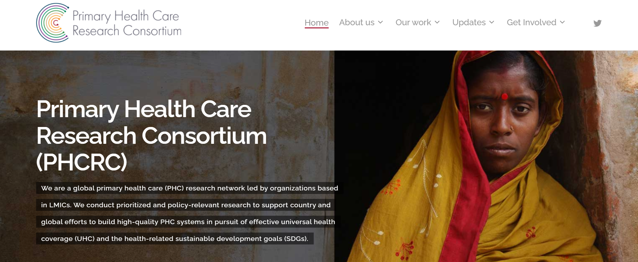
Website and communication
https://phcrc.world
Delhi 2020

Slide 9
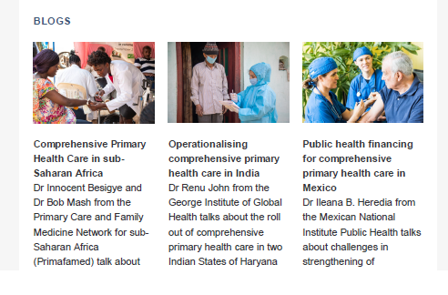
Communications update
Newsletter No 1 published in 2020 was a general update about the consortium.
Newsletter No 2 – August 2021; blogs from our partners from Uganda and South Africa, India, and Mexico on comprehensive primary health care

Slide 10
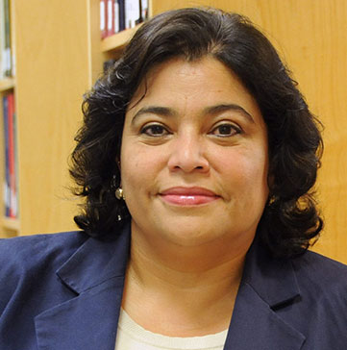
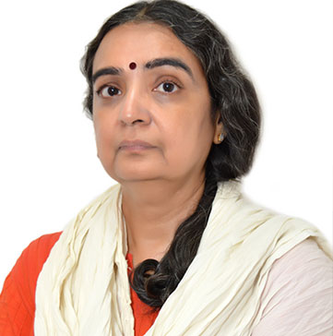
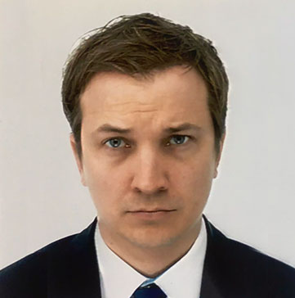
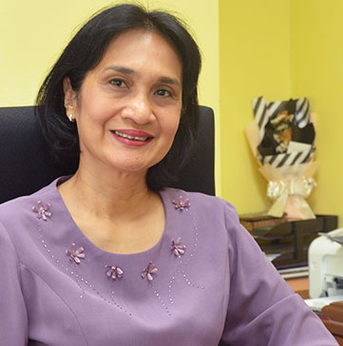
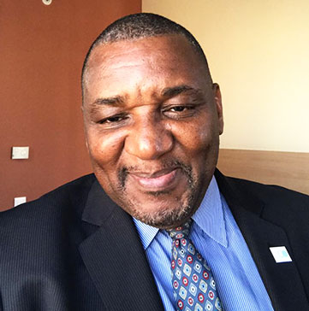
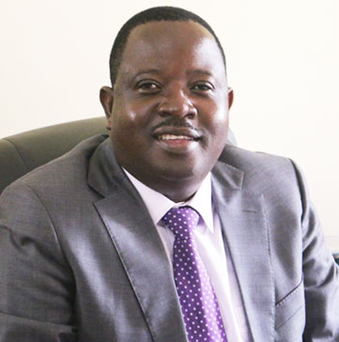
Advisory committee
Emma Ariarte – Inter American Development Bank
Rajani Ved – Previously with National Health Systems Resource Centre, India
Robert Marten, WHO Alliance
Sherina Sidik, Family Medicine, University Putra Malaysia
Koku Awoonor-Williams, Previously with Ministry of Health, Ghana
Beth Tritter, PHC Performance Initiative
Itai Rusike, Community Working Group on Health, Zimbabwe
Delhi 2020
Notes:
Civil society, health and development policymakers, WHO, family medicine, PHCPI.

Slide 11
PHCRC: Webinar series
Theme - Scaling new frontiers in primary health care through research and partnership
Showcase the existing evidence base, consider research and policy priorities and highlight gaps that remain in taking forward a PHC research agenda
Initiate and engage in a constructive dialogue on PHC
Delhi 2020

