Slide 1
WHO AFRO / Wonca Africa
“Progress in collaboration”
Prof. Shabir Moosa, President Wonca Africa
Primafamed Conference, 28th October 2020

Slide 2
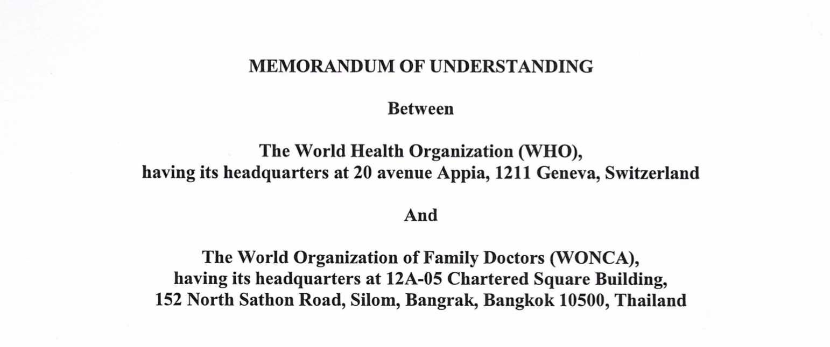
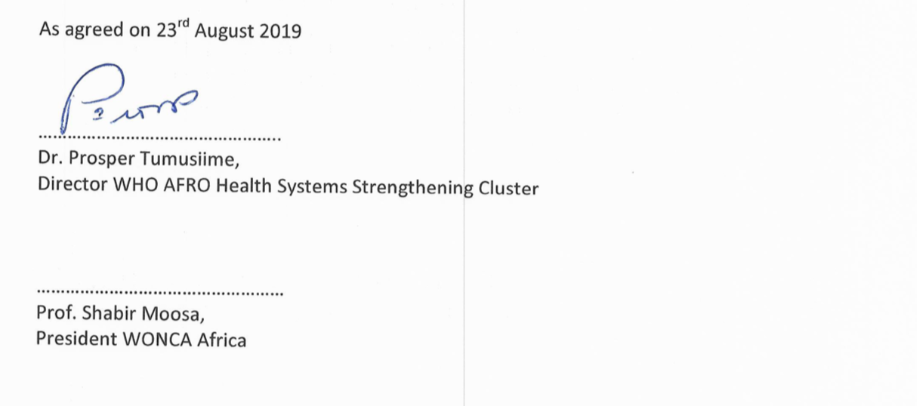
Background

Slide 3
6 areas of collaboration
Building relationships and mutual understanding further
Strengthening the DHS through family physicians
Improving the quality of PHC and DHS
Connect WHO resources with the training of family physicians
Primary care research
Support for development of AfroPHC Forum

Slide 4
6 areas of collaboration
Building relationships and mutual understanding further
Strengthening the DHS through family physicians
Improving the quality of PHC and DHS
Connect WHO resources with the training of family physicians
Primary care research
Support for development of AfroPHC Forum

Slide 5
Building relationships and mutual understanding further
Focal points – Dr Tumusiime / Prof Moosa
Wonca Africa orientation pack for WHO AFRO
Wonca Africa presentation at RPM with WCR’s
Wonca Africa presentation at Regional Committee with Dr Tumusiime
Wonca Africa to provide contacts to WHO AFRO
WHO AFRO participation in Wonca Africa Conferences
WHO AFRO to facilitate 6 country level meetings on PHC/Family Doctor
WHO AFRO/Wonca Africa annual face-to-face at RC
WHO AFRO/Wonca Africa quarterly virtual meetings
WHO AFRO/Wonca Africa explore collaborations at expert level (WPs/SIGs)
WHO AFRO/Wonca Africa to cross post on social media

Slide 6
6 areas of collaboration
Building relationships and mutual understanding further
Strengthening the DHS through family physicians
Improving the quality of PHC and DHS
Connect WHO resources with the training of family physicians
Primary care research
Support for development of AfroPHC Forum

Slide 7
Strengthening the DHS through family physicians
WONCA Africa contribute to HR section of DHS Operational Manual
WHO AFRO to invite WONCA Africa Member Organisations to participate in UHC flagships at country level
WHO AFRO HSS Cluster ensure WONCA Africa participation in UHC, PHC and DHS processes led by WHO AFRO.

Slide 8
6 areas of collaboration
Building relationships and mutual understanding further
Strengthening the DHS through family physicians
Improving the quality of PHC and DHS
Connect WHO resources with the training of family physicians
Primary care research
Support for development of AfroPHC Forum

Slide 9
Improving the quality of PHC and DHS
WONCA Africa input into guidelines from a primary care perspective
WONCA Africa assist with dissemination /awareness of WHO AFRO documents and guidelines.
WONCA Africa assist with evaluation of implementation of DHS Manual

Slide 10
6 areas of collaboration
Building relationships and mutual understanding further
Strengthening the DHS through family physicians
Improving the quality of PHC and DHS
Connect WHO resources with the training of family physicians
Primary care research
Support for development of AfroPHC Forum

Slide 11
Connect WHO resources with training of family physicians
WHO AFRO assist WONCA Africa/Primafamed to develop a repository of PHC-relevant clinical and other guidelines
WHO AFRO assist WONCA Africa/Primafamed to access WHO AFRO resources that can be shared e.g. e-learning on UHC, IDSR etc.
WONCA Africa assist WHO AFRO to contextualise learning resources to African training

Slide 12
6 areas of collaboration
Building relationships and mutual understanding further
Strengthening the DHS through family physicians
Improving the quality of PHC and DHS
Connect WHO resources with the training of family physicians
Primary care research
Support for development of AfroPHC Forum

Slide 13
Primary care research
WHO AFRO and WONCA Africa/Primafamed will explore primary care research projects of mutual interest, starting with primary care focus on COPC, PHC performance and positioning of family physicians in the health system.
WHO AFRO will use the African PHCFM Journal to share information and resources.

Slide 14
6 areas of collaboration
Building relationships and mutual understanding further
Strengthening the DHS through family physicians
Improving the quality of PHC and DHS
Connect WHO resources with the training of family physicians
Primary care research
Support for development of AfroPHC Forum

Slide 15
Support for development of AfroPHC Forum
WHO AFRO will support the development of AfroPHC with involvement of Dr Tumusiime in core group of AfroPHC
WHO AFRO will ensure that key officials from HSS and PHC-related clusters participate in the AfroPHC Google Group and activities with content support, ensuring that appropriate guidance is provided.
WHO AFRO will ensure that key officials from HSS and PHC-related clusters participate in the AfroPHC Meeting planned for June 2020 in South Africa.
Dr Tumusiime will explore funding support for participation by disadvantaged African groups (Clinical Officers, CHWs) and countries in planned annual AfroPHC meetings.
WHO AFRO and WONCA Africa/Primafamed will extend their cooperation and resources to support training of the PHC team, as involved in AfroPHC

